Slide 1
GCSE Art and
Design
Three Dimensional Design Support and Guidance: Product Design Focus

Slide 2
Project Content
Each project we undertake encompasses a core series of tasks which can happen in any order and numerous times depending on the students personal journey. We aim to teach students how to approach the creative design process so as they experience this repeatedly we have to support less and less making them more independent, autonomous and self regulating.
Overall Task List
Set Context / Dates (slide 3)
Mind Map and Imagery (slides 4 / 5)
Primary Research and Photographs / Visits (slides 6 / 7)
Observational Studies (slides 8 / 13)
Secondary Visual Moodboard (slides 14 / 15)
Secondary Research of Existing Artists / Designers
(slides 16 / 20)
Focused Research (slides 21 / 22)
Personal Creative Intentions (slides 23 / 24)
Abstractions and Processes Manipulation (slides 25 / 33)
Idea generation and Creative Strategies (slides 34 / 46)
Development and refinement (slides 47 / 61)
Final Design Proposal (slides 62 / 70)
manufacturing Diary (slides 71 / 74)
Presenting Final Outcomes (slides 75 / 90)
Evaluation (slides 91 / 94)

Slide 3
Set Contexts / Dates
We support students in choosing contexts and starting points which they can relate to and which will engage them.
GCSE
Y10 Sept - April ‘What If’ Project
Y10/11 April - Dec ‘Optional Context’
Y11 Dec - April ‘Exam Context’
A-Level
Y12 Sept - April ‘Organic’
Y12/13 April - Dec ‘Optional Context’
Y13 Dec - April ‘Exam Context’
Themes
Architecture - Aerodynamic - Alien - Animalistic - Culture - Fragmented - Futuristic - Geometric - Industrial - Natural Disasters - Organic - Play - Streamline - Wearable Fantasy
Statements
What if….designed….?
A moment in time
That's surreal
Problem Solving
How could you aid people with arthritis?
How could you help children become more active in response to child obesity?

Slide 4
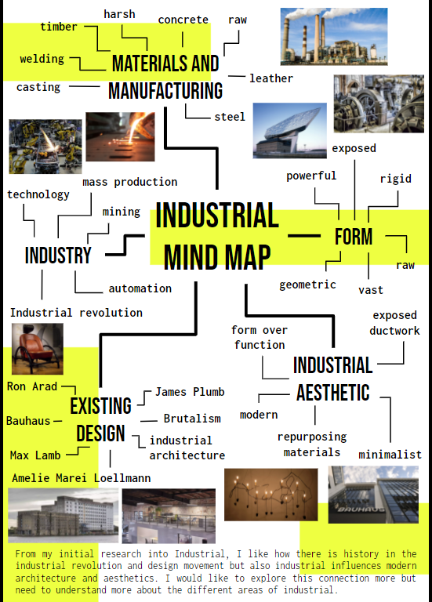
Mind Mapping
Mind Mapping Guidance
Add your keyword to the center of the page
Add as many linking words around this as possible x 25 minimum
Research designers/artists that could link in and add in their names for you to further explore
Add in relevant images (THIS IS NOT THE FOCUS JUST FOR AESTHETICS - RESEARCH / MOODBOARD TO COME)
Make the slide fit the theme and look professional
Write a reflection statement explaining what you’ve learnt from the task and what you’re going to do next

Slide 5
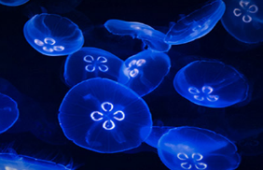
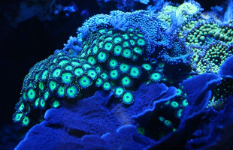
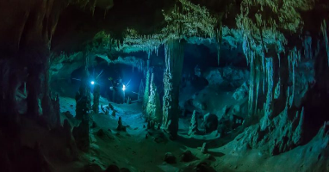
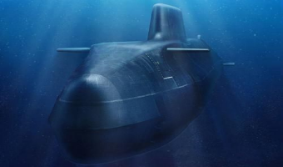
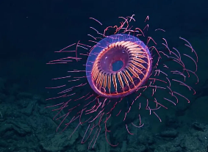
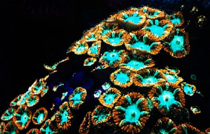
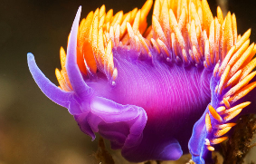
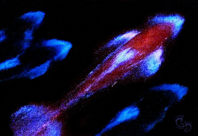
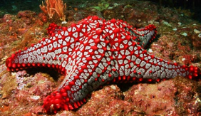
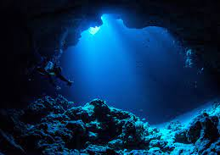
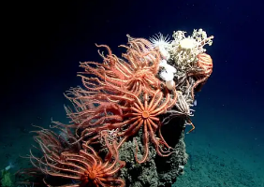
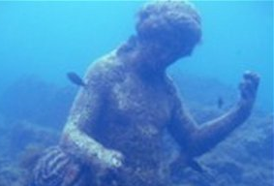
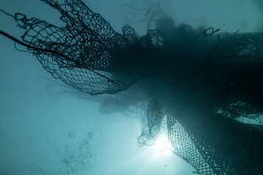
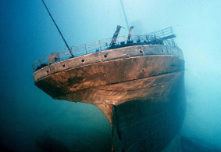
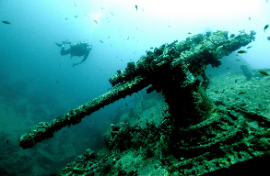
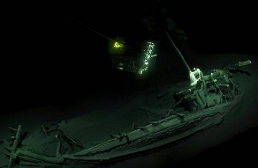
bioluminescence
iridescent
continuous
exoskeleton
aerodynamic
phosphorus
glowing
transparent
sleek
camouflaged
aggressive
bold
LIGHT
colourful
stealthy
SUBMARINES
mythical
neon
elegant
dark
silhouette
torpedo
futuristic
streamlined
dynamic
outlined
exploration
graceful
sharks
Zaha Hadid
flowing
bold
THE DEEP
colourful
exotic
DESIGNERS
coral
camouflaged
Lloyd Wright
form
alien
ANIMALS
abstract
continuous
abandoned
texture
octopus
Bermuda
jellyfish
myths and legends
The abyss
Titanic
jewelry
fishing nets
plastic
upcycling
MYSTERIOUS
Kraken
Atlantis
wrecks
POLLUTION
oil
mermaids
furniture
megalodon
preserved
Lusitania
4Ocean
fashion
Mariana Trench
graveyard
endangering
EVALUATION:
I highlighted the key areas of investigation for this page as exploration, designers, pollution, animals, bioluminescence and mysterious, as i think that these areas are the most inspirational aspects about The Deep. From this page, i have learnt more about potential research points. My next steps are to analyse Zaha Hadid to gain more inspiration.

Slide 6
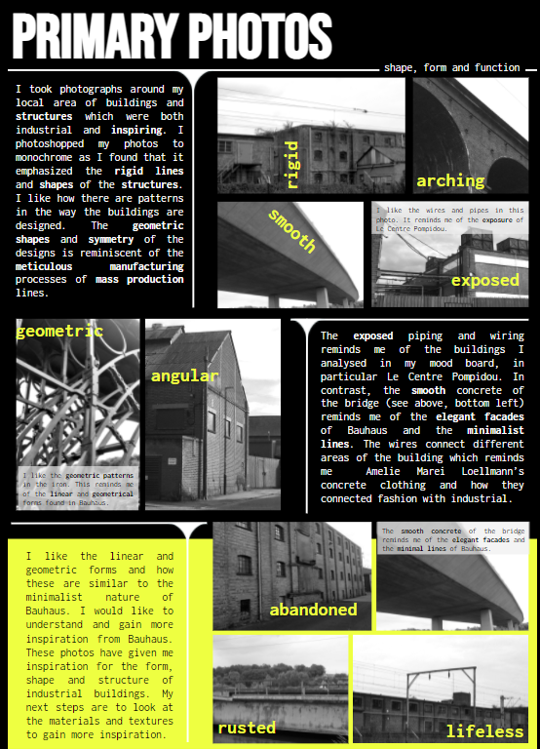
Primary Research
Primary Research Guidance
Using your mind map to guide you take 50/100 photos of relevant sources of inspiration.
Create a slide(s) with 10 - 30 of your best images and explain in a paragraph the process of gathering these images. Discuss these photos considering:
Their meaning/purpose
Materials
Shape & Form
Texture
Function
Colour
Mood
Pattern
What are your opinions of the objects you have photographed? What do you like about them? How do they inspire you? Why have you chosen to include them within your work?
Add a reflection statement evaluating the process and directing next steps.

Slide 7
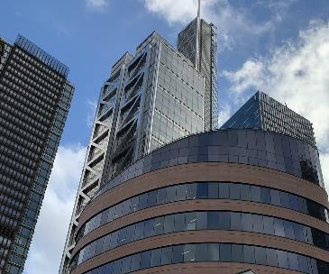
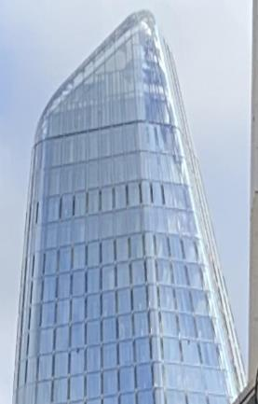
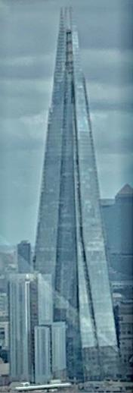
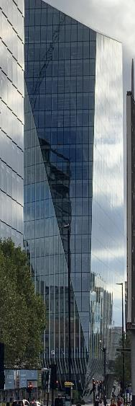
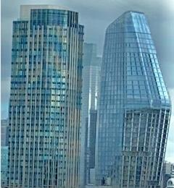
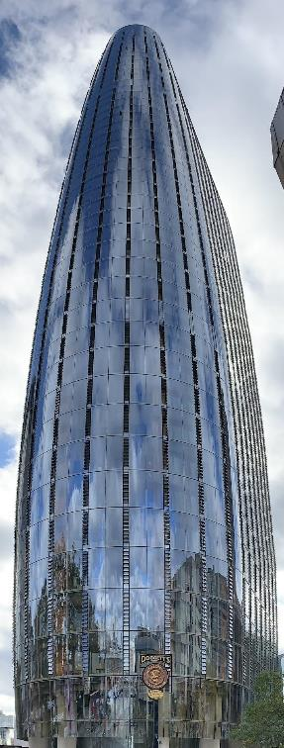
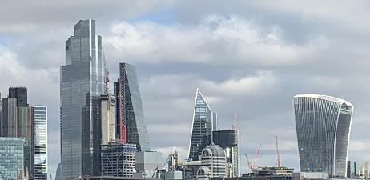
London skyscrapers - primary research
Simple shapes
I find skyscrapers very inspiring because they are abstract and unique. Every skyscraper is different from the other and they are part of our culture. I also think that it’s very interesting how the glass creates texture and details in the structures.
Symmetrical
Unique
For my second piece of primary research I visited London and took photos of skyscrapers from the London eye and on foot. Skyscrapers are often characterised by their extreme height and glass walls. On this page you can see the shard, the Leadenhall Building, and 20 Fenchurch Street.
Abstract
Modern
Revolutionary
Geometric
Surprising
Asymmetrical
In my opinion the moods created by skyscrapers are adventurous and surprise because the structures are out of the ordinary and not something you see every day - I find that very interesting and revolutionary. I would like to take that idea forward into my designing.
Here you can see a part of the skyline of London. What I really like about this picture is that you can see the outline of each building. In the future I would like to take that under forward into my designs.
Reflection statement: From this page I have learnt that London hosts some of the most influential skyscrapers in the world and that design structures and other things that don’t look like the everyday standard is revolutionary and not too abstract. . And these structures have really inspired me to do some secondary research on geometric structures and take this research and that research forward into abstractions and potentially initial ideas.

Slide 8
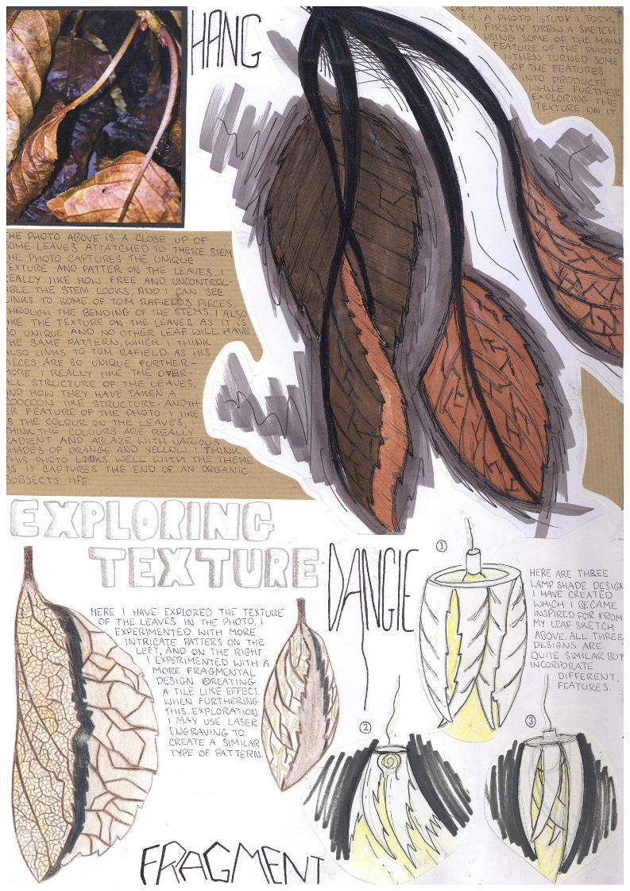
Observational Studies
Observational Studies Guidance
Using physical objects or primary photos create observations of your context utilising a range of different media such as:
Pencil
Pen
Marker rendering
Water colours
Paint
Chalk
Pastel
Collage
These studies will allow you to understand the shape, form and texture of your subject matter in greater detail.

Slide 9
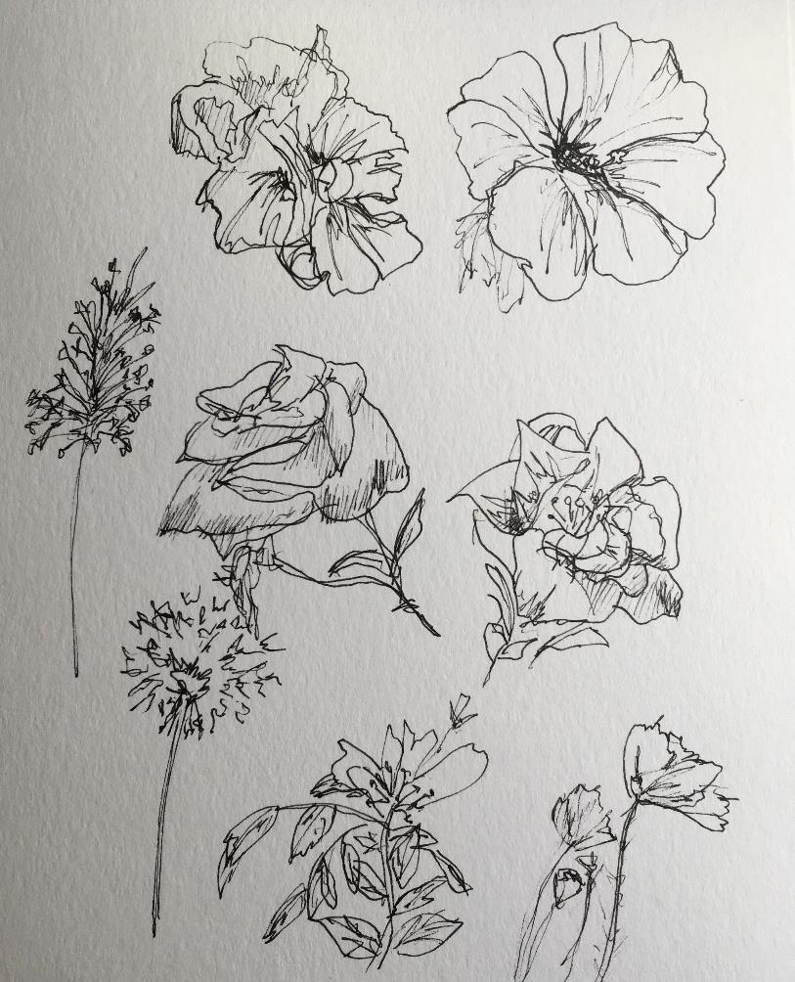
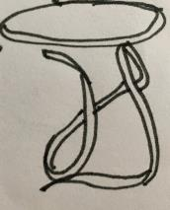
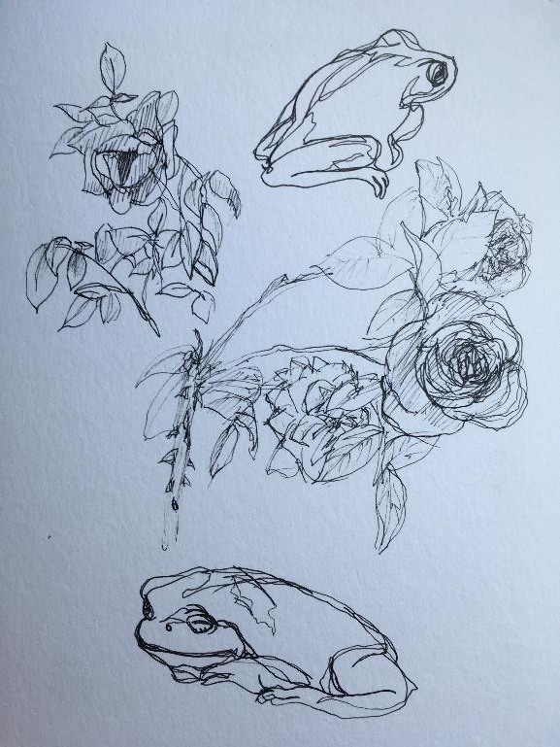
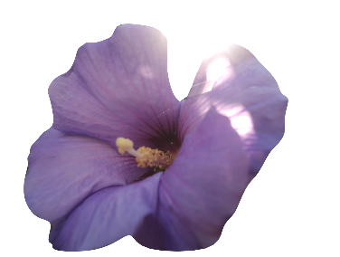
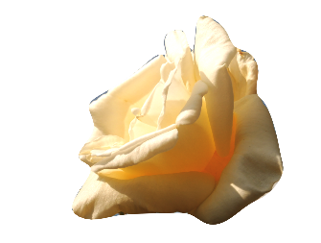
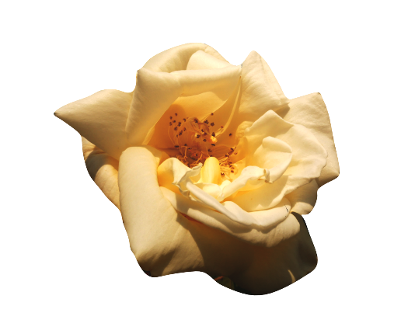
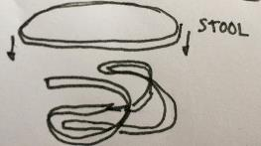
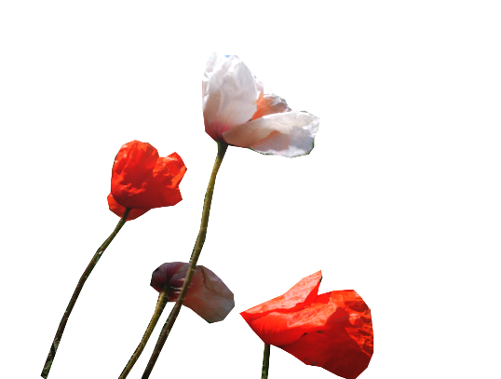
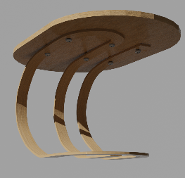
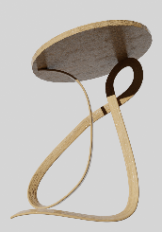
Fineliner Studies & Abstraction
Frog stool
I started by sketching my photos in detail, to get a better understanding of their shape, form and design. The two CAD designs I created in blender, of the frog and vegetation, were broken down into very basic forms. They are almost unrecognisable without context, however side by side you can see the similarities. My aim was to get a feel of abstracting simple shapes and forms from organic objects without making the inspiration obvious.

Slide 10
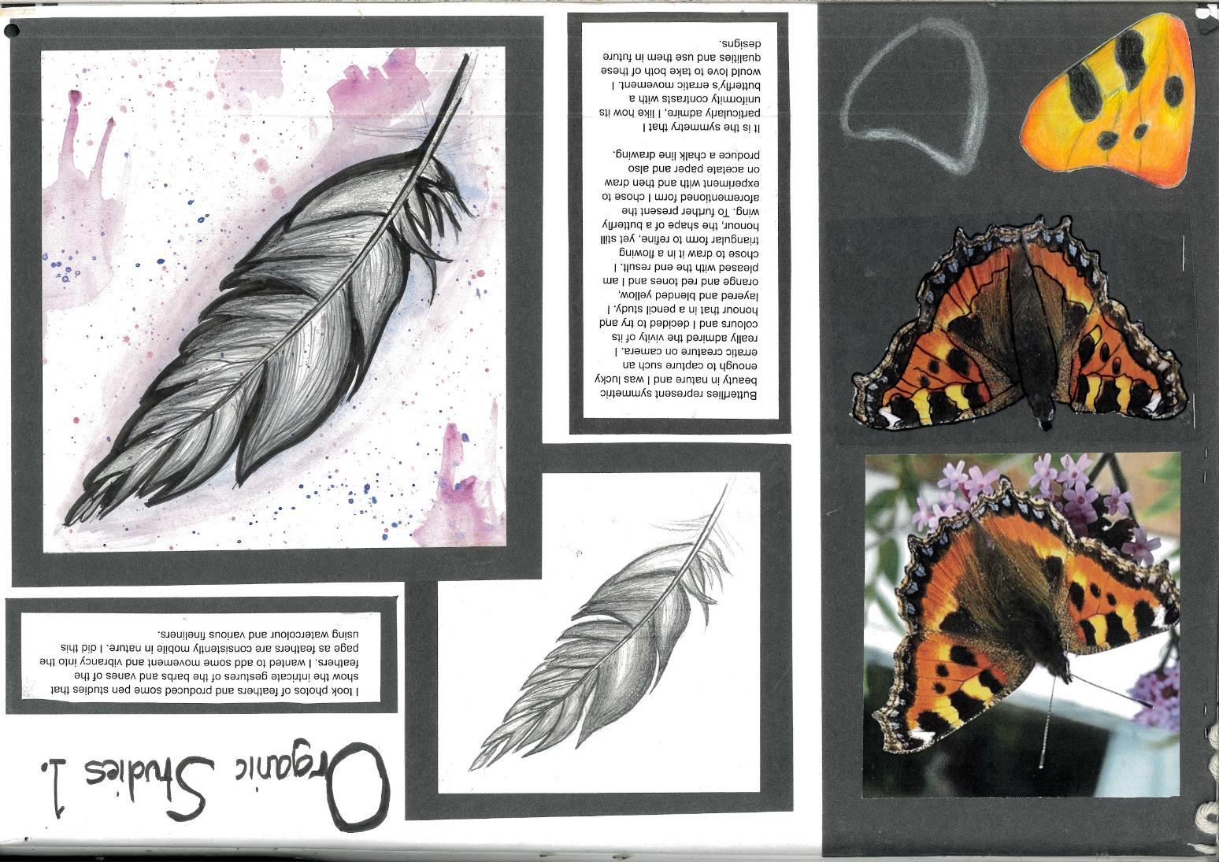

Slide 12
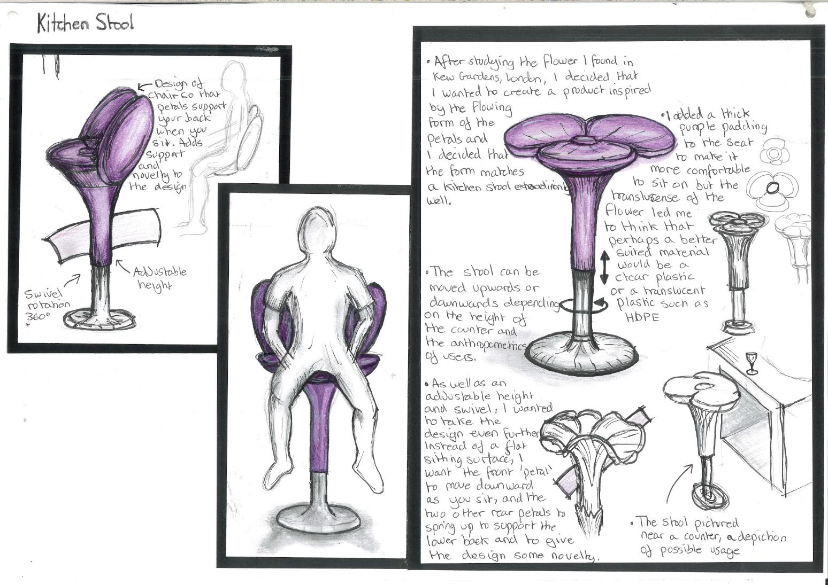
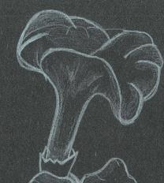
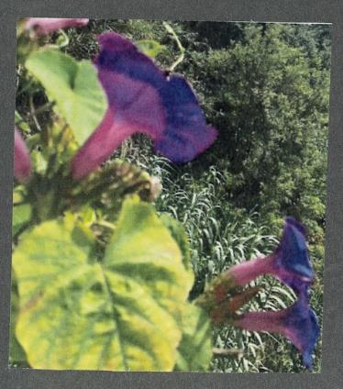
Kitchen Stool based off of purple flower

Slide 13
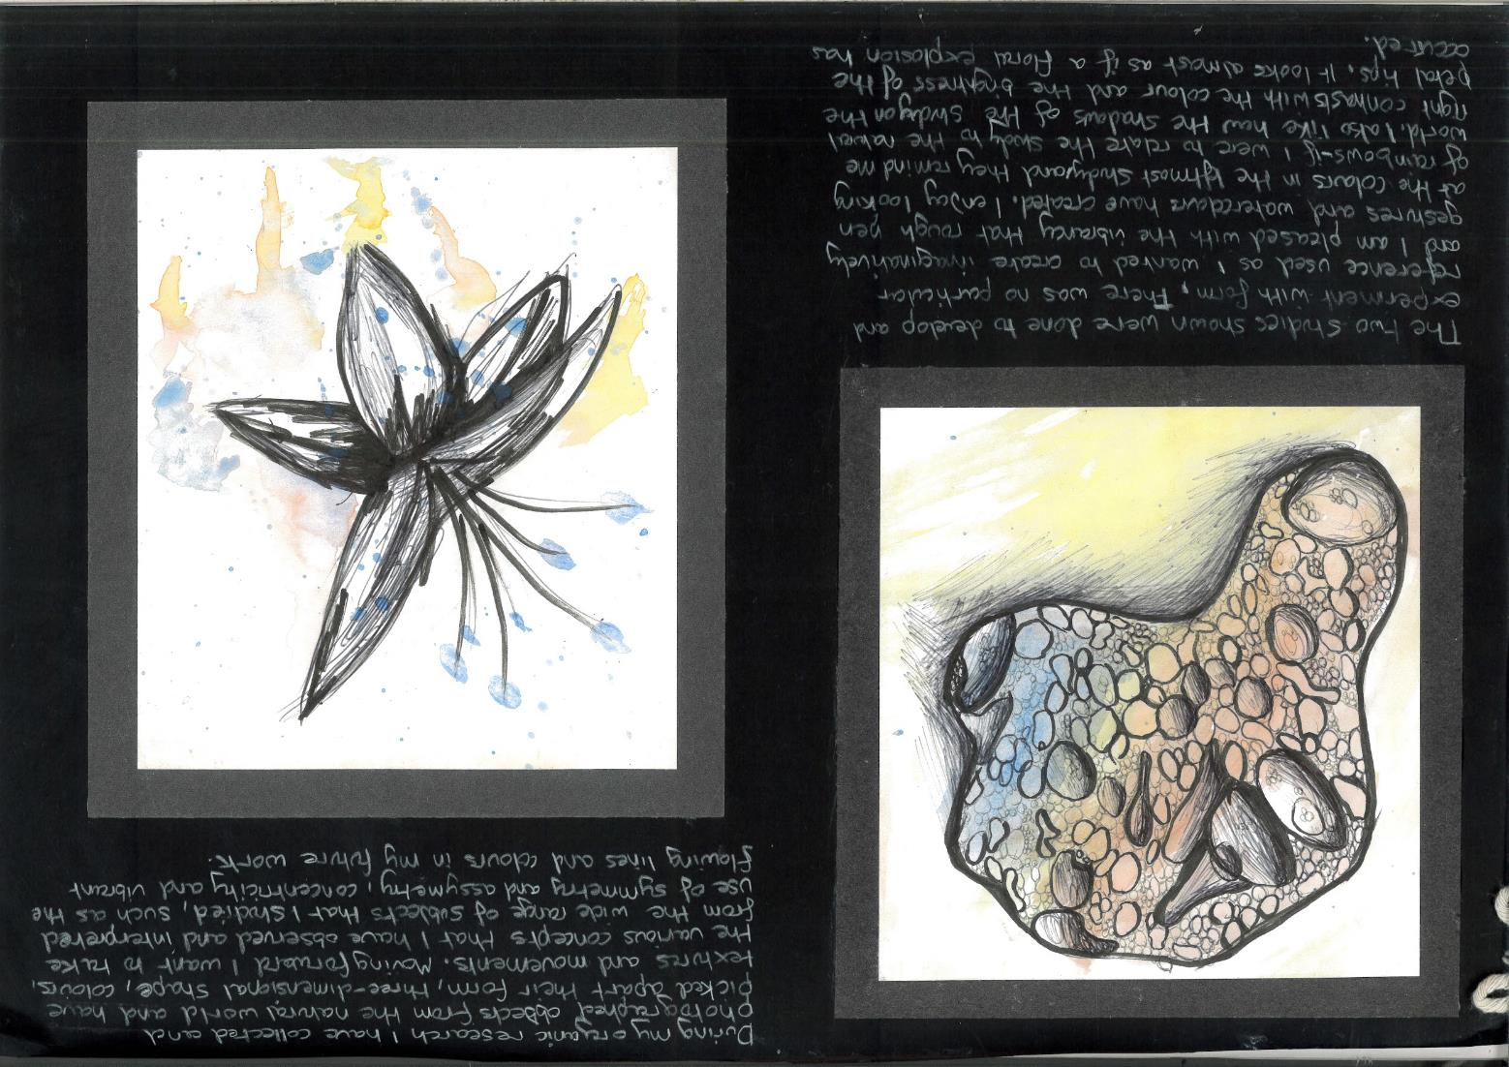
During my organic research I have collected and photographed objects from the natural world and have picked apart their form, three dimensional shape, colours, textures and movements. Moving forward I want to take the various concepts that i have observed, practiced and learnt and interpret the wide range of subjects I studied. I particularly enjoyed observing symmetry and asymmetry, concentric shapes and vibrant flowing colour in the organic world and I look forward to translating such factors in my future design work.
The two fineliner and watercolour studies shown here were done to done to develop and experiment with form. There was no particular reference used as I wanted to create a summation of some of the organic research I have done so far. I am very pleased with the rough vibrancy I managed to create, being inspired by the way refracted light shines on the rocky surface as a rainbow. I also enjoy the floral explosion I managed to create with the flower study.

Slide 14
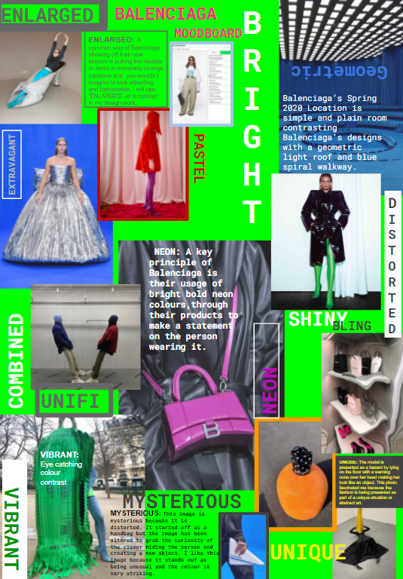
Secondary Moodboard
Secondary Moodboard Guidance
10 or more high quality images showing a range of angles, shapes, forms, textures, themes, patterns, structure and overall variety to inspire designs
10 or more perceptive keyword adjectives and verbs graphically laid out
10 perceptive analysis statements discussing your chosen image/word and discussing how you could then use this going forward. How does it inspire you?
Reflection statement discussing the key points of what you’ve learnt about philosophy, aesthetics, design etc what you’ve learnt and what you’re going to do next in terms of the next task and moving forward

Slide 15
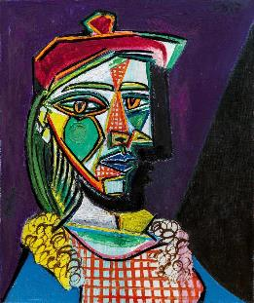
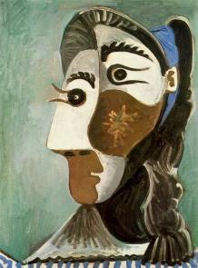
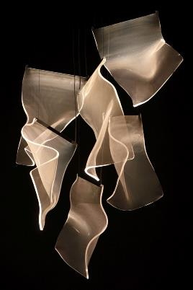
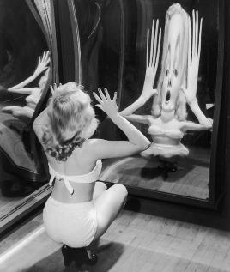
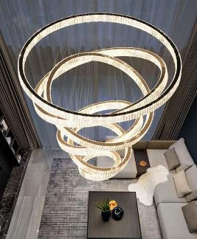
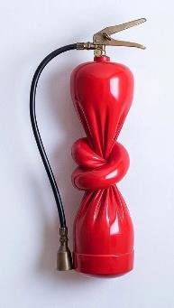
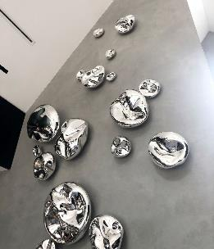
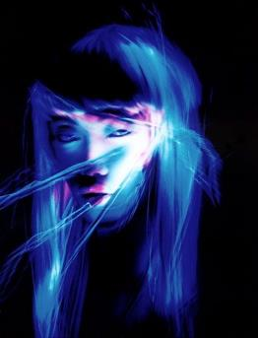
Cubism
Malformed
I really like the twisted design of these lights. I think they are very elegant which is similar to the original Balenciaga designs. In my own design work, I could use the twisted look for the distorted part but then link back to vintage Balenciaga by having an elegant aesthetic to it.
Balenciaga further research: distorted
Misshaped
I could take inspiration from Picasso’s distorted cubism designs. He reflects the word distorted in his work by showing an abstract view on human faces and other objects. He also uses bold and contrasting colours which can add to make the work seem more distorted. Picasso was a spanish painter which links to how Cristóbal Balenciaga’s designs were heavily influenced by the spanish culture.
I like the twisted fire extinguisher because it is eye catching and out of the ordinary. Similarly, the metal drops and the mirror catch people’s attention as they are unusual. In my own design work I could try to add something out of the ordinary to catch attention. However, it could be hard to incorporate this aspect into my work as well as all all the other parts.
Contort
Twisted
ᗪIᔕTOᖇTEᗪ
Distorted: pulled or twisted out of shape; contorted.
Warped
I like the broken glass effect as it is similar to Picasso’s work but a lot less abstract and more realistic. I could use this effect in my own work by giving my design a broken glass or fragmented aesthetic.
Disfigured
Dali is a famous artist. His work is known for being distorted and having a ‘melted’ aesthetic.This is his clock artwork which represents the word ‘distorted’ very well. I could use his work to inspire me when creating my own design.
Some of these chairs, have a melted/ smeared look to them. This is similar to Dali’s artwork as he also uses a melted look in his designs. I could take inspiration from these designs when creating my own design work.
Deformed

Slide 16
Designer Analysis
Designer Analysis Guidance
IDENTIFY the movement/ designer/ artist/ brand and provide a concise and coherent background
IDENTIFY the movement/ designer/ artist/ brands key features/ key philosophies with regard to STYLE, SURFACE, STRUCTURE, TEXTURE, COLOUR, FORM, SCALE, STRENGTH, MATERIALS, FUNCTION
IDENTIFY any key statements / phrases that are attached to the the movement/ designer/ artist/ brand and what they mean such as ‘Form Follows Function’
ANALYSE AND EVALUATE the work in your opinions discussing your likes and key areas you would like to take forward
COMPARE AND CONTRAST the work with other designers you have researched creating links.
COMPARE AND CONTRAST the designers work with your own work if there are any links etc
REFLECT on your investigations and write a statement to summarise the key points of your learning, what has inspired you and what you’re going to do next

Slide 17
Knowledge Organiser - Designer Research AO1
CONTENT | LINKS | NEXT STEPS
IDENTIFY the designer/ artist/ brand and provide a concise and coherent background IDENTIFY the designer/ artist/ brands key features/ key philosophies with regard to STYLE, SURFACE, STRUCTURE, TEXTURE, COLOUR, FORM, SCALE, STRENGTH, MATERIALS, FUNCTION IDENTIFY any key statements / phrases that are attached to the the designer/ artist/ brand and what they mean such as ‘Form Follows Function’ ANALYSE AND EVALUATE the designers work in your opinions discussing your likes and key areas you would like to take forward COMPARE AND CONTRAST the designers work with other designers you have researched creating links. COMPARE AND CONTRAST the designers work with your own work if there are any links etc REFLECT on your investigations and write a statement to summarise the key points of your learning, what has inspired you and what you’re going to do next | OTHER DESIGNERS COMPARE AND CONTRAST the designers work with other designers you have researched creating links. COMPARE AND CONTRAST the designers work with your own work if there are any links to STYLE, SURFACE, STRUCTURE, TEXTURE, COLOUR, FORM, SCALE, STRENGTH, MATERIALS, FUNCTION OBSERVATIONS, INITIAL IDEAS AND DEVELOPMENT INSPIRATION: Use the research you have conducted to inspire your designs and write about this discussing the links to shape, form, pattern, materials etc INSPIRATION: Use the images you have included as part of your research to show visual links to your inspiration | OBSERVATIONS, INITIAL IDEAS AND DEVELOPMENT INSPIRATION: Use the research you have conducted to inspire your observations, initial designs and development and write about this discussing the links to STYLE, SURFACE, STRUCTURE, TEXTURE, COLOUR, FORM, SCALE, STRENGTH, MATERIALS, FUNCTION INSPIRATION: Use the images you have included as part of your research to show visual links to your inspiration and tell a visual design story

Slide 18
Jittrakarn B is the designer behind these inspiring and out of this world jewelry pieces at a young age she was inspired by reading books and watching movies to someday create something inspiring herself. She chose to study Industrial Design in Chulalongkorn University, Thailand. There, she was inspired to take up design and later furthered her studies in School of Jewellery in Birmingham, UK, where she was introduced to the world of contemporary jewellery, jewellery used as an art expression.
polished
These jewelry designs remind me of outer space as the triangular formations as well as the chromatic material used create a spacecraft aesthetic.
c
o
i
mysterious
l
The 3D printed black nylon jewellery are inspired by the sea and the silhouette gives connotations of the deep and shadows making them quite mysterious. Intricate details and textures show complexity and replicate textures of animals such as octopus tentacles and fish scales. This makes it look “out of this world” again linking to the deep as the deep is often referred to as another world.
“Every jewellery collection is a journey to the alternate universe where the futuristic frontier merge into reality through artistic expression of wearable fantasy.”
Jittrakarn’s designs link to my work as they are inspired by underwater and astronomy which are my topics of inspiration too.
“FUTURISTIC
PHENOMENA”
Jittrakarn has a consistent futuristic style throughout her work and can be seen herein her necklace design, I like how its more of a fashion statement rather than just a necklace, it reminds me of how people put their headphones around their neck as a fashion statement and she is creating a similar effect
The bracelet design is inspired by the orbit of the mood which is represented by the circular forms surrounding the pearl and moon like jewels, and also the two circular bands of the bracelet to make it look like its rotating like the solar systems
This pink bracelet reminds me of the coral reef or an underwater creature due to the intricate shapes and layering, it was made by laser cutting acrylic
I would like to use her work as inspiration for more design ideas and also her wearable fantasy has inspired me to have my own wearable fantasy which I will develop throughout making my jewellery pieces.
contemporary
intricate

Slide 21
Product Analysis
Product Analysis Guidance
10 x interesting and varied product images
10 x key word adjectives / descriptors
10 x statements discussing your opinions of the designs and likes for what you could take forward based on materials, properties, shape, form, function, pattern, style
Reflection statements summarising your key learning points and focusing on what’s next

Slide 22
Walking stick analysis
Adjustable
A walking stick is used primarily to aid walking, to be a fashion statement or even used for self-defence.
Fundamentals of a walking stick
Twisted
Should be level with the wrist bone - consider adjustable walking sticks
Consider including a wrist strap to hang up the walking stick, or easily carry the walking stick
Walking sticks can be made with a variety of materials. Generally they are made from hardwoods such as: maple, walnut and birch. More modern walking sticks are made from aluminium.
Have a look at handle shape - comfort is a key element
Have a look at including a non-slip rubber shock absorbing ferrule -n less pressure on the walker and less likely to fall over.
Luxury
streamline
fashionable
Analysis:
Materials:
The main materials used to make these walking sticks have either been hardwood or aluminium. This is due to the walking stick needing to be robust. I will have a look at different materials and consider which ones will best suit to my design ideas. Additionally, i will look further into the materials to make the handle to see if i want to aim for comfort or flare. I will not only consider material for the structure but added materials for texture and form.
Luxury:
Luxury has been presented through the elements of gold which has been added to the handle. Black is the other colour which has been used which gives a sophisticated and modern look which is something that you could see as a fashion statement. I will consider using this theme when designing by using a sophisticated colour palette.
Fashionable:
Walking sticks are not only used by people struggling with mobility impairments :many people use it as a fashion statement piece. A walking stick, for a long time, has been a symbol of strength, power, authority and social prestige. This ties in cleverly with McLaren as their cars obtain power and strength both through their structure and animalistic intent. I will consider these ideas to design a structurally and symbolically strong walking stick which may help people with mobility impairments to be confident when owning one of these - personal strength.
Streamline:
Streamline design is a theme which I have analysed previously. This includes flowing and aerodynamic shapes and forms. I will consider this concept when designing to create a futuristic twist on a walking stick whilst keeping the same fundamentals.
Colour:
The walking sticks that i have analysed follow a minimalistic colour palette presenting a sophisticated finish to the walking stick.
Structure:
I will consider designing adjustable walking sticks so that they can grow with the person using it however this may hinder the complexity of the design. Most walking sticks are in a straight and sturdy format, I may want to consider twisting and spiralling to emphasise the theme of movement.
Reflection statement:
This analysis page has helped me gain an understanding of the key fundamentals of a walking stick. By looking deeper into existing walking sticks, I have considered which people use walking sticks. I have noticed that not only people with Mobility impairments use walking stick but people who want to make a fashion statement may own them as well. Going forward i will consider streamline design to include in my ideas with the structure of the walking sticks and look into the symbolic values of walking sticks.

Slide 23
Creative Intentions
Creative Intentions Guidance
What have you learnt from research / initial abstractions / ideas?
From my initial investigations and analysis I have…(here you discuss the main points of your learning and investigation and what has stood out to you, how has your research linked and compared? what have you liked? What would you like to consider going forward?).
What's your focus? What will you be taking forward?
I will now focus my project on exploring ‘What if NASA designed playgrounds?’ taking forward elements of streamline design, moving parts, educational learning……………….
What are you going to do next?
Are you going to do more research on further topics? Are you going to start generating design ideas? Are you going to play around with modelling abstract shapes and forms to use based on your images?

Slide 24
CREATIVE INTENTIONS - “THE DEEP”
From my initial investigations and observations I have really enjoyed editing the photos of my models and designs to create new abstractions and shapes and forms. The bold colours and glowing effects were part of the inspiration for my lighting designs and again something which I found inspiring. I’ve also enjoyed exploring the abstract, flowing and continuous designs of Ron Arad and Frank Lloyd Wright. However, the design area of my investigations into “organic” which has inspired me the most is my work investigating marine and deep sea animals because it links together all the aspects of the course I have enjoyed so far; the neon lighting, the flowing shapes and forms and the abstract nature of the animals.
I will now focus my project on exploring the subtitle ‘The Deep’ focusing on deep sea and marine life for inspiration for new products and outcomes based on aesthetics and theme while also considering the issues the oceans face from pollution and the initiative to help conservation. I will also explore how I can creatively generate ideas using ‘organic’ for sources of inspiration as well continuing to investigate the work of Zaha Hadid and Frank Lloyd Wright while expanding on that of Ron Arad also. This may link in to the form of objects and functional designs where form and function are equally considered as we interact with products. I will also consider the organic nature of materials and manufacturing processes by comparing and contrasting Tom Raffield’s work.
Initially I am going to create a mindmap focusing on ‘The Deep’ to collate all of my ideas and potential research options which will enable me to focus my research and investigations.

Slide 25
Abstractions / Experiments
Abstractions / Experiments Guidance
Include a page title and short paragraph explaining what abstraction / experimentation process you have done
Include clear images / sketches
Include photos of the original inspiration where possible
Include your opinions of the shapes and forms you have created and what you like about them?
Include a reflection statement discussing what you’ve learnt and what you’re going to do next / take forward?

Slide 26
LONG EXPOSURE PHOTOGRAPHS INSPIRED BY ZAHA HADID AND THE DEEP
The outline of the shapes is similar to the outlined patterns of bioluminescent animals.
I took long exposure photographs of random, continuous patterns of light. I then edited the photos to add the neon purple colours.
continuous
outlined
asymmetrical
I really like this shape as it looks like a clam shell which is something I haven't yet explored.
vibrant
circulating
The trails of light reminds me of a squid propelling itself through water.
These shapes look like coral or shells. The fluid and spiraling lines look like Zaha Hadid’s Vortexx lighting.
EVALUATION:
From investigating The Deep and Zaha Hadid, I now have enough shapes and forms to design from. I have enjoyed using light to create random forms and will take inspiration from. My next steps are to design lighting based on these shapes and Zaha Hadid’s designs.
trailing
twisting
spiral

Slide 27
What if designed speakers ?
Further ABSTRACTIONS through CAD
futuristic
Curved lines
Abstract
streamline
On this page i have taken inspiration from my first speaker design and placed into onshape and played around with the shape and form extruding shapes on the sides of the main body and then using the fillet tool to make the edges smooth so it has a shiny and clean finish, as this will allow it to link into streamline following onto there finish of streamline cars and products. Also by using the fillet tool to make the edges clean and smooth this creates more of a curved line design on my product also making it link into streamline. Using the inspiration of the streamline vehicle this had allow me to try think about making my products aerodynamic which is also a big part of nasa as they make there rockets aerodynamic to reduce drag when taking off and going up into space.

Slide 28
LIGHTING MODELS EXPERIMENTATION
cascading
I laser cut circles of varying sizes which had 2mm holes around the circumference of the circles. I then used thin wire to create shapes and forms based on my sketches. The shapes at the bottom are very predictable and symmetrical compared to the random, asymmetrical shapes at the top. I prefer the top shapes as they look more organic. The cascading wire looks like the trailing arms of jellyfish.
trailing
asymmetrical
flowing
symmetrical
EVALUATION:
I like the way the shape of the more organic model twists and cascades. However, i would like to make more abstract shapes and experient more with how I can use light to make the lighting stand out. These models give me the basic shape of the lighting but my next steps are to make models which can light-up and glow when it is dark.

Slide 29
Pewter casting into a pine mould
When attempting the pine casting, the first attempt did not fill the mould. To fix this I created a second piece using more pewter. This fit perfectly and created an extremely interesting design.
Once the pewter had cooled and it was removed from the mould I could see that it had not fully taken up the laser etched design, this could be because of how small some of the sections were. This would mean that the pewter wasn't fully able to fill the gaps only creating the slight impressions seen on the piece.
However the coaster did instead develop an extremely interesting colour pattern due to the sap and oils leftover from the pine and a very fascinating texture from the pines surface, I was extremely happy with the way this turned out.
Once the mould had then been created, we heated up a piece of pewter and poured it in using the weight to create downwards pressure. When we removed the piece it had created and interesting burn pattern however it had not fully filled the mould so we tried again with more metal.

Slide 31
Space texture samples
Once I had created the sample textures that I could use for my coasters, I then exported them as .DXF files so that they could be laser etched into a piece of 6mm MDF. This allows me to gain a sample of each pattern, and see whether it will be suitable to pewter cast from, or if it is not big enough for the pattern to be fully developed in the mould. If the pattern is suitable It could be then incorporate into later designs.
Once the samples had been laser etched, I then removed them and assessed the suitability of the patterns. All three patterns worked very well, and if scaled up, would yield an interesting form and texture. However, out of all three, I believe that the sponge pattern turned out to be the most suitable for the casting.
This has helped me to visualise the patterns so that i can see which ones could be taken forward to produce the best looking coasters following the the theme of space and the pewter casting process.

Slide 32
Exploring Space Textures
After creating the textures and looking at the different possibilities of where they could be placed, I decided to again explore how they would look on casted coasters. To improve on my initial designs, I will use a wider laser etched pattern so that the pewter can take up the full form that i would want.
In addition to he different planet patterns, I will also look at casting them into different materials. After seeing how the piranha pine affected the colours in the pewter, I am interested to see how other materials will affect it as well and what explorations I can gain from them.
So far, I am very happy with how my designs and pewter casting have gone. It has provided me with plenty of interesting shapes and forms that I can explore and take further into my project whilst also maintaining the link to organic sustainability.
To further explore the organic theme I looked at space and different planets to see if there was some way I could bring in the natural patterns of planet surfaces such as craters.
To physically explore this I decided to take planet textures and laser etch them onto a piece of oak, pewter was then cast into the etching to create a new coaster texture and design. Overall I was very happy with the way these coaster textures turned out and by learning from my previous designs by making the pattern bigger, created a more defined and interesting pattern to be seen

Slide 33
Space inspired Coasters

Slide 34
Idea Generation
Idea Generation Guidance
Clear page title
3 - 9 ideas per page
2D views
3D views
Exploded diagrams
Different Material renders
Colour and fine liner used
Technical structure
Reference to analysis adjectives and links to Research
Relevant thumbnail images linking to research and investigation / abstractions
Reflection statement focusing on the ideas you like, the links to your different designers and what you’re going to do next

Slide 35
Conceptual Combination (Idea Generation / Development Strategy)
Conceptual Combination
Conceptual combination is a fundamental cognitive process by which two or more existing basic concepts are mentally synthesized to generate a composite, higher-order concept. The products of this process are sometimes referred to as "complex concepts." Combining concepts allows individuals to use a finite number of concepts which they already understand to construct a potentially limitless quantity of new, related concepts.
+
=

Slide 36
Visual Language (Idea Generation / Development Strategy)
Visual Language
Visual language can be used to generate and also develop ideas.
As a bridging task to GCSE students were provided with images of the Shard and asked to design lighting ideas. In each box the students were then challenged to combine the images of the Shard with the given word to change its visual language and adapt this.
They were then asked to develop their favourite ideas using a different 6 words. This allowed us to explain the use of language to inspire creativity as well as work with them on their sketching and presentation.

Slide 37
I came up with this idea initially from where each point in the shard is situated and from there I developed a structure full of loops and curls. Each hollow part of the loops represent the windows letting in light. The overlapping of each shape brings out the volume and depth of the shard which contributes to the whole design.
The reason why I have created this cracked version of the shard is due to the fact that a shard could be referred to a broken piece of glass which is what I wanted to represent in this sketch. I used angular and geometric patterns and parts from the shard to really reflect the inspiration.
This idea emerged from the structure of the shard. Especially the diamond shapes. As this was a mirror design, i in operated unique angular positions of each shape giving the overall design an original look.
This design was generated by the idea of the different layers of the shard which are then copied. I have brought across depth and perception with staggering each shape making the idea simple but effective. I don’t think that I would take this idea forward to it’s simplicity.

Slide 38
This design reminds me of gems and jewels. It presents the beauty of even the smallest thing. What once was the shard became something worthless. The angular shapes are still present whilst giving a twist on the idea. I would model this either out of cardboard or paper as the geometric nets would be fairly easy to construct and put together.
This design definitely gives the effect of flowing however only light would be present at the centre of the shape. Little to no patterns would be created from this if lit up so I won’t be taking this design further.
As the style for this design was aggressive, I decided to have a pattern of jagged triangular shapes almost cutting into the light giving the feeling of being trapped or teeth devouring it.On another note,, this sucks out the light from the piece however there would be two mirrors so that the light would be reflected.
This idea emerged from the feeling of being trapped but still having the light shining from within . This is why I have included an elongated mirror going through the centre of the design. I would model this with acrylic, using a heat gun to bend the spiral round the main structure. The light source will come from the centre of the structure which will emulate light in all directions. The simple yet grasping design enveloping the main structure will project dispersed shadows in a variety of directions.
I didn’t like this design as much as it was very bland. It gave a twist on the design that I did on the previous mood board and it does present elements from the shard however it it too simplistic and not unique enough.
This design puts forward the idea of the shard coming in two directions into the light. These would be mirrors which would reflect a lot of light. The shard has windows and the reflection of the light is what I wanted to add to this piece. There I’ll be a few curved pieces around the light portraying some more wavy patterns. I would model this out of acrylic to be able to bend each curved shape in place.
This design unfolded as the use of perspective was enhanced. With the shattered pieces through the design, more elements of the shard come into play from the angular shapes to the structure.the light doesn’t only pass through the centre but the other cracks as well. I would model this using cardboard.

Slide 39
What if designed speakers ?
Initial ideas - streamline design
aerodynamic
Curved lines
On this design page I used abstraction by looking at the streamline design movement, I used vehicles from the design movement to get shape and form and then used this to create new shapes and include a speaker
Abstract
I tried to focus on the finish and colour of the streamline design movement products when drawing and designing my products as well as they use a clean shiny finish which makes it stand out and have good finish on the product and i want to dry add this into my work when designing.
On this page i focused more on streamline design movement rather than directly on NASA’s design theme this is because i wanted to link in how NASA and streamline are similar and have seen this by the use of materials such a shiny metals like aluminium as they give off a good finish and are durable and want to try use this material in my work. I have used abstraction by taking the style of curved lines and aerodynamic shapes to create my shapes and then tried to include a speaker and then i can further on link it into NASA more with designs patterns and materials.
What if designed.speakers

Slide 42
What if McLaren designed walking sticks?
Streamline designs
I like the use of simplistic shapes inspired by my streamline design analysis page which has formed my first design. The use of the teardrop shape and curvaceous structure creates a sense of movement which is what i am trying to portray.
The colour and the aerodynamic shape of the McLaren logo, has further inspired the handle design. The logo symbolises the smoke rushing over the car.
This second design is innovative due to the abnormal structure of the walking stick. This has been inspired by aerodynamic streamline and architecture brought into the teardrop handle. This includes elements of twisting and contortion which I could consider looking into by bending acrylic to create these unique shapes and forms.
By taking the structure of the building, I have been able to twist the base of the walking stick to give the appearance of movement
Teardrop shape:
This teardrop shape has been taken from streamline design which has inspired the handle of the walking stick.

Slide 43
RON ARAD AND THE DEEP INSPIRED INITIAL DESIGNS
These designs are inspired by the longline and flowing aspects of Ron Arad’s designs and the bold and asymmetric nature of the deep.
The wave shape of this design was inspired by the shape.
I like how the arm rest curves around the main shape but prefer the simpler designs.
EVALUATION:
I like the more simplistic designs as I think that they are more impactful. I think that if the colours of the chairs are bright then the colours as well as the shape will create talking points. My next step is to model the rocking chair design in CAD.
This rocking chair design is my favourite as I like how the side view curves around itself. This reminds me of the circulating long exposure shapes and forms I experimented with.

Slide 45
Initial Designs
From these designs I am going to experiment with shape and form using mesh netting. I will use this to try and make shapes such as the looping feather on one of Chanel’s hat, along with varying other creations.

Slide 46
Biophilic Design Initial ideas - LIGHTING

Slide 47
Development & Refinement
Development & Refinement Guidance
Discuss how your design has evolved and developed from the initial concept to now. Link the inspiration and starting points.
Discuss the process of your development through shape and form iteration, scale drawing, physical modelling and CAD and how you did it.
Discuss any intended materials and processes planned for production.
Include dimensions and scale visually
Reflect on your development and refinement and how designs have evolved and what you’re going to do next bottom right.

Slide 48
Biophilic Design Development- LIGHTING
The intertwining shape of this design divides the lighting system into sections that can be used for different types of plants e.g. hanging plants & succulents
This structure is more open with no twists or loops making it a more free-flowing design
I have taken this simple design from my initial ideas forward because I wanted to further explore the use of a flexible strip light that would be used in all of these structures and developed it further by adding degrees of complexity and exploring new shapes and forms for hanging light systems
This shape is too complex for a hanging lighting system however I think it would work better as a floor lamp
The open shape allows plants to hang in the structure and the grooves allow for plants to grow upwards
I like the way this design twists vertically.
Tightly looped shape allows multiple plants to be placed in the structure and creates a lobular effect.
the use of platforms in this design may make it look too angular and less organic.
Now that I have explored the aesthetics and different interpretations of this design, I now need to look into the function of the lighting system & suitable weight-bearing materials so my next step is to prototype my preferred designs.
This is a very small and basic design which may be too simplistic and I think that it would work better as a table lamp

Slide 49
Biophilic Design sketches - LIGHTING development
I investigated several floor mounted designs for a standard lamp. These comprised different support mechanisms & ensured that the light source/electricity were kept away from the plants and any contact with water.
I also explored how the bulb could hang down and over the plant enclosure using the intersection of the support above the plants to suspend the bulb.
The tripod arrangement on the light resembled more of a table-like structure than a standing lamp.
Other support mechanisms included an overhanging pendulum which I feel was too similar to current lighting designs.
These designs feature a ‘scissor’ leg arrangement and, one having a more enclosed structure above the light source which I prefer as it is more of a continuous and organic design. I feel the design above is too basic and looks like it hasn’t been finished as it is missing a top structure.
My next step is to create a final design inspired by the likes of this page such as the intertwined ‘scissor’ like design on the bottom right of the page. I also need to look into dimensions and consider an overall more organic and unique shape and form.

Slide 50
Biophilic design Table lamp
However, I felt as if the stem did not complement the gaps, so on this page I have explored a thicker, more bulbous form
I liked this pendant arch design from my previous sketch page because of the gaps in the support arm as it provided a more organic structure rather than a linear design.
I would add stones to the base of the lighting system in order for it to look an integral part of the design and to compliment the plants.
A consideration is the size of the lamp because if it was a floor lamp then would the light bulb alone look too small compared the the bulbous structure? However, I am going to explore how it can be scaled to be a table and floor lamp to see which dimensions suit the design more.
SIDE#
VIEW
Throughout this development, I considered more suitable and functional spaces for the plants because the weight of the light enclosure would be too heavy to carry plants and soil on the end of the stand and there would be a chance of it falling over. So, instead, I have used the spaces in the stem of the light to place the plants inside, This makes it easier to install and grow the plants and would be more suitable to water considering it is not near the light source. In addition, the overall weight distribution would be better.
The design enables the plants to hang down and grow freely and naturally over the base of the light, this would make the structure of the light more integrated with the plants, creating a more natural look.
In reflection, I have now generated an idea that focuses on form as well as function and uses space better. My next step is to use OnShape to explore how I can build this design and to consider where the lighting goes and the best structure for the plants.

Slide 51
Developed Idea
This design will feature a central light that will cast outwards through geometric shards attached to the sleeve
For this idea I decided to develop one of my table lamp designs inspired by modern architecture. This design feature heavily on the geometric and modern forms in work by architects such as Sir Norman Foster.
I Like this design as it takes inspiration from both my research designers and modern iconic architecture. I will continue to develop this design up until its making.

Slide 54
CHAIR DESIGNS CAD MODELING
When light is shone on the chair it will give the same glowing effect as the Ron Arad inspired shapes.
The colours remind me of Zaha Hadid’s lighting. I think that the effect of the chairs glowing makes them look mythical and alien-like.
These design are my favourite as I like the shapes and how they are of different types of chairs for example the bar stool or the rocking chairs and would like to design more types of chairs.
EVALUATION:
These CAD models helped to get a better understanding of how the designs will look and function. I like how the chair curves around itself like aspects of the deep I have explored but it also gives the longline effect that is found in Arad’s work. My next steps are to model my favourite designs in 3D.

Slide 55
THE DEEP CHAIR DESIGNS 3D MODELING
MOVEMENT
FLOWING
OUTLINED
LONGLINE
EVALUATION:
I like how the weight distribution of the rocking chair design make it look as if it is in motion. I also like how it curves under itself and would like to experiment more with this shape. These chair designs are very inspirational and I can see them being developed into more designs.the shape and form of these models is very organic and fits in with the deep however, I would like to edit the images in neon colours to make the colours fit in with the deep.
CURVING

Slide 56
Modelling the acorn bowl design with paper
I am pleased with the outcome of this design, even if was just experimenting with paper. Despite the untidiness of the inside, the outside is relatively intact and presentable. The only problem would be trying to make both the inside and the outside presentable when gluing the model together. I can wipe the glue gun off after each use
but this is, again, tedious
and time consuming
As I imagined, it was
difficult to create this model
misplacing one petal leads to a whole disproportionate model. I was relatively happy with the outcome but I’m not sure how practical it will be to create out of wood, especially when it’s not a flat 2D shape. I only used masking tape to bond the shape together but I’d imagine I’ll use something a lot stronger and a lot less noticeable when it comes to building my model: like a glue gun.
However this comes with another problem of it’s own. I will have to wait for each scale to dry before I try moulding another. This is not only time-consuming, but it will also be frustrating if I misplace one as I will have to readjust the whole thing.

Slide 57
Abstract flower vase development
This shape was relatively simple to recreate,in larger sketches and digital form, since it is made up predominantly of triangles. I measured each line so that I could rescale it and adapt it to blender. I mapped out the shapes in blender and translated them to 3D since I only sketched the 2 dimensional viewport.
It was important to use each and every line when translating this to a larger size or digital form, since there is no use of angles each line helps me get a reference of where each triangle should be. The main form of this design is inspired by nothing in particular, it’s just a number of triangles put together to create an eluding shape. The overlooming theme is scales in nature, pinecone scales in particular for this piece. The premise of this idea is that these scales can fit onto any surface, no matter how complex. Reinforcing the idea of procedural textures.

Slide 58
CAD renders for my
Pinecone lamp
These finalised renders replicate how I envisioned my piece to look like in a 3 dimensional form. Since my initial ideas were just a 2D plane there was not much to go off of, so I just pulled out random vertices until there was a little depth, and then mirrored the object. There was of course more thought put into it than that, but overall the random nature of the design further reinforces the main idea. It was important to have the scales be a different colour and/or texture to the main body, since they need to stand out. Having them contrast to the lamp makes them almost reminiscent of fungi or mold, taking over and infecting the host.

Slide 59
Presenting my finalised cardboard model
I’m proud of my final model, it looks just how I envisioned it in my sketches, as well as my CAD designs. The cardboard doesn’t shy far from the MDF material and the scales are a different texture and material just as I described. Just like my other prototypes I showcased this model against a white background to make it stand out, using natural lighting which is reminiscent of studio lights. This model is almost exactly how my final piece should turn out, just at a larger scale and cleaner, more professional standard.

Slide 60
I laser cut the layers out of card using the laser cutter, to model them stacked together.
ONSHAPE MODELS
Using onshape, I extracted the patterns into three layers to give the lamp more dimension and multiple colours.
LAYERING
Once I had stacked the layers up, I could see how the lamp would look in real life. I really liked the tiered effect as it added another element to make it a more complex and intriguing structure. I would now like to add a pattern to each layer, to fit in with my creative intentions and to give it a more intricate aesthetic.

Slide 61
ONSHAPE MODEL
To see how the lampshade would look painted instead, I laser cut the bottom layer from clear acrylic. I then used a heat gun to bend the petals upwards so I could then paint over this using acrylic paint and outline the details.
PAINTING PROTOTYPE
I wanted to experiment with different colours so I used pink, blue, yellow and green on the petals to make the lamp vibrant. I did two coats to make sure there were no gaps in the paint.
I have developed the bottom layer of the lamp shade by adding more swirls. This makes it fit in with the theme of art nouveau because of the free flowing and organic lines.
Once the paint had dried, I used a thin paint brush to go over the outline of the swirls and the edges of the petals. I am now going to light up the model to see how it would look in use.

Slide 62
For the print on this flower, I was inspired by the feathers of a peacock. I used the same style of curves as on my peacock plant pot. It also has an art deco aesthetic because of the bold geometry.It is also inspired by the print on a butterfly.
PEACOCK INSPIRED LIGHT
The swirls add an elegant aesthetic to the lamp and make it fit in with the theme of art nouveau because of the organic free flowing lines.
BUTTERFLY PATTERNS
ART NOUVEAU
DEVELOPING THE PATTERNS/COLOURS
Once I had designed the extra pattern on onshape, I used the laser cutter to cut it out of card, along with scaled up versions of all the layers.
Once I had combined the layers to create the whole model, I decided I should scale the middle layer up. This is so you could see more of the pattern and the layers would be more proportionate.
I used the laser cutter to cut and engrave the different layers out of card. I scaled the middle layer up so you could see more of the pattern and so the layers were more proportionate.
I then planned which colours I would want to use to paint the lampshade. I liked the bright, vibrant colours I used on the prototype as they link to flowers, butterflies and peacocks.
Overall, I think the layers provide the perfect balance between the elegance of the swirls to the sleek look of the geometric shapes. The top of the lamp is too plain so I am going to design another pattern on onshape to finalise the look.

Slide 63
Final Design Proposal
Final Design Proposal Guidance
Sketch and render your final design in 2D and 3D to communicate this thoroughly. You may use CAD for this if you wish through Onshape, Illustrator, Photoshop etc
Use exploded diagrams to show how it could be made in industry or the workshop showing the different parts
Could you add fine liner and background graphics to make your work stand out if using rendering pens?
Add thumbnail images to show the origin and discuss how the design has been influenced by your chosen movement/ designer/ brand/ artist. Essentially show and discuss where your design has evolved
Add dimensions for the scale model to be made in the workshop

Slide 64
Final Design Proposal
Final Design Proposal Guidance
Sketch and render your final design in 2D and 3D to communicate this thoroughly. You may use CAD for this if you wish through Onshape, Illustrator, Photoshop etc
Use exploded diagrams to show how it could be made in industry or the workshop showing the different parts
Could you add fine liner and background graphics to make your work stand out if using rendering pens?
Add thumbnail images to show the origin and discuss how the design has been influenced by your chosen movement/ designer/ brand/ artist. Essentially show and discuss where your design has evolved
Add dimensions for the scale model to be made in the workshop

Slide 65
Final Design Proposal
Final Design Proposal Guidance
Sketch and render your final design in 2D and 3D to communicate this thoroughly. You may use CAD for this if you wish through Onshape, Illustrator, Photoshop etc
Use exploded diagrams to show how it could be made in industry or the workshop showing the different parts
Could you add fine liner and background graphics to make your work stand out if using rendering pens?
Add thumbnail images to show the origin and discuss how the design has been influenced by your chosen movement/ designer/ brand/ artist. Essentially show and discuss where your design has evolved
Add dimensions for the scale model to be made in the workshop

Slide 66
Biophilic design table lamp development & modelling
I created the design as a table lamp on OnShape in order to explore the shape and form as well as the best way to layer the design to create a cavity for the cable.
I have made the bottom space smaller on the outside layer and larger on the internal layers so that when soil is placed in this space, it is not visible and the plants will be able to sit in the cavity. This would also make the plants look like they are an integral part of the structure.
If each layer had a cavity for the wire then this would make the light loose and give it too much space to move.
I need to create a new face that does not contain a cavity and place 2 layers with a cavity for the light lead in the middle of the structure so the light will stay stationary.
By considering how this design will be layered and structured, I have found that the internal part of the light needs to have larger spaces in the middle in order to provide a cavity for soil and plants. I have learned that I now need to create a layer that contains a larger hole still without the cavity for the wire of the light. From here, I can assemble the design with only 2 of the layers with a space for the wire which will mean that there is less space for the light to move between solid layers.

Slide 67
Biophilic design Table lamp - OnShape technical drawing
SIDE VIEW
FRONT VIEW
The technical drawing shows the dimensions of the table lamp. This is helpful for the manufacturing process because it provides the manufacturer with suitable material measurements.

Slide 68
Redevelopment:
Thread
I have started to redevelop my previous design. One of the elements of the feedback said the strings were too long and became tangled much too quickly. Therefore, in this design, I
plan to focus on solving this issue. I will do this by having less strings, and more gaps for the strings to feed through. The parent said the game was tricky/fiddly, so I plan to scale up the game and make it easier for a child to use. I need to work on stability and balance, as the feedback said the toy was difficult to hold and use at the same time.
This is a side profile view of the cube. I think the layers look effective and will work to engage the children in their play and experimenting with the toy.
Here, I have shown three drawings of my different upstanding rectangles. The tallest middle one will have a 3x3 square pattern, the second layer will have a 3x2 square pattern. And
the smallest layers will have a 3x1 square pattern.
This is the top base layer. It will have rectangular pieces cut out and (17x6mm) and this will create space for the weaving squares to slot in. The base will need to be quite big so that
it supports the five upstanding pieces, but also so it is steady on a table
and children can play with it safely and easily.
As someone looks from the angle of the front of the toy, they should see a face of a Rubik’s cube. This continues the links to Rubik’s, along with the geometric shapes and challenge/ game element.
This is the final sketch of the evolved design for Rubik’s thread. It shows the five layers, which will each be painted a Rubik’s colour, and the base which I will paint white. There will be a string attached to each end of the base for children to weave and thread through the gaps. I will need to make sure the strings aren’t as long so they don’t get tangled easily.
CONCENTRATION
To Reflect:
On this page, I have progressed in my Rubik’s thread toy, by experimenting with a new shape form and organising the shapes in a different way. For my next steps, I am going to do some measurement drawings and move in to CAD development.
WEAVING

Slide 69
Scale Drawings:
20mm
6mm x 2= 12mm (1.2cm)
2 cm+1.2cm= 3.2cm
10+3.2= 13.2cm
3.2+2= 5.2cm
5.2+3= 8.2cm
30mm
30mm
20mm
230mm
I have created some scale drawings for my new toy. I had to create a bigger gap between the bottom row of cubes and the base, so that the squares had room to slot in to the base layers. I kept the cubes
the same size as before (3x3cm), and I have also kept the 3 base layers the same,
so it is sturdy and able
to withstand children handling/ playing with it, and also
so it is easy to use.
182mm
6mm
170mm
82mm
32mm
20mm
50mm
170mm
300mm
20mm
170mm
30mm
132mm
30mm
32mm
32mm
30mm
170mm
To Reflect: On this page, I have finalised the dimensions and shapes for my new toy design. I can now move on to using OnShape to develop further, as well as creating a 3D visualisation. I will then be able to start laser cutting.

Slide 70
OnShape Development:
The first element I created was my base plates. I decided to keep to using the three layers as opposed to two, because i wanted to make sure the upstanding parts would be secure. I have two layers with the rectangles cut out, and then one layer which will be solid. All of my parts will be made of 6mm thick MDF which I will paint.
Next, I created the coloured parts. The highest layer will go in the middle slot, and then the others will be arranged symmetrically in size/ height order. I have one of each colour to contrast the base which will be painted white.
To the left is a front view of the toy, which creates the illusion of the face of a cube as I’d hoped, and above is a side profile showing the heighted layers of the game.
To Reflect:
On this page, I have finished the OnShape development stage of my project. I have gained a greater understanding of what my final product will look like. For my next steps, I am going to move in to laser cutting and then painting my outcome.
All of the exposed corners are curved to make the toy safe for young children.

Slide 71
Developed Lamp inspired by Modern Architecture
For my final design i have decided to create a lamp inspired by modern architecture. This lamp will feature a stone or concrete base surrounded by metal shards that will bend the light and cause different shadows. Within school this will be constructed using MDF, acrylic and finished using different sprays.
This was one of my favorite ideas to develop and take forward as it focuses of the very modern and futuristic style presented by Sir Norman Foster in many of his designs such as the Hearst Tower and new London city hall.
Inspired by modern design, my lamp will appear to be constructed of strong materials such as metal and concrete. These shards will be attached to a transparent acrylic sleeve allowing the light to filter out through the different channels to create interesting patterns and shadows.
The base will be made of layered MDF and raise it upwards similar to that of modern skyscrapers and buildings making the light spread further around the room it is featured in.

Slide 72
Manufacturing Diaries
Manufacturing Diary Guidance
Clear photos of each significant step
Annotation which provides context for each step
Use of technical language when discussing materials, tools and components
Use of technical language when discussing material properties
Clear and highlighted reflection on any revised design / construction plans which may occur through the manufacturing process.

Slide 73
Laser etching and casting process
Once the the main pieces of the table had been created and finished, I next looked into how I was going to create exploration and space themes on the surface. To do this, patterns from previous space exploration coaster were laser etched into the top of the oak. These were done to create planet textures in the surface and enforce the ideas of exploration and organic themes, because of the randomness of nature, these etchings were placed at different, non uniform locations.
Once the lasers etchings had been completed, rings were cut out to provide a border for the pewter casting. I decided to pewter cast planet texture coasters into the oak surface because it created an interesting burnt aesthetic and interesting textures as well as helping to show the idea of exploration through the pattern being hidden under the coaster.
I was very happy with the way the coasters turned out, they captured the texture of the oak extremely well whilst also developing an interesting one of their own on the opposite side.

Slide 74
When the designs for the layers had been finalised, I could laser cut them out of acrylic using the laser cutter.
I draped the petals over a concrete mould once they had been heated by the heat gun. I made sure to not get too close to the acrylic, otherwise it would bubble.
MANUFACTURING THE LAMP
Bending
Once the bottom layer had been heated and draped, I placed the middle layer on top. I then repeated the process and did the same for the top layer.
The method was very successful as all the petals draped into the right place, ready to be painted.

Slide 75
At first I painted them over with emulsion then sanded them down. I made sure to paint them on paper towel and transfer them back to the wood so they wouldn’t stick. I then painted them with acrylic paint with many layers, since I used more than one colour it was rather difficult replicating the shade of brown each time. I stuck them together using a glue gun since PVA would have taken forever to dry.
Adding the scales
The first side I added had no problems, however I messed up a number of times on the second side with the glue gun which led to the paint ripping. This is why I had to repaint numerous times. I also had to paint the back of the scales, but only after I had stuck them on otherwise I wouldn’t have been able to glue them together.
After many repaints and unsuccessful bonding, I managed to partly finish my model.

Slide 76
Final Product Presentation
Final Product Presentation Guidance
Clear and professional photos of the final outcome presenting it where possible in situation
Clear and professional photos of different views
Clear and professional photos of the product functioning
A sophisticated and professional graphic layout

Slide 77
Final Product Presentation
Final Product Presentation Guidance
Clear and professional photos of the final outcome presenting it where possible in situation
Clear and professional photos of different views
Clear and professional photos of the product functioning
A sophisticated and professional graphic layout

Slide 78
THE DEEP AND ZAHA HADID INSPIRED LIGHT
EVALUATION:
As a development of this lamp I would like to experiment with there being layers of the flowing shapes stacked on top of each other. I think this will create a more sophisticated design and add to the mythical and deep sea theme and appearance.

Slide 79
THE DEEP AND ZAHA HADID INSPIRED LIGHT
EVALUATION:
I like the way the lines twist and cascade over each other. It reminds me of squid tentacles floating in the water. Making this product has inspired me to design and experiment with more with The Deep. I also like how when it is dark the design lights up and becomes an iconic design but when it is light the design is a unique feature. I would like to take this into consideration in future designs. I can see this design developing into more lighting and I would like to experiment with shape and form.

Slide 80
Presenting final practical

Slide 81
Presenting final practical

Slide 82
Final outcome
Reflection statement- I like the outcome, I feel giving my jewellery pieces the background of the shipwreck environment really emphasises how they resemble buried treasure which adds to my collection giving it more depth and something that has never been seen before on the market. Inspiration from under the sea and jewellery designers is evident too as I use the organic forms similar to tiffany and co collections and created my own wearable fantasy inspired by Jittakarn and her collections.

Slide 83
Final outcome image manipulation using light and editing
My wearable fantasy
The journey I want to take my viewers on and my wearable fantasy for this jewellery collection is that the target market feel as though they have found precious sunken treasure when they find my jewellery pieces. That same ‘awe’ feeling scuba divers would have when they find treasure, I wished to replicate.

Slide 85
Thread

Slide 86
Presenting the final product

Slide 87
Presenting final product in action

Slide 88
Final
Presentation
Here is the final design. The lamp features white curving legs, that uphold a a deep black circular base. Ivory pearls are looped around the base in a irregular and asymmetrical fashion. Off-centred at in the middle, stands a tall and slender Edison bulb, reminiscent of a model on a catwalk. Behind stands a mesh netting decoration that sprawls out to create a fan like shape. The base of the mesh fitment is lined with a row of ivory pearls, adding an extra layer of depth to the design, as it contrasts to the inky black of the base.

Slide 89
Final
Presentation

Slide 90
Biophilic design table lamp - Final Product

Slide 92
Project Evaluation
Project Evaluation
What to include:
evaluate your final concept against your creative intentions/brief considering successes and where you have met elements while also where you feel you could have potentially done more as well as your personal opinions on successes and areas for improvement
evaluate your design story and discuss links to the initial starting and where you have used different sources of inspiration from designers to your observations and how your design evolved through time
Consider future modifications if any based on your evaluation also
IMPORTANT
As part of your evaluation could you do a visual evaluation and time line showing where this idea was initially conceived and linking this to all of the sources of inspiration which helped it move along. Imagine if the first bit of research and sketch was on the left how did this then evolve with every design decision?

Slide 93
Reviewing final practical
When reviewing my final practical I was very happy with the way it came together. Throughout its design I was constantly attempting to bring in aspects from many of my different research and exploration ideas and techniques. I think that I have been able to capture these aspects quite well, taking inspiration and techniques from the designers I researched such as Tom Raffield and Max Lamb, and using their natural forms and techniques to influence the way the table was designed. When looking back on the design features included such as the organic oak twists from Tom Raffield and Central support and casting from Max Lamb, I believe that these have greatly helped the aesthetic of the table to fit in with my overall organic theme, as well as linking in to my sub theme and brief of organic and sustainable design.
Overall I think the final product turned out extremely well, I was very happy with how the form came together, the way the twists spiral upwards towards the top of the structure as well as how each disk is offset on the central support helping to show the planets in the solar system moving towards the sun in a spiralling pattern
I believe that each process used within this design to create the final form fit into my brief quite well, using simple low energy processes and sustainable materials to create an interesting piece of furniture surrounding the organic theme whilst also being sustainable.
This final practical turned out extremely well, I am very happy with its aesthetic and form and how it links into my overall theme and brief tying all of my project together into this final product.

Slide 94
Student Feedback:
Child A:
Child A has high functioning ASD, which means he is one of the more able children. Once shown what to do, he was inquisitive and came up with the idea of racing his friend threading all the way to one side and back again. He said “It was difficult at first, but then it was easy.” He wanted to continue playing after being told to stop.
Teacher Feedback:
The teacher is an SEN (Special Educational Needs) teacher, and overall, she liked the concept of the toy. She said it encouraged cooperative play and sharing amongst the children, as well as being a good tool for improving fine motor skills. She also liked the material of the toy, as it is robust; children with autism can be heavy handed. She commented on the bright colours working really well to engage the children, and make them inquisitive. Finally, she said that despite the fact the toy looked simple, the children found it to be a challenge, which meant they remained focused on it for a fair amount of time.
In terms of improvements and changes, the teacher said the spaces in between the upstanding threading squares could be made bigger, as some children’s hands got stuck in the gaps as they were trying to thread. She also said I should make the strings two different colours, so that two children can differentiate as they are playing at the same time.
Child B:
Child B also has higher level ASD, and was paired with child A to play with the toy. The TA said he particularly liked the levels, as he made the comment “I liked going up high.” The game encouraged child B to be more competitive than usual. The toy wasn’t originally designed as a game, but the child turned it into a game by racing his friend.
Middleton School
Middleton school is a primary school for 4-11 year old children with moderate learning difficulties. Their children also have speech, language and communication difficulties, and most of them have been diagnosed with ASD (autism spectrum disorder). There are 96 children, and between 55 and 60 staff members, as the staff to children ratio has to be very high.
Child C:
Child C has moderate ASD, and ADHD (Attention Deficit Hyperactivity Disorder). She struggles to focus on one thing for a long time, and the TA said she stayed engaged for a fair amount of time. She struggled to get her fingers between the gaps, but did not need prompting on how to use it. She was curious, and said “I like the windows.” The TA said that the second set of children played with the toy independently, at the same time, so the size worked well.
Staff Discussion:
The teacher also discussed the toy with her 3 Teaching Assistants. They observed the children
as they played, and all said they liked the fact the children felt a sense of achievement as they completed the challenge. They suggested I made the base of the board more sensory (e.g. using
a durable material that could be cleaned, such
as astro turf.
Situation:
The teaching assistant picked four children of different abilities, and split them into focus group pairs (child A & B, and child C & D). She took two different approaches with the game. With the first group, she demonstrated what to do, but with the second group, she gave them independence to figure it out themselves. For safeguarding reasons, I wasn’t able to take photos, but the teaching assistant noted any comments the children made, and watched how they interacted with the toy.
Child D:
Child D was paired with child C, and he has low functioning ASD, as well as speech and language disorder and poor fine motor skills. He struggles to maintain any focus at all, and he initially picked up the cube and tried to push it through. Once he worked it out, he was engaged and threaded to the other side. The toy gave him stimulation, confidence and also helped with manual dexterity (synchronising hand and finger muscles).
To Reflect:
Receiving feedback from autistic children and their teachers
has been extremely helpful in working out where to go next. I have learnt that simplicity is key, and that the children benefit from a challenge, and enjoy the feeling accomplishment. My next steps are going to be moving away from threading, and looking at a different area of toys. However, the feedback from this toy will help me as I consider different elements for ym next area of work. I’m going to start by bringing a new area of research to my work.

Slide 95
Redevelopment 2:
This is a side profile of my design. It is exactly the same as before, but the gaps between the upstanding pieces will be bigger, as this is something I was told to do.
In the feedback of the first design, the school suggested I made the gaps between the upstanding parts bigger, so I have made them 80mm instead of 50mm. Hopefully this will make the toy easier for the children to use. Due to the children turning the toy into a multiplayer game themselves, I used this idea and recreated the toy to have an active competition (who can thread there and back and hit the lights quickest). This will encourage collaborative play, sharing, whilst continuing to help with fine motor skills.
I’m going to have four lights that are switched on by pushing the tops in. I chose light, rather than a buzzer, as loud noises can startle the children or frighten them.
These are the upstanding parts that will slot in to the base of my design. I will have a white base, so the five main colours will make up the upstanding parts of the toy.
I looked at my first design, and I thought about a way to keep it similar but incorporate the feedback.
I decided to create a new feature (two lights), which the children can press once they’ve completed the game.
The size of the square holes seemed to be a success, so I am going to
keep that the same, and have the same size cubes for the children to thread with.
I am going to need to make sure I have enough layers for the lights to sit flush in the MDF. The bottom layer will be flat.
The upstanding pieces are exactly the same, with the same dimensions. The only difference is the gap size.
To Reflect:
On this page, I have completed my redevelopment sketching, and I have added a new function in to the toy, which has flights to act as a race element for the children. For my next steps, I am going to complete the OnShape redevelopment, and show what the new toy would look like to be sent off for manufacturing.

