Slide 2
THE NATIONAL ASSEMBLY FOR WALES
Structure
Role of the Presiding Officer
Roles of legislation and scrutiny
Key developments since the May 2016 elections:
The Wales Act 2017
Electoral Panel on Electoral Reform
Engaging with the people of Wales
Further devolution of taxation powers

Slide 3
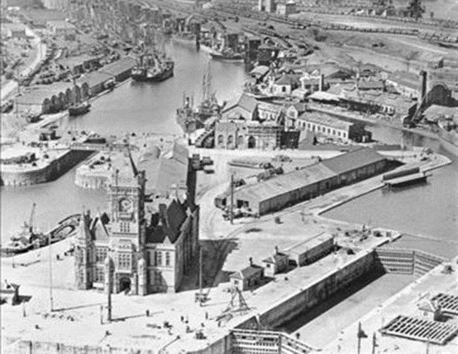
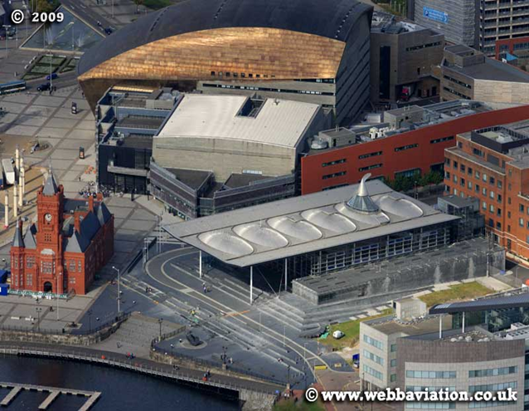

Slide 4
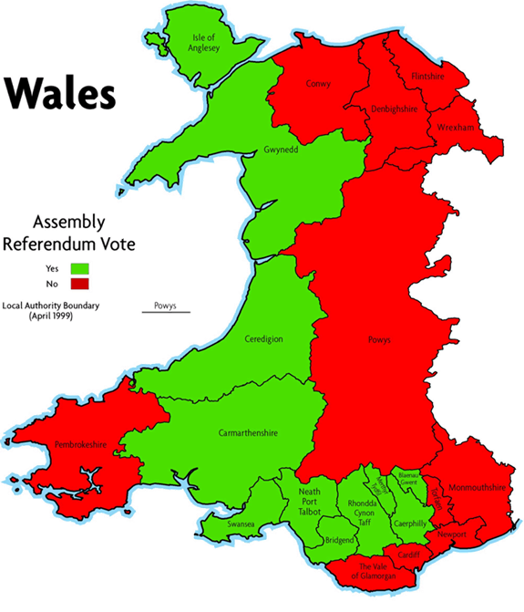
DEVOLUTION ACHIEVED
Labour government elected in 1997 on a manifesto commitment to establish a Scottish Parliament and a Welsh Assembly;
1997 referendum resulted in a narrow majority (50.3% / 49.7%) in favour of an Assembly.

Slide 5
DEVOLUTION UNDER THE 1998 ACT
An Assembly of 60 elected members (elections: 1999, 2003, 2007, 2011 and 2016).
The Assembly was a corporate body.
No separation between Government and Legislature.
The Assembly had to exercise all functions collectively or delegate them to Ministers.
The Assembly had no powers to make primary legislation.
But, it had power to:
make policy;
give grants;
make subordinate legislation.

Slide 6
SEPARATION OF POWERS – 2006 ACT
‘Old’ National Assembly for Wales
‘New’ National Assembly for Wales Legislature Has its own staff (who are not civil servants) Tŷ Hywel
Welsh Government Powers to make policy Powers to spend Secondary Legislative Powers Staffed by civil servants Cathays Park

Slide 7
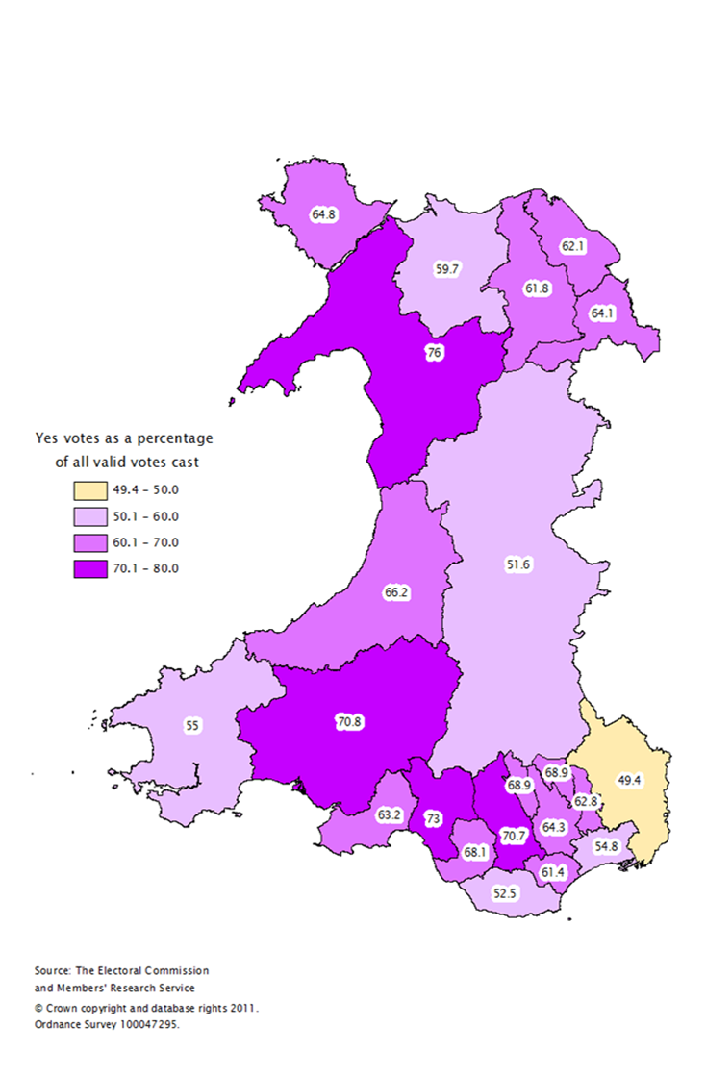
DEVOLUTION 2007-11
In the One Wales coalition agreement on 27 June 2007 the Wales Labour Party and Plaid Cymru made the commitment "to proceed to a successful outcome of a referendum for full law-making powers under Part IV of the Government of Wales Act 2006 as soon as practicable, at or before the end of the Assembly term".
The two parties agreed "in good faith to campaign for a successful outcome to such a referendum" and to set up an All-Wales Convention to prepare for such a successful outcome
“Do you want the Assembly now to be able to make laws on all matters in the 20 subjects areas it has powers over”
Yes= 63.5% No=36.5%

Slide 8
THE NATIONAL ASSEMBLY FOR WALES CAN PASS LAWS WITHIN 21 DEFINED ‘SUBJECTS’
Agriculture, fisheries, forestry and rural development
Ancient monuments and historic buildings
Culture
Economic development
Education and training
Environment
Fire and rescue services and promotion of fire safety
Food
Health and health services
Highways and transport
Housing
Local government
National Assembly for Wales
Public administration
Social welfare
Sport and recreation
Tourism
Devolved taxes
Town and country planning
Water and flood defence
Welsh language

Slide 9
RESPONSIBILITIES OF THE UK GOVERNMENT
Taxes and benefits
Immigration
Defence
TV and broadcasting
The criminal justice system
Foreign policy
Nuclear energy
Large energy-producing plants
Abortion, human fertilisation and embryology
Control and safety of medicines
Vivisection (animal testing)

Slide 10
THE ASSEMBLY’S LEGISLATIVE COMPETENCE (SINCE 5 MAY 2011)
The Assembly can make primary legislation (Acts of the Assembly).
The Welsh Ministers retain their powers to make secondary legislation.
The UK Parliament retains its power to make law for Wales.
The National Assembly for Wales (Official Languages) Act 2012 became law in Wales on 12 November 2012.

Slide 11
THE EVOLUTION OF DEVOLUTION THE COMMISSION ON DEVOLUTION IN WALES (“THE SILK COMMISSION” – 2011-14)
Considered how to finance devolved government in Wales (Part 1 report) and the powers of the Assembly (Part 2 report).
Recommended a move to a “reserved powers” model of defining legislative competence (similar to Scotland and Northern Ireland);
Recommended devolution of powers in further, specific areas – notably, policing ( St David’s Day Agreement ,published Feb 2015)
Giving the Assembly control of its own name, size and method of election.

Slide 12
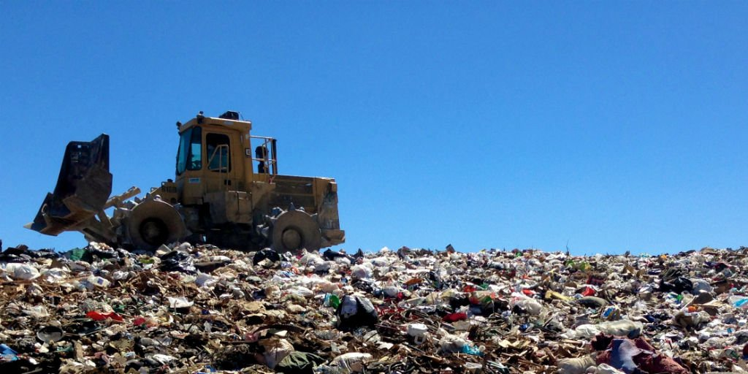
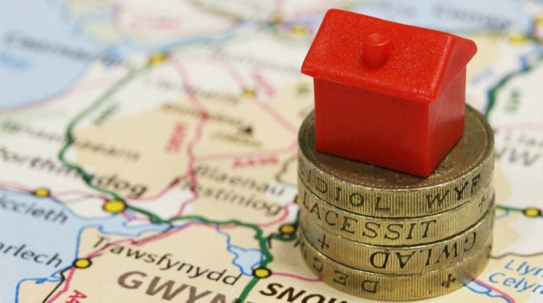
THE EVOLUTION OF DEVOLUTION THE WALES ACT 2014
The Wales Act 2014 turned these recommendations into law and the powers were devolved to the Assembly.
First tax-raising powers for Assembly (landfill and stamp duty).
From April 2018, control of stamp duty and landfill tax will pass to the Welsh Government, which is replacing them with a land transaction tax and a landfill disposals tax.

Slide 13
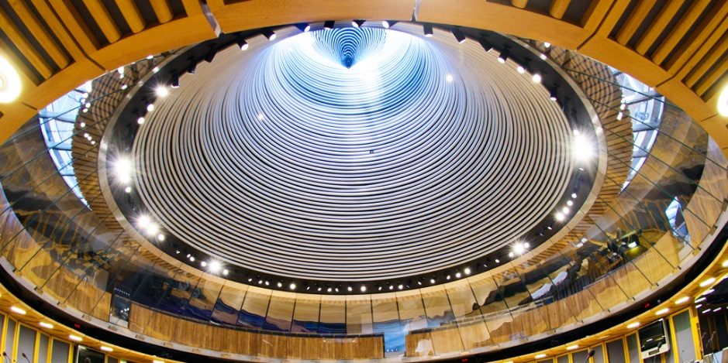
STRUCTURE
Welsh Labour 29 Assembly Members
Plaid Cymru 11 Assembly Members
Welsh Conservative 11 Assembly Members
UK Independence Party 6 Assembly Members
60 Assembly Members
40 First Past the Post (FPtP)
20 Additional Member System
12 Welsh Government
5 Commissioners
Welsh Liberal Democrats 1 Assembly Member
Independent 2 Assembly Members

Slide 14
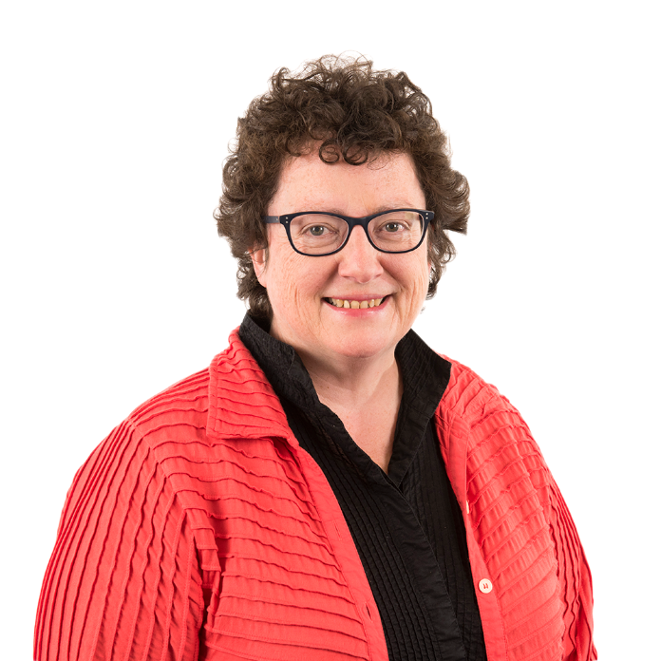
THE PRESIDING OFFICER – Y LLYWYDD
In the National Assembly for Wales, the Presiding Officer is known as the Llywydd. The Llywydd is the highest authority in the National Assembly.
The role of the Llywydd is our equivalent of the ‘Presiding Officer’ in the Scottish Parliament, or the ‘Speaker’ in the Northern Ireland Assembly and the UK Parliament.
The Llywydd chairs the Commission meeting; Business Committee and Plenary.
The Llywydd is supported in her role in chairing Plenary session by the Deputy Presiding Officer, Ann Jones.
Providing leadership on constitutional change issues; steering a Digital News and Information Taskforce and engaging with the people of Wales.
Elin Jones AM Llywydd, National Assembly for Wales
@yLlywydd

Slide 15
PLENARY CHAIR
Usually Presiding Officer or Deputy
Chair responsible for:
Ensuring business is handled fairly and impartially
Maintaining order
Discipline disorderly Members
Respond to Points of Order
Interpret Standing Orders
Conduct Votes

Slide 16
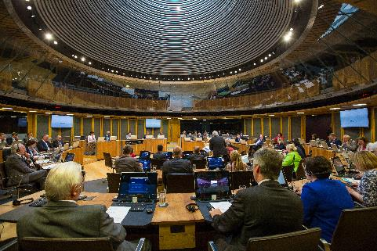
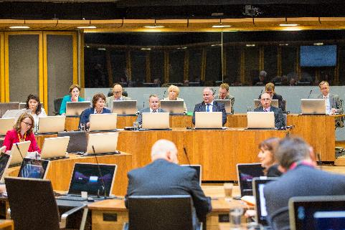
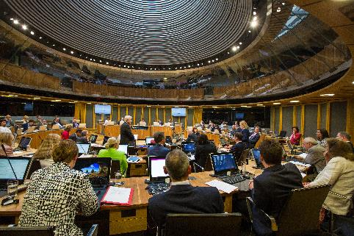
PLENARY : THE BASICS @SeneddChamber @SeneddSiambr #Senedd
Held in the Siambr and involve all AMs
Tuesday and Wednesday afternoons: 13.30 start
Two categories of business:
Government (3/5)
Assembly (2/5)
Business reflects representative, scrutiny and legislative functions

Slide 17
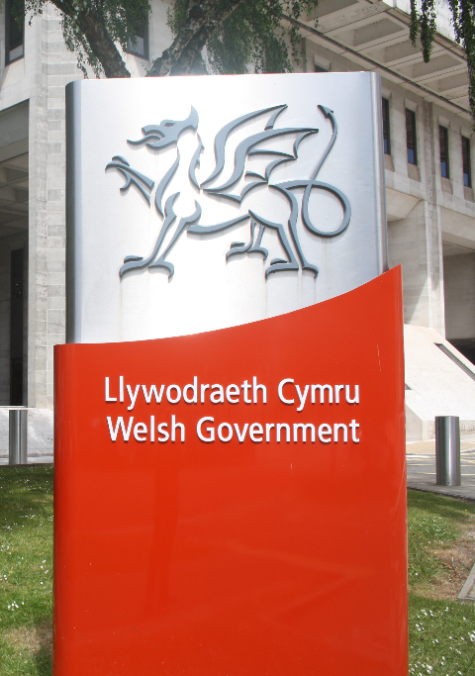
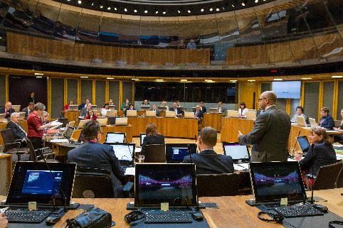
GOVERNMENT BUSINESS
Comprises 3/5 of Plenary Business
Normally Tuesday afternoons and first thing Wednesday
Types of Government business:
Oral Questions to Ministers
Statements (including Business Statement)
Debates
Government legislation

Slide 18
ASSEMBLY BUSINESS
Wednesday afternoons
TYPES OF BUSINESS INCLUDE:
Commission Questions
Commission / PO Statements
90 second statements
Opposition Debates
Committee Debates
Short Debates
Non-government Legislation
Individual Member Debate

Slide 19
LEGISLATION: PASSING ASSEMBLY ACTS
When an Assembly Act is proposed it is referred to as a Bill. A Bill is a draft law. There are 4 stages before a Bill becomes an Assembly Act.
A Bill can be proposed by :
Welsh Government Ministers (Government Bills);
Assembly Committee;
An individual Member (Ballot);
The Assembly Commission.

Slide 20
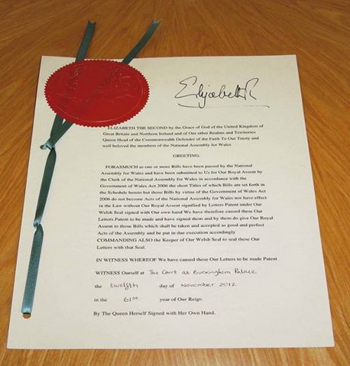
THE ROYAL SEAL
If the Bill is passed at Stage 4 it must be submitted for Royal Assent. Once a Bill has received Royal Assent, it becomes an Act of the Assembly.

Slide 21
COMMITTEE MEETINGS
There are 13 different Committees in the Assembly made up of Assembly Members from each political party.
Current Committees:
Children, Young People and Education
Climate Change, Environment and Rural Affairs
Culture, Welsh Language and Communications
Economy, Infrastructure and Skills
Equality, Local Government and Communities
Health, Social Care and Sport
External Affairs and Additional Legislation
Constitutional and Legislative Affairs
Finance
Public Accounts
Standards of Conduct
Scrutiny of the First Minister
Petitions

Slide 22
WALES ACT
The Wales Bill was introduced in the House of Commons on 7 June 2016.
The Wales Act 2017 received Royal Assent on 31 January 2017. The Act is the latest in a series of changes to the powers of the Assembly since its establishment.
The Wales Act 2017 will set out a new constitutional framework for Wales. It will change the devolution settlement from a conferred powers model to a reserved powers model. In a reserved powers model the Assembly can pass legislation provided it does not relate to a reserved matter (i.e. a matter which is reserved to the UK Parliament). The reserved powers model will come into effect on a day appointed by the Secretary of State for Wales—we anticipate that this will be in April 2018.
The Act will also give the Assembly powers to control its own electoral and internal operational arrangements, including the power to change its name, and determine the number of Members it needs.

Slide 23
ELECTORAL PANEL ON ELECTORAL REFORM
The Llywydd announced on 1 February 2017 that she has appointed an Expert Panel on Assembly Electoral Reform, to be chaired by Professor Laura McAllister.
The role of the Expert Panel is to make recommendations to the Assembly Commission by autumn 2017 on:
the number of Members the Assembly needs;
the most suitable electoral system to be used to elect them; and
the minimum voting age for Assembly elections.
The Commission intends to publish a draft Bill in spring 2018, before introducing any final Bill in autumn 2018.

Slide 24
ENGAGING WITH THE PEOPLE OF WALES
To establish a Youth Parliament for Wales
The Campaign for The Children and Young People's Assembly for Wales consultation report handover.
Commission will now use findings and work with key organisations and young people to create this new body

Slide 25
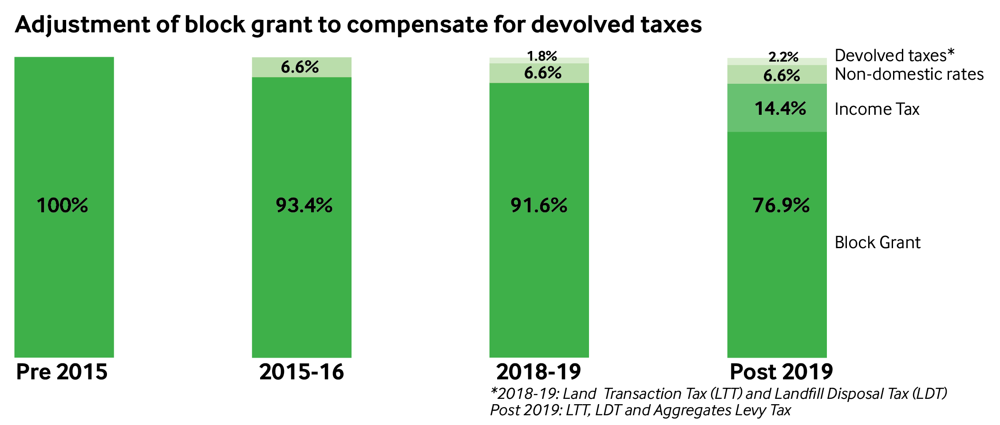
FURTHER DEVOLUTION OF TAXATION POWERS
What taxes are being devolved?
Income tax rates in Wales could be varied from April 2019 as part of a deal with the UK Treasury.

Slide 26
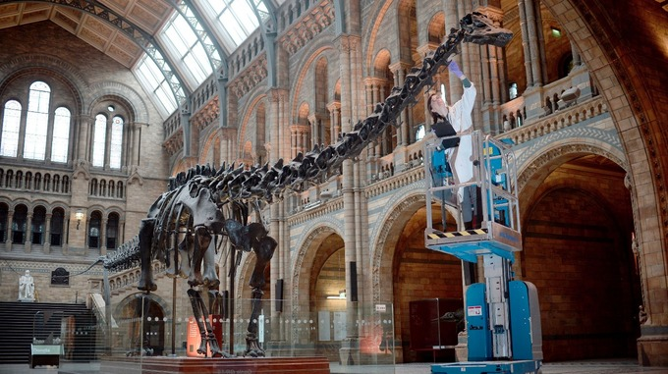
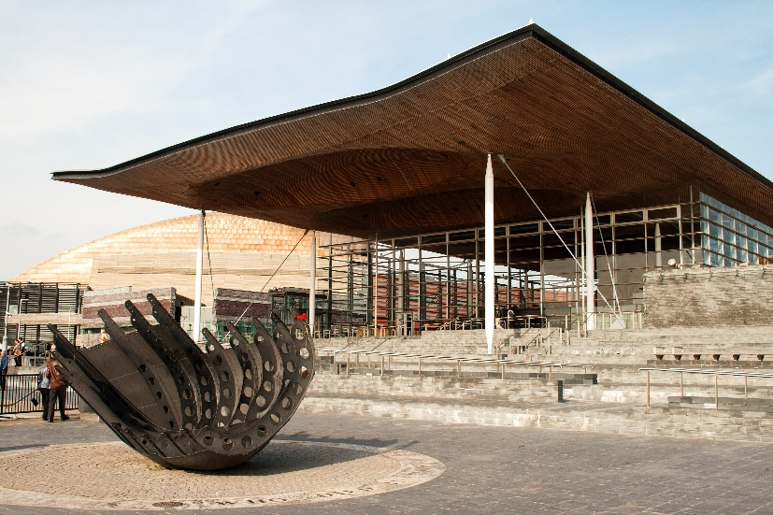
THE DIPPLODOCUS WILL VISIT THE SENEDD IN 2019!

