Slide 1
Community Challenge through the pandemic
Examples from centres

Slide 2
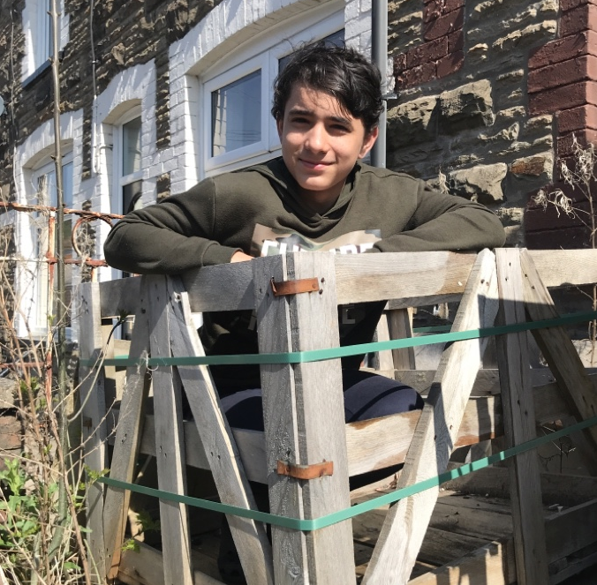
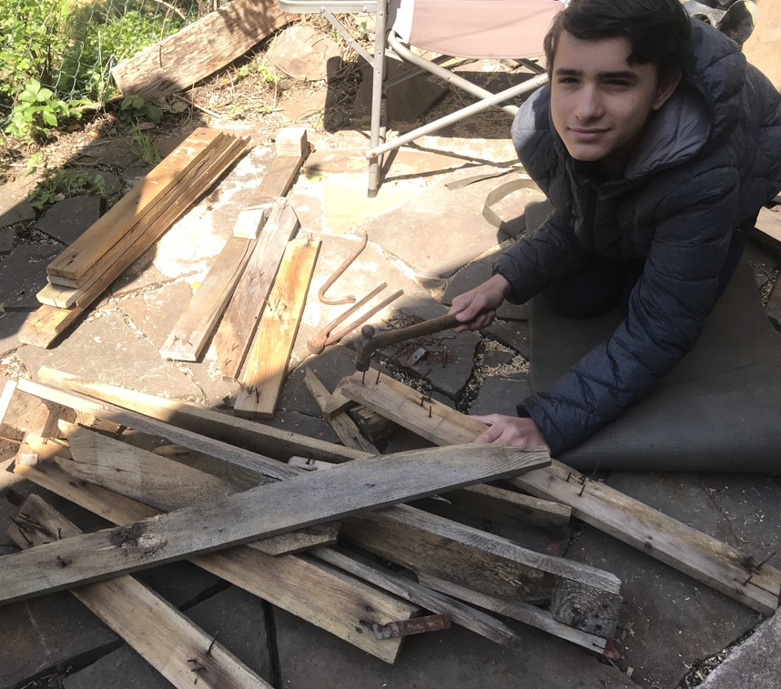
BEING SUSTAINABLE
Rio Roberts, a student at Idris Davies School in Rhymney, was in the middle of preparing for his Community Challenge when lockdown happened.
Being very community minded, Rio decided that he would continue to put the skills he had learnt to good use and considered how he could help the local neighbourhood during the difficult time.
Using an old pallet, he firstly decided to recycle the wood.

Slide 3
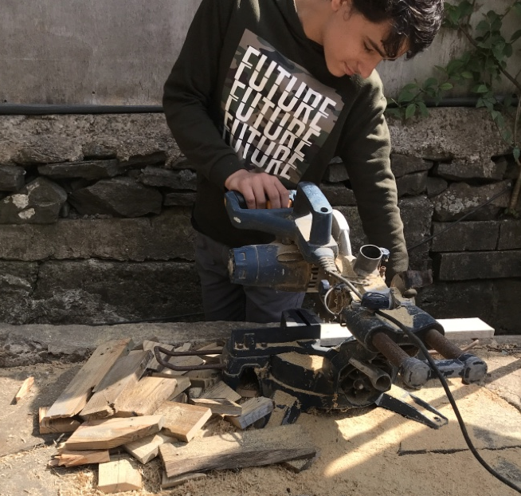
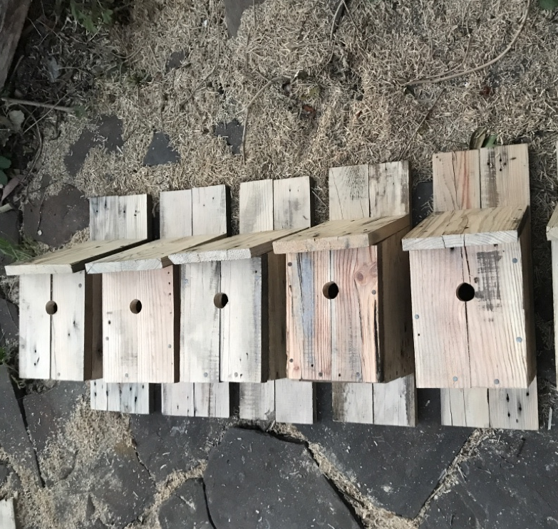
BIRD NESTING BOXES
When enjoying watching a wren forage for foliage to make a nest, the idea struck him that bird boxes would be a great thing to enhance the neighbourhood. In total he made 11 bird nesting boxes for his neighbours.
“I didn’t stop there”, Rio explains. “I produced a hand-written letter and information sheet to go with each box. It had information regarding how to place the box so that it would be most beneficial for the birds. I also included some facts about the type of birds that could be using the boxes in our community. My aim was to divert people’s minds away from potential loneliness and more towards learning and observing”

Slide 4
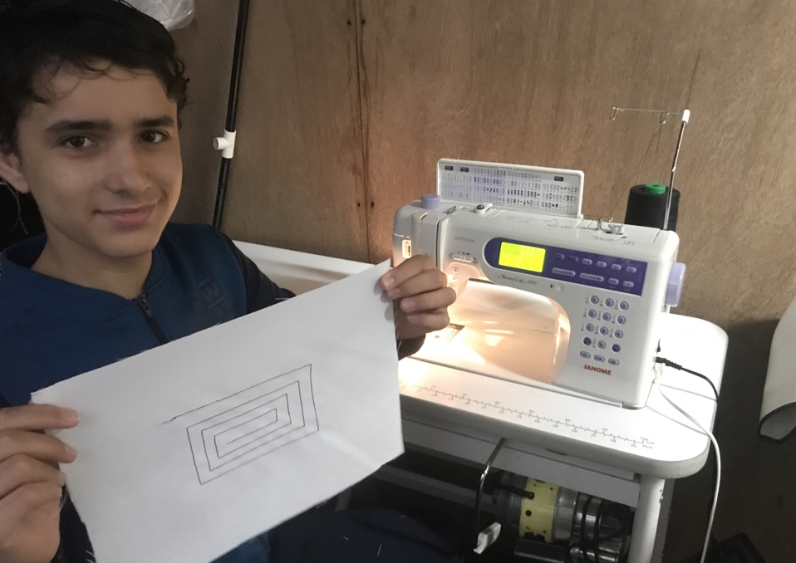
COMMUNITY WINNER
Rio’s community action has not gone unnoticed. He was First Give’s ‘Helping from Home’ Community Winner of the month. His nominated charity for the £200 prize was St. John’s Ambulance. Being a member of the St John’s Ambulance himself, the charity was an easy choice.
Having completed his bird boxes, Rio then turned his attention to another community action initiative which links strongly with his ambition to be a doctor, making scrubs!

Slide 5
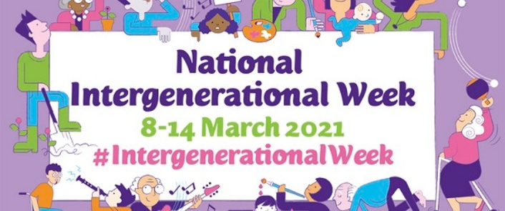
BRIDGING THE GENERATIONS
Staying at Idris Davies School, some of their Year 12 learners took part in Dementia Friends Awareness workshops last year before going on to hold sessions on dementia awareness in the local community and the school.
Working with the organisation Mobi-Game and the health board, one of the students has been able to support care home residents virtually for her Community Challenge.

Slide 6
BRIDGING THE GENERATIONS
Lexie Powell, a Yr. 13 student, had the opportunity to improve the physical health and wellbeing of care home residents last year during lockdown by delivering virtual sessions encouraging movement and stimuli.
Lexie's inspiration and work ethic impressed everyone involved in this initiative and as a result Mobi-Game offered her a paid internship – well done Lexie!
Lexi said, “Supporting the elderly community has been extremely rewarding. Not only have I experienced the residents' joy through the activities delivered, I have also been able to develop an array of skills of my own such as my communication, leadership and planning and organising by writing session plans and leading these sessions. I am able to use my creativity skills to ensure that the residents are entertained and having fun”.

Slide 7
BRIDGING THE GENERATIONS
“I am extremely proud of her achievements, and I am fully supportive of such collaborative partnerships, allowing our students to broaden their horizons, improve their skills and strengthen their opportunities”. - Mrs Sheen, Lexi’s teacher.
You can hear more from Lexie and Mrs Sheen in the Bridging
the Generations Podcast that they took part in recently by clicking on the speaker icon below:

Slide 8
SELF-SOURCED COMMUNITY PARTICIPATION
YSGOL GYFUN GŴYR
As a school during 2021 Ysgol Gyfun Gŵyr decided to implement the Community Challenge for Year 10 and 12.
In line with the amendments by WJEC and the restrictions in place, they decided to create a plan for completing the Community Challenge in 2021 that was realistic and accessible to all their learners.
Parents/guardians were very supportive.
Activities included- beach cleans, improving communal areas, creating and /or improving garden areas.
Based on the success of this model, the school has decided to continue with this model and structure for future cohorts!

Slide 9
2021 MODEL AND STRUCTURE
2- Introducing tasks
1- Letter to parents/guardians
Completion of tasks as usual following the adaptations to controls.
A copy of the first page of a “Neighbourhood Enhancement” brief was sent to parents.
A letter was sent to all parents/guardians with an overview of the requirements of the challenge, along with a summary of the advantage of the challenge to learners.
Parents/guardians were required to sign and return a slip stating that they were supporting the requirements. The slip also included an outline of the activity the learners had decided to complete.
Parents were encouraged to contact the school if they would like to discuss any potential ideas and opportunities.
The SCC teacher had to agree every application submitted.
3- Learners complete community participation
Emphasis was put on the importance of keeping evidence and a log.
Teachers monitored every fortnight how many hours had been completed.
4- Second letter to parents/guardians
Reminder letter sent.
Final deadline given.
Completion of
Community Challenge
5- Completion of hours
Learners return and create digital log of participation

Slide 10
HOW Neath Port Talbot college approached the Community Challenge DURING THE PANDEMIC
The college held training meetings to support staff in adapting their approaches to the Community Challenge so they could fit with the Government restrictions that were in place.
They held discreet training sessions solely for Community deliverers to explain the impact the pandemic would have on the different briefs.
The SCC Coordinator at the college devised new resources to accommodate online learning and altered existing resources to reflect these changes.

Slide 11
ADAPTING THE BRIEFS
Coaching & Tutoring – No going into schools or clubs – had to be completed virtually or with a family member, encouraged use of Zoom
Social Wellbeing – Had to be mindful of who they came into contact with and the current restrictions
Neighbourhood Enhancement – Again, had to be mindful of who they came into contact with and daily restrictions
Supporting a Charitable Organisation – Actively discouraged and this option was removed from resources

Slide 12
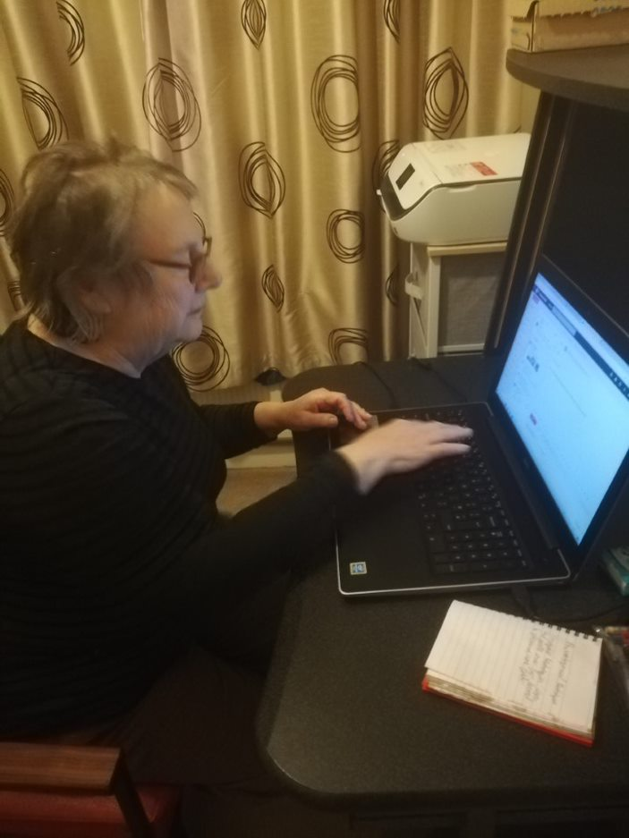
GRAN AND THE INTERNET
Who? One student chose to tutor his Grandmother on how to use her phone, computer and the internet.
What? He devised 30 lessons, covering a different area in each.
Why? His plan was so that his Gran would be able to use technology without ringing him all the time!

Slide 13
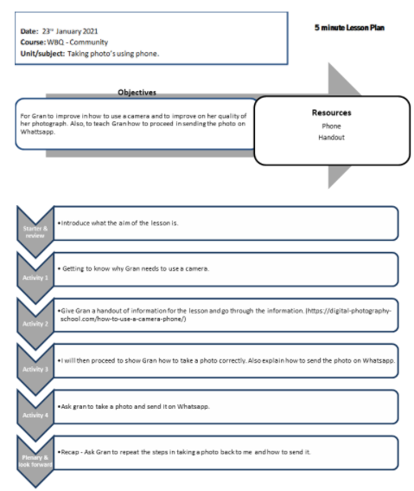
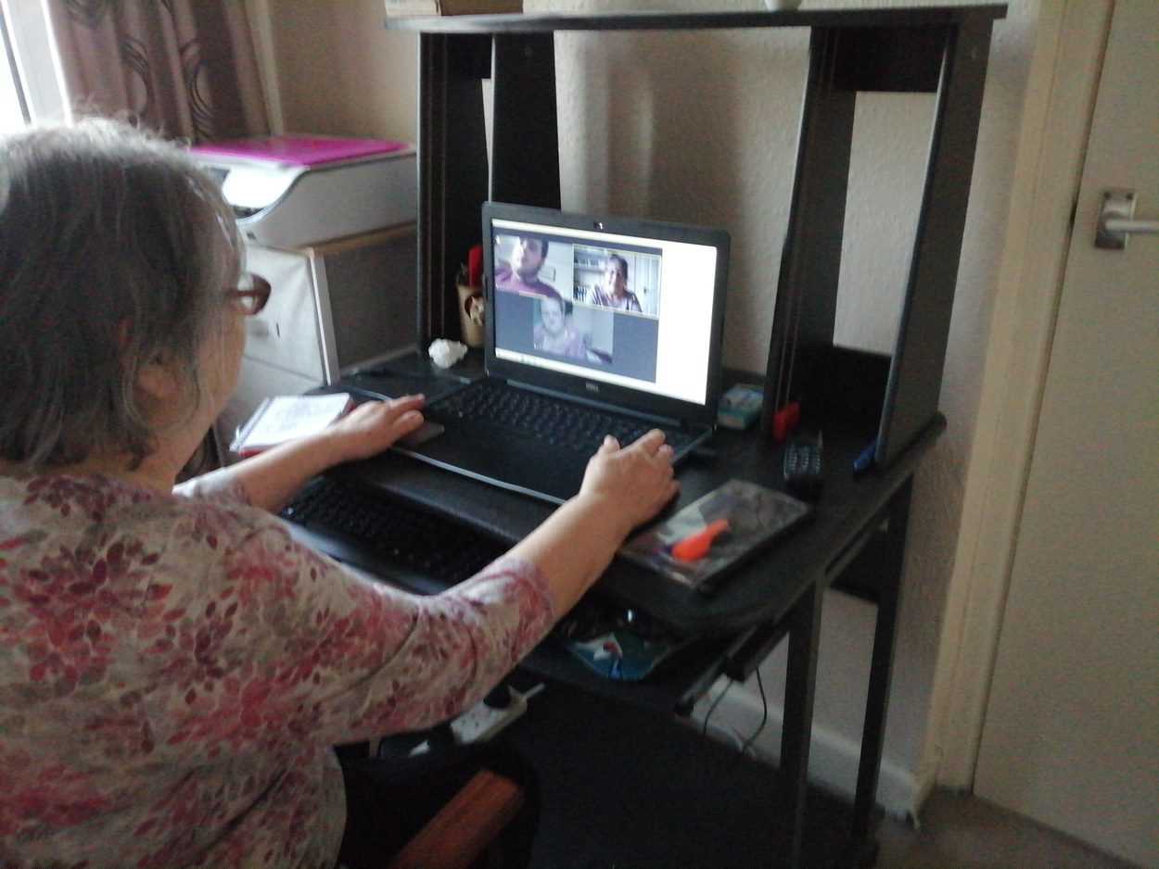
GRAN AND THE INTERNET
Where? They did this from home. His Gran was in his contact bubble at the time which allowed him to see her.
When? They had 26 lessons from October – February.

Slide 14
Using TikTok to Support Revision
Who?
One Sixth Form student chose to support a revision group & wider audience via TikTok videos.
What?
She posted wellbeing and revision videos on the social media platform to help students revise and keep busy during lockdown. She created free revision & time management sheets linked on her account, along with a questionnaire to get feedback on the videos.
Why?
She was inspired by Joe Wicks teaching PE lessons online to children and wanted to do the same to help with revision techniques/to help anyone feeling bored during lockdown.

Slide 15
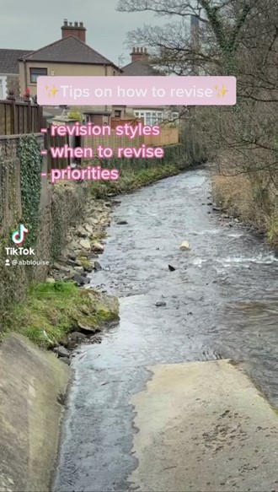
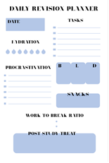
Using TikTok to Support Revision
Where?
This was all completed from her own home, so complied with lockdown rules. Sometimes she used videos from her daily walks.
When?
Every Friday for 3 hours for 10 weeks in a row, she filmed, edited, and uploaded videos for TikTok & then collated any responses.

Slide 16
Mindfulness, Wellbeing and Yoga Zoom Sessions
Who?
Another student decided to host mindfulness and wellbeing Zoom meetings.
What?
A two hour Zoom session that consisted of managing stress, practicing mindfulness, discussing wellbeing and practicing yoga.

Slide 17
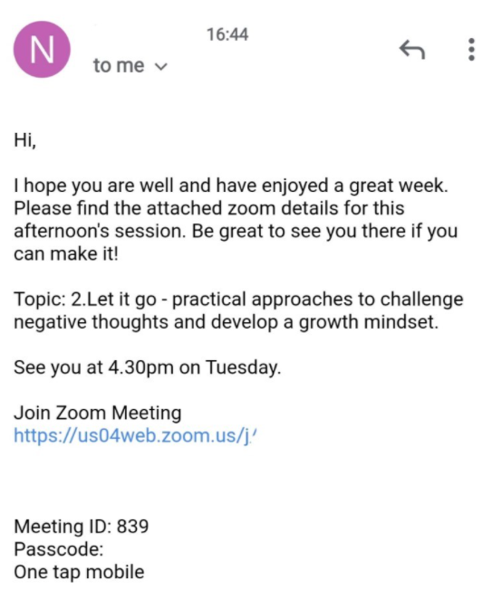
Mindfulness, Wellbeing and Yoga Zoom Sessions
Why?
This student had previous work experience with the charity MIND, where she had held similar sessions in person and so was able to discuss her ideas with the staff there. She chose to deliver these online as she thought it would be helpful to others during the pandemic.
Where?
These sessions were delivered from her own home.
When? 2-hour sessions a week for 15 weeks.

