Slide 1
LEVEL 3 FOOD SCIENCE & NUTRITION PRACTICAL SKILLS

Slide 2
Please note: In order for a dish to be considered HIGH SKILL, not only should the skills demonstrated reflect the high skill criteria, but the practical work should also be conducted in a HIGHLY SKILLED manner. The working practices of the learner should be exemplary, and the finished presentation and flavour balance of the finished dish/es should be done to a high standard.

Slide 3
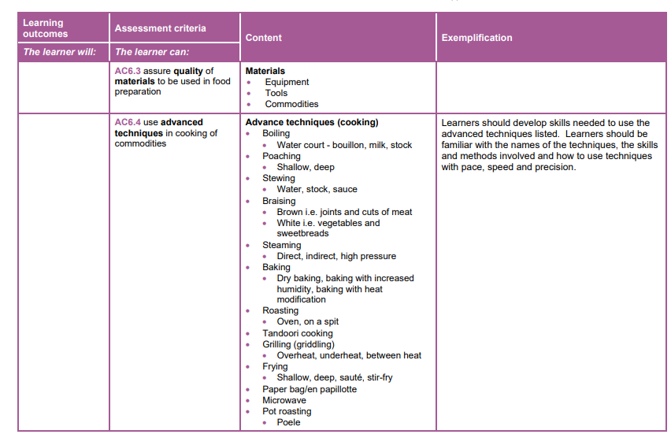
Specification p20-22
These are the skills and techniques needed for Level 3, building on and developing the learner’s skills from GCSE or Level 1/2

Slide 4
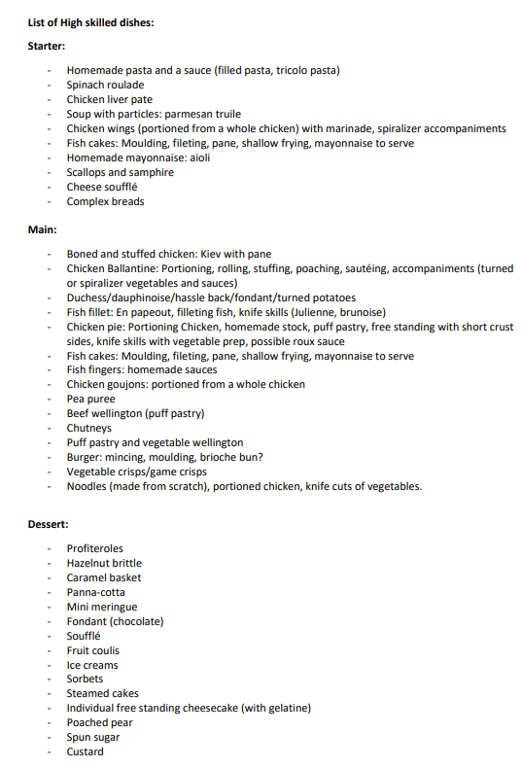
Suggestions from open website

Slide 5
Text book
Excellent resource for the Certificate course.
Assessment Criteria | Title | Page number
AC 6.1 | Use of tools in the preparation of commodities | P194 - 211
AC 6.2 | Advanced techniques in commodity preparation | P212 - 221
AC 6.3 | Quality assurance | P222 - 233
AC 6.4 | Advanced cooking techniques | P234 - 245
AC 6.5 | Advanced presentation techniques | P246 - 257
Recipes p258 - 279

Slide 6
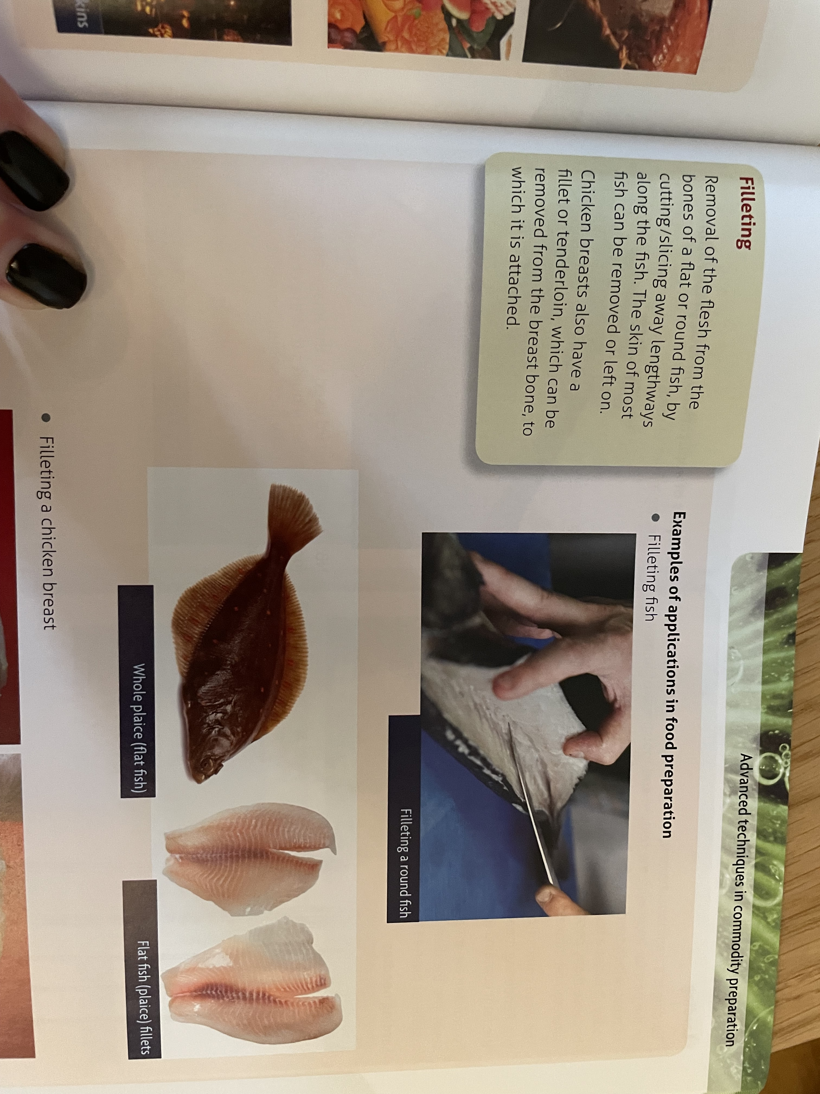
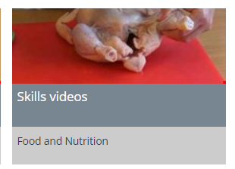
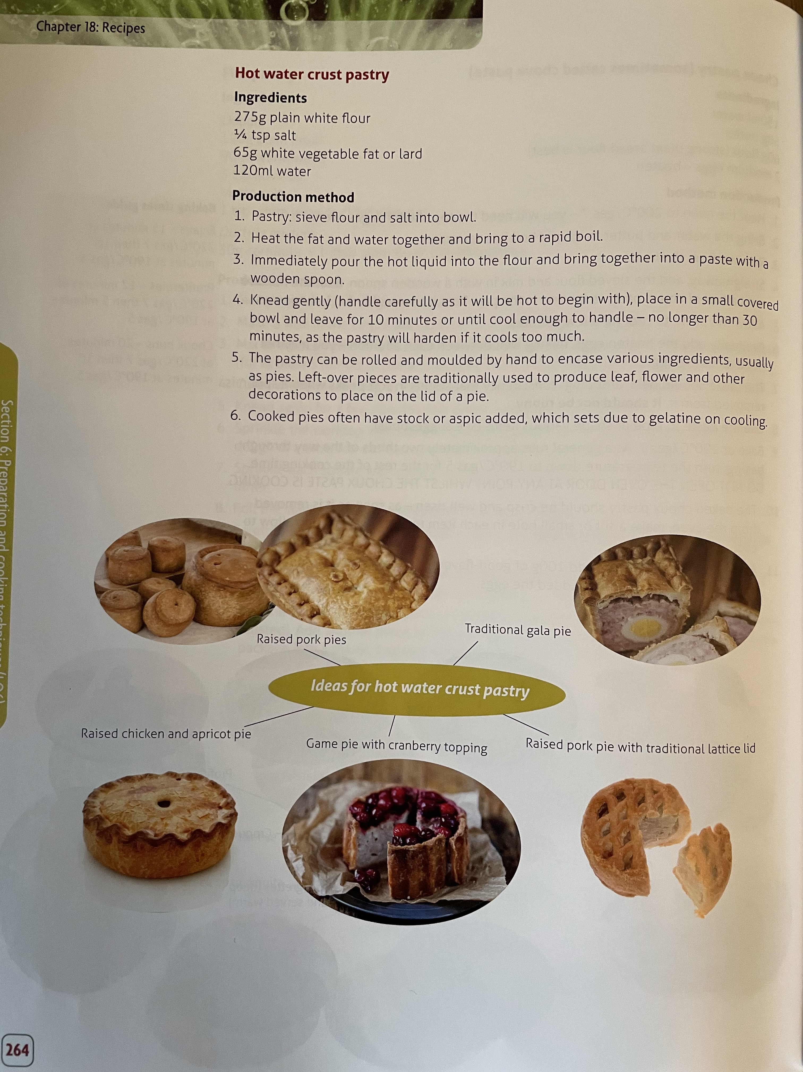
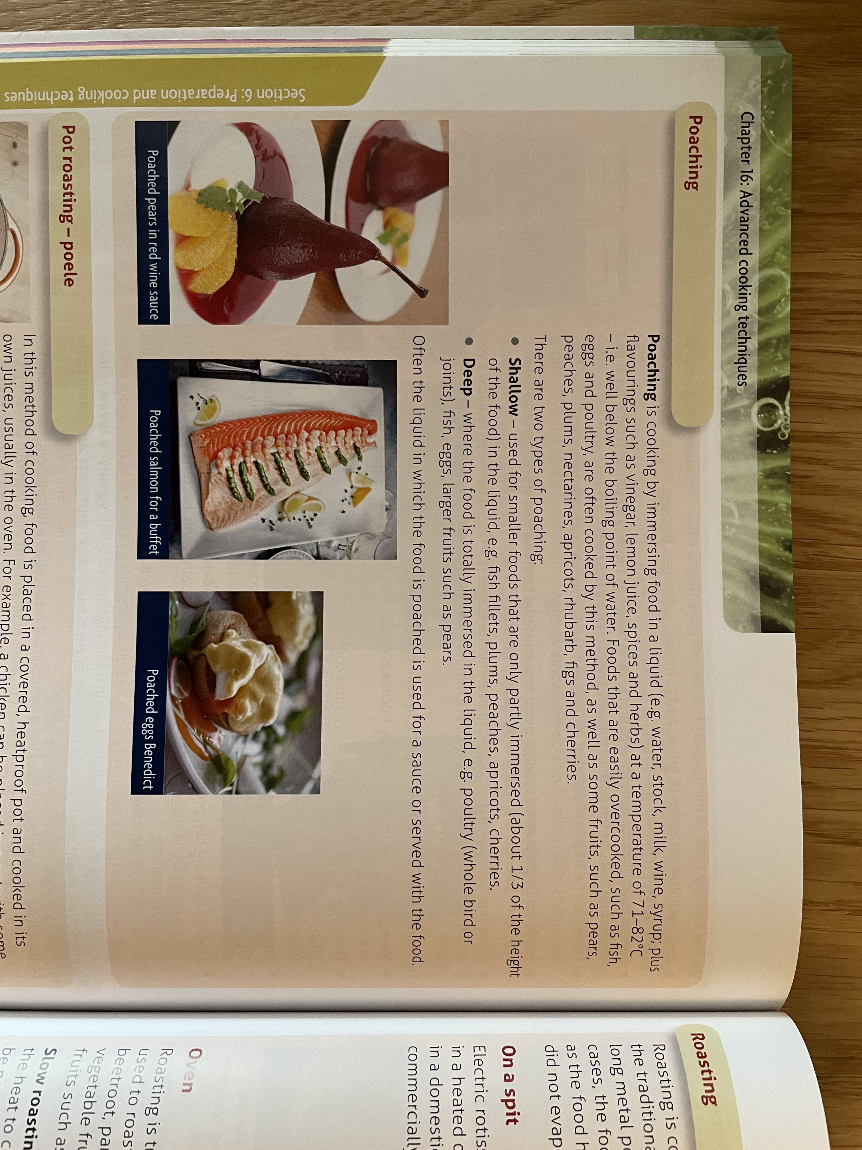
Recipe
AC 6.2
Don’t forget the skills videos on the open website/resources
AC 6.4

Slide 7
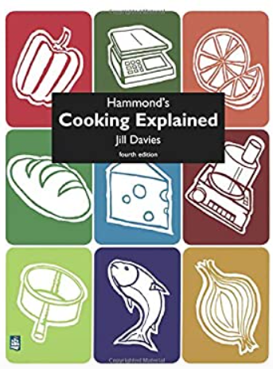
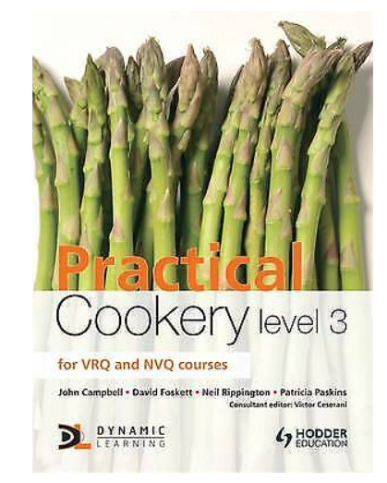
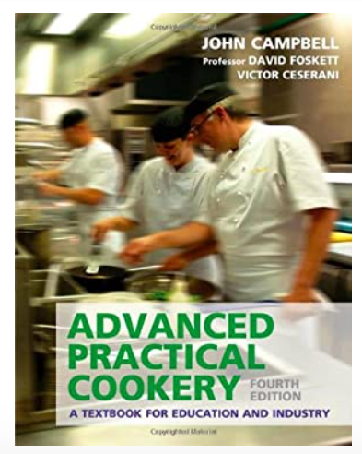
Books

Slide 8
Build up a recipe bank/record book
You may find it useful to develop a Record Book (like a Portfolio) so that learners can keep a record of all their practical tasks – as the course develops this will be a useful reference document to remind them of the skills they have demonstrated plus photographic images of their final dishes.

Slide 9
Preparation techniques:
blending*
beating*
creaming**
crimping***
dehydrating**
folding**
Grating*
hydrating *
juicing*
kneading**
laminating (pastry )***
marinating*
mashing *
measuring**
melting*
melting using bain -marie***
mixing**
piping***
proving*
puréeing**
rub-in**
rolling **
shaping***
shredding*
sieving*
skinning**
tenderising *
toasting(nuts/seeds) **
unmoulding***
weighing**
whisking(aeration)***
zesting*
Knife techniques:
chopping*
bâton**
chiffonade**
brunoise***
dicing**
julienne***
mincing***
slicing**
deboning***
deseeding**
filleting***
peeling*
segmenting***
spatchcock**
trimming*
Cooking techniques:
basting*
baking**
baking blind***
blanching**
boiling*
braising**
caramelising***
chilling*
cooling*
deep fat frying***
deglazing**
dehydrating*
emulsifying***
freezing*
frying**
griddling**
grilling*
pickling**
poaching***
reduction**
roasting**
sautéing**
setting**
skimming*
steaming**
stir-frying**
tempering***
toasting*
water-bath (sous-vide) **
The preparation and cooking techniques are categorised as follows:
Low* Medium** High***
Ready-made/prepared components used in the preparation and cooking of dishes are all classed as basic.
REMEMBER:
In order for a dish to be considered HIGH SKILL, not only should the skills demonstrated reflect the high skill criteria, but the practical work should also be conducted in a HIGHLY SKILLED manner.

Slide 10
Basic/Low: Making fishcakes with readymade produce: tinned fish/ready filleted fish, boiling and mashing potato, purchased breadcrumbs and salad with homemade vinaigrette.
Medium: Making fishcakes with homemade breadcrumbs, pre -filleted fish that needs skinning, boiling and mashing potato, shaping the fishcakes into different shapes and served with a homemade mayonnaise served with a salad demonstrating a range of knife skills
High/Complex: fish that requires filleting, homemade breadcrumbs, pané, boiling and mashing potato containing vegetables using a range of knife skills, hollandaise sauce or similar level served with stacked vegetables, demonstrating a range of knife and cooking techniques along with wedges/chips that are deep fat fried.
FISH CAKES:
A good example of how one dish can be prepared using high level skills compared to low and medium level skills.
REMEMBER:
we are looking for advanced preparation, cooking and presenting skills.

Slide 11
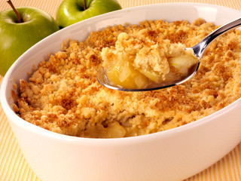
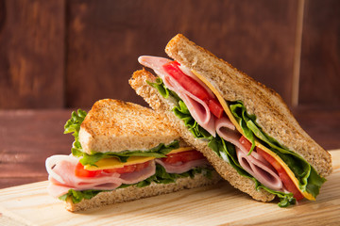
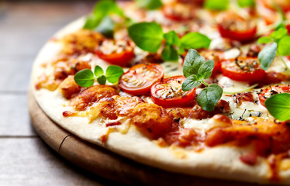
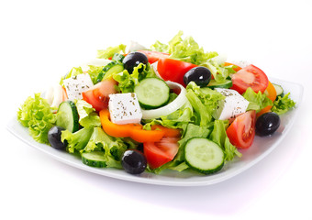
Examples of dishes that demonstrate low level skills:
• crumbles
• sandwiches
• pizza with ready-made bases
• simple salads.

Slide 12
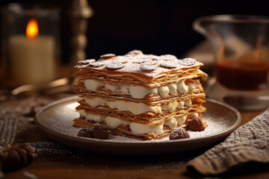
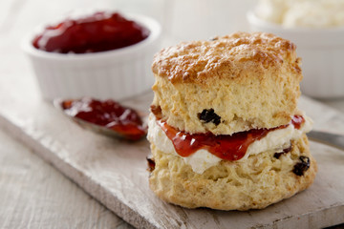
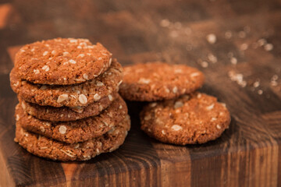
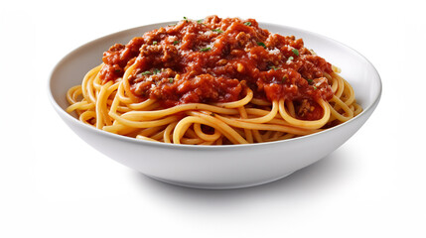
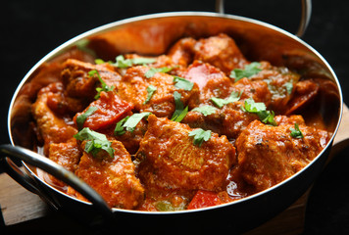
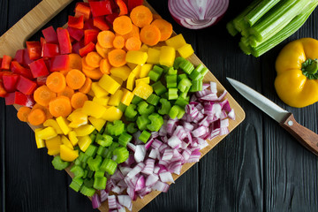
Examples of dishes that demonstrate low to medium level skills.
• readymade pastry items assembly e.g. mille feuilles
• fruit and vegetable dishes that require even sizes
• simple cakes, cookies, scones, undecorated
• pre-cut meat products or simple meat dishes such as curry, bolognaise with homemade sauce

Slide 13
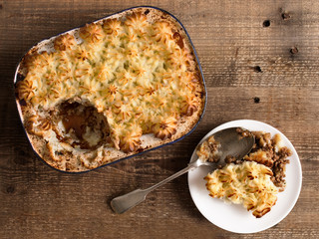
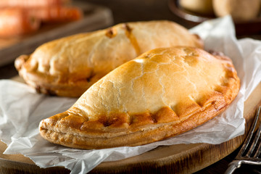
Examples of dishes that demonstrate medium level skills:
• cheesecakes, homemade ice cream
• simple sauces— e.g., red wine sauce
• decorated cakes and genoise sponge
• homemade short crust pastry products
• piped potato dishes, e.g., duchess, croquette, shepherd’s pie.

Slide 14
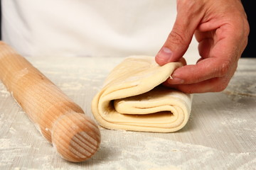
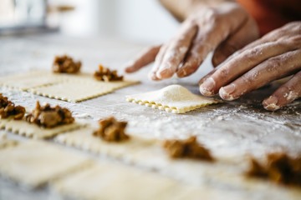
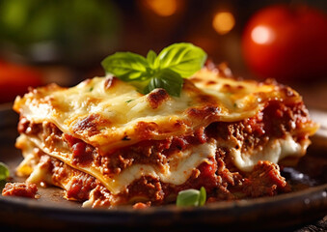
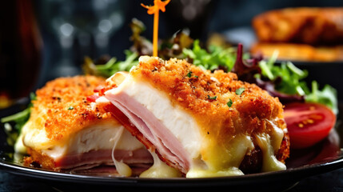
Examples of dishes that demonstrate medium to high level skills:
• cheesecakes—gelatine, baked panna cotta
• rich yeast doughs
• 1 or 2 complex accompaniments/garnishes
• choux buns, homemade puff pastry
• tiramisu with homemade sponge
• homemade pasta dishes
• roux based sauces
• lyonnaise, dauphinoise potatoes
• meat and fish dishes that require changing the shape of the meat e.g. chicken kiev.

Slide 15
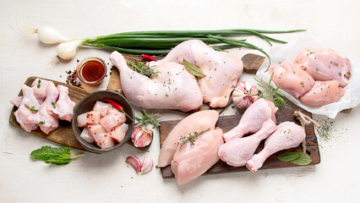
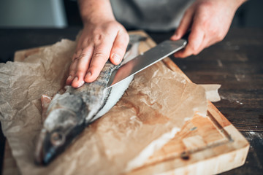
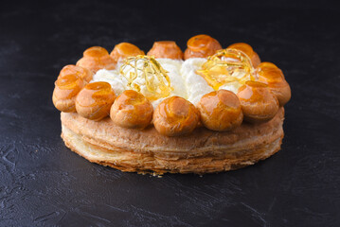
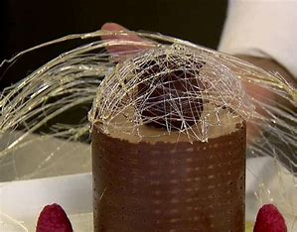
Examples of dishes that demonstrate high level skills:
• de-boning/ portioning chicken
• filleting fish
• 3 to 4 complex accompaniments/ garnish
• 2 or more high skills to make one product e.g. gateau St. Honore
• exemplary presentation of dishes —clean neat presentation
• chocolate run outs, spun sugar for decorated cakes. Accurate piping skills.

Slide 16
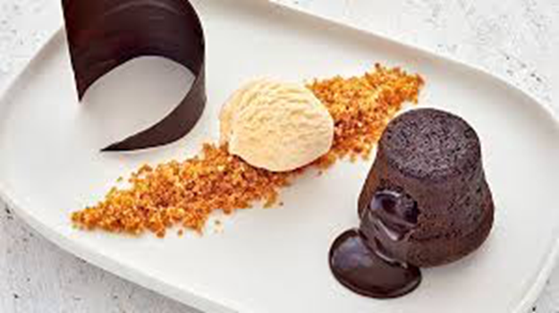
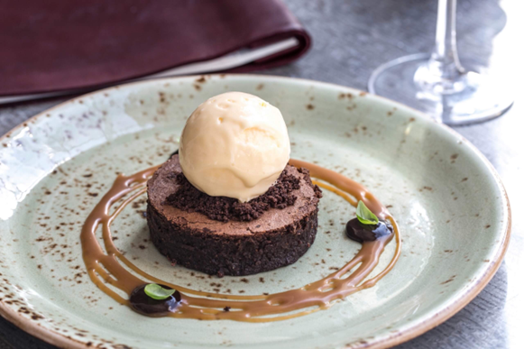
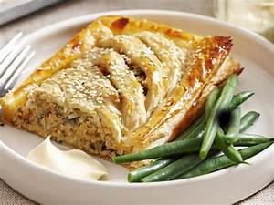
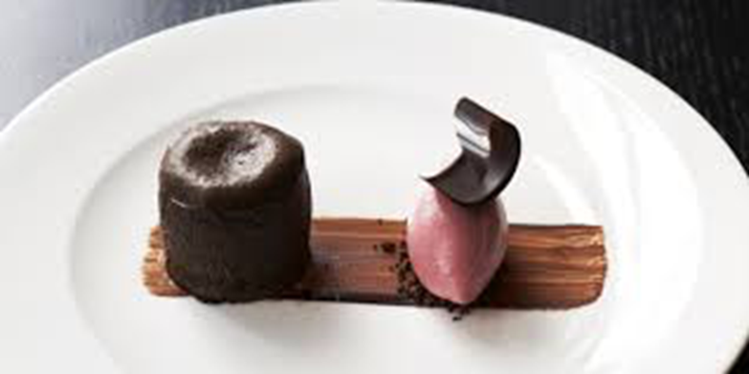
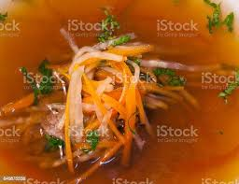
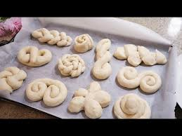
Suggestions…
Poached salmon jalousie – filleting fish, puff pastry, poaching, spinach and cream cheese sauce, hollandaise sauce, spiral vegetables.
Chocolate fondant, chocolate soil, tempered chocolate, salted caramel sauce, toffee work, Ice cream, fruit coulis
Consommé, julienne vegetables, shaped bread.
Think: How many advanced high level skills and techniques can I fit into the 3 course menu?
3½ Hours

Slide 17
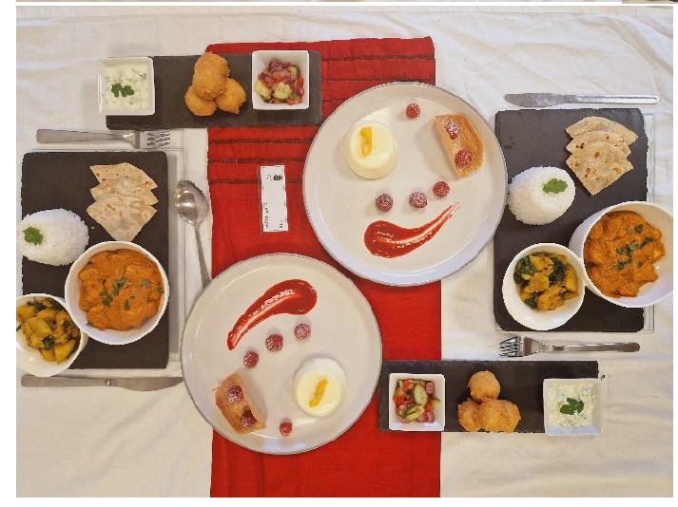
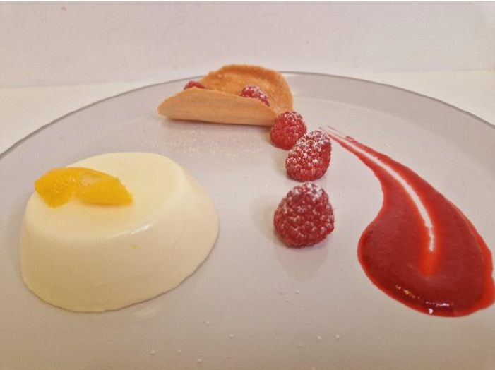
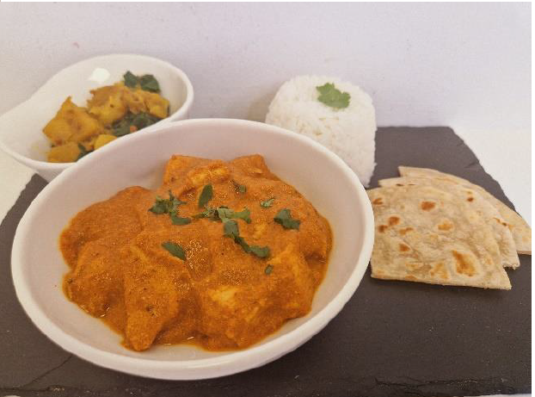
The College brief
Examples from this Summers’ cohort.

Slide 18
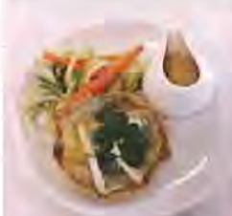
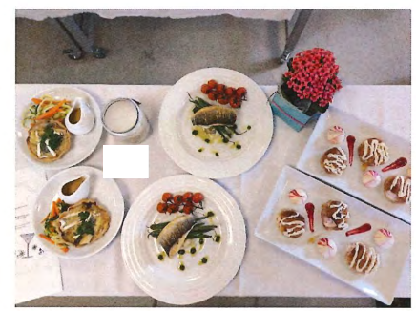
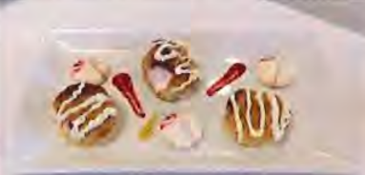
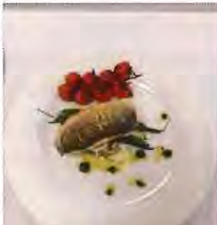
Spa brief

Slide 19
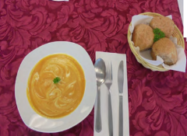
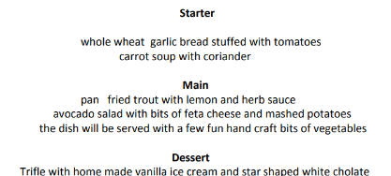
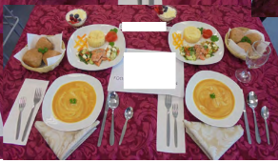
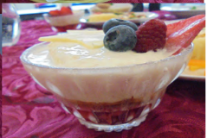
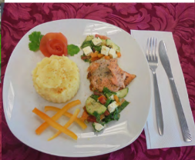
Children’s menu

Slide 20
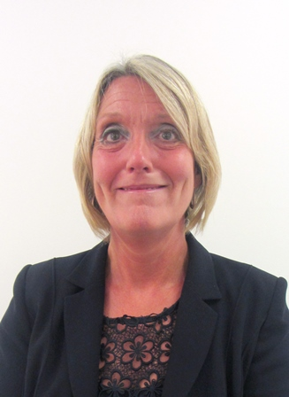
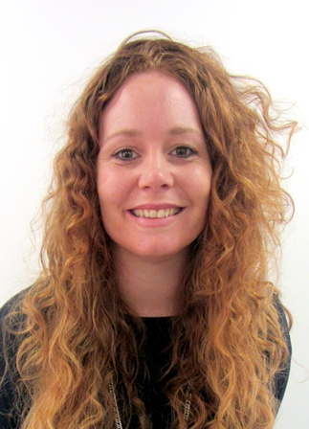
Diolch/Thank you
CONTACTS:
Contact our specialist Subject Officer and administrative support team with any queries.
Allison Candy - Subject Officer
food@wjec.co.uk
Gemma Edwards - Subject Support Officer
food@wjec.co.uk
Sian Williams – Subject Adviser
food@wjec.co.uk

