Slide 1
WJEC Level 3 Food Science and Nutrition WORK SMARTER NOT HARDER – UNIT 3 INVESTIGATION Pre-recorded Professional Learning: Autumn 2023
Notes:
Welcome to this Pre-recorded Professional Learning resource for teachers of WJEC Level 3 Food Science and Nutrition. The aim of the resource is to help you to prepare yourself and your learners to complete Unit 3 – Experimenting to solve Food production Problems. We’ll consider how to best achieve the required scientific results needed to complete the investigation. The aim of this resource is to make you work smarter and not harder.
I am Sian Williams, Subject Adviser for this qualification. My role is to offer support to your Professional learning and to assist you in delivering the best outcomes for your learners.

Slide 2
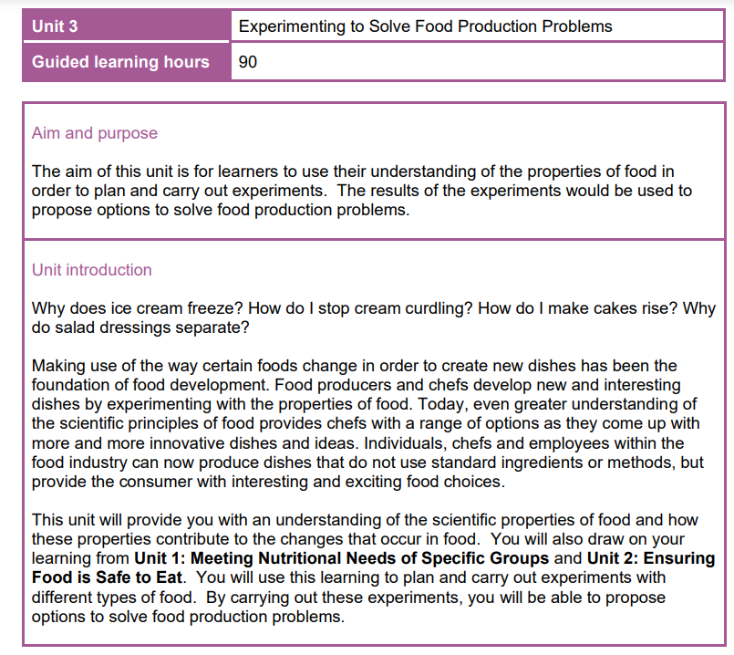
THINKING OUTSIDE THE BOX
UNIT 3
Experimenting to solve food production problems:
How to “work smarter and not harder”
Notes:
You need to start thinking outside the box. This investigation is available on the secure WJEC website now. The tasks do not change. You can give the choice to your learners, or you can choose for your class.

Slide 3
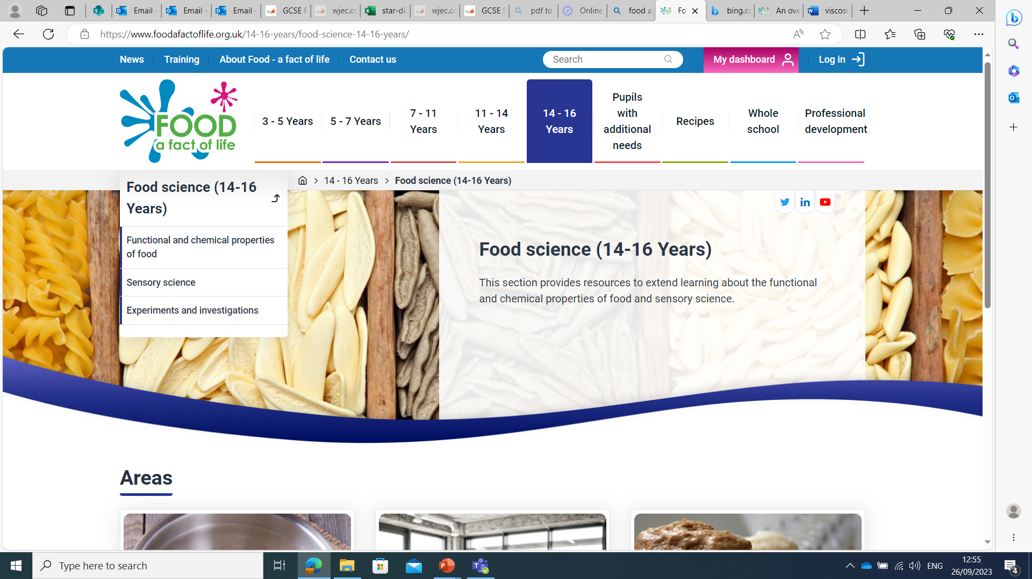
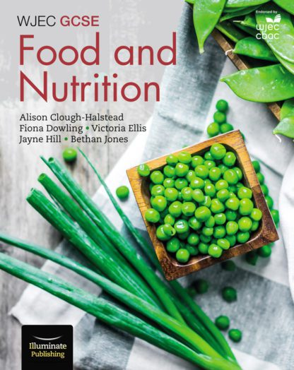
WHERE TO START?......
There are mini food science experiments in the Illuminate text books, and lots of resources on the Food a fact of life website. Don’t forget the exemplars on the WJEC secure website.
WJEC GCSE Food and Nutrition - Student Book - Illuminate Publishing
Food science (14-16 Years) - Food A Fact Of Life
Notes:
Not sure where to start? You may have taught Food and Nutrition for GCSE, so you have small head start, but if you have delivered Hospitality and Catering – then not so much. There are numerous free resources on the Food a fact of life website. The illuminate GCSE text book has lots of mini experiments at the end of each commodity. Remember there are plenty of exemplars on the WJEC secure website.

Slide 4
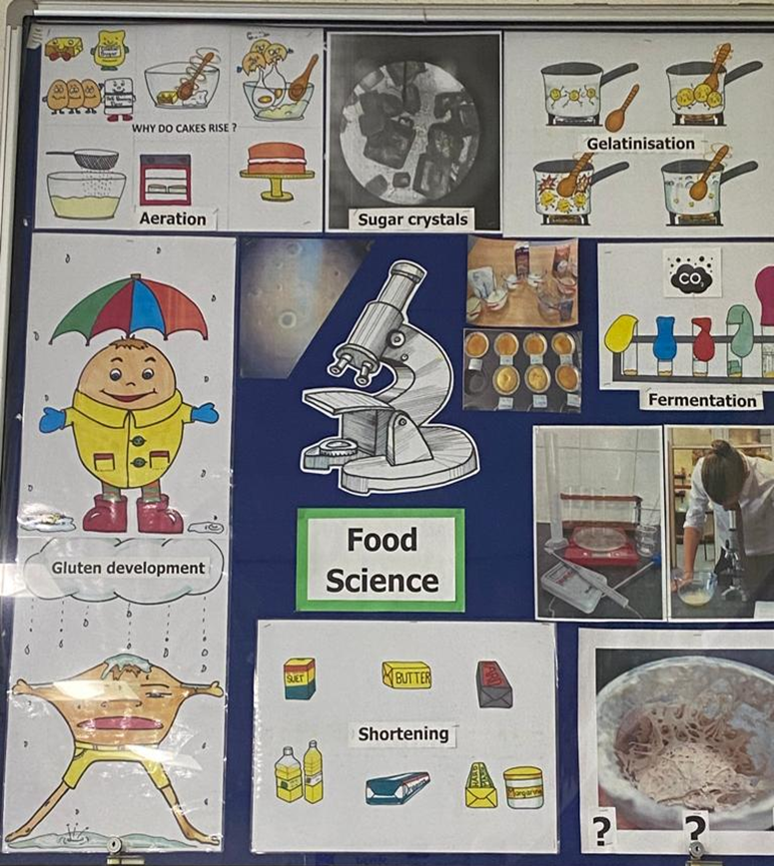
GET THE CONTENT DONE BY THE END OF YEAR 12.
Ideally, all the teaching for this is done as an integral part of the commodities and practicals in Year 12. Many centres start this unit at the beginning of Year 13, with the aim to finish in the Spring term, giving you time to prepare learners for Unit 2 external examination in May.
Classroom display boards
Notes:
Ensure that content & how to record scientific investigations are taught before learners embark on their chosen/allocated summative investigation. Remember that once learners start their investigation it should be their own work, not teacher led. When you are delivering the content – DON’T FORGET THE SCIENCE. Teach the science with every commodity, every practical - don’t leave it. Your class is making Lasagne – so teach gelatinization of starch. Could the class make bread one week, and then get everyone to adapt this recipe, changing a variable in the next lesson – smaller quantities with school ingredients. Do a group evaluation of tasting and testing, showing different methods of displaying their results. What about making a classroom display on scientific investigative methods/terminology
. Make it an integral part of your classroom. Teach adapting recipes with every practical. What ingredients e.g fats, sugar or flour could be adapted?

Slide 5
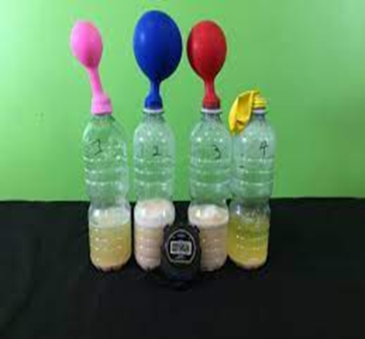
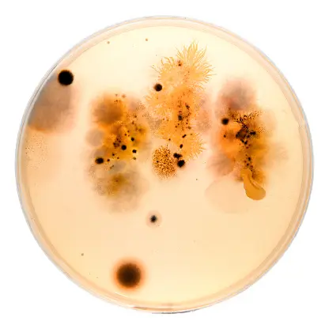
MAKE THE SCIENCE DEPARTMENT TECHNICIAN YOUR NEW BEST FRIEND!
OR DIY!!
Specialist equipment is expensive. Science have plenty. They also have expertise and advice.
Notes:
Make the Science department technician you new best friend – in fact learn to love the whole department. They have so much fabulous specialist equipment that you probably don’t have. This equipment is expensive. They have expertise and experience. You can DIY some equipment, but go to them first.

Slide 6
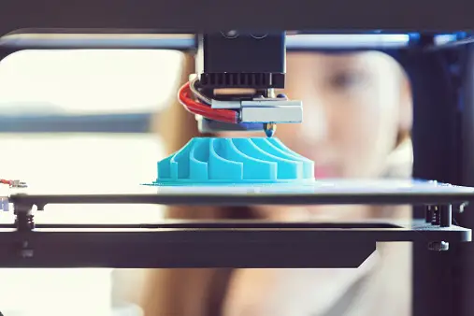
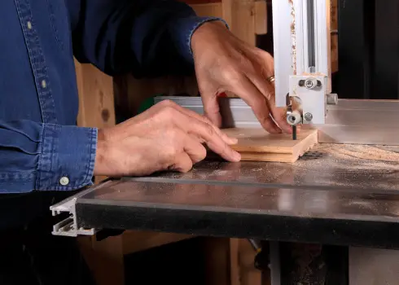
REMEMBER YOUR NEIGHBOURS THE DT DEPARTMENT…….
LASER CUTTER
3D PRINTER
BAND SAW
They can make, cut, adapt many things for you, cheaply!!
Notes:
Don’t forget your neighbours – the DT department. They have laser cutters, 3D printers and Band saws. They can make moulds, shaped cutters, depth guides for rolling out. Go to them early in the term, so that they can start helping you put equipment together for your class box.

Slide 7
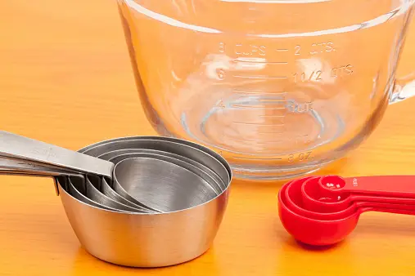
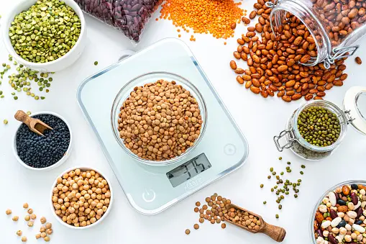
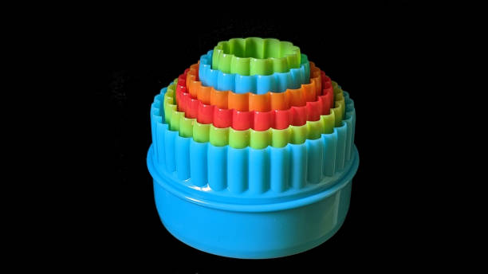
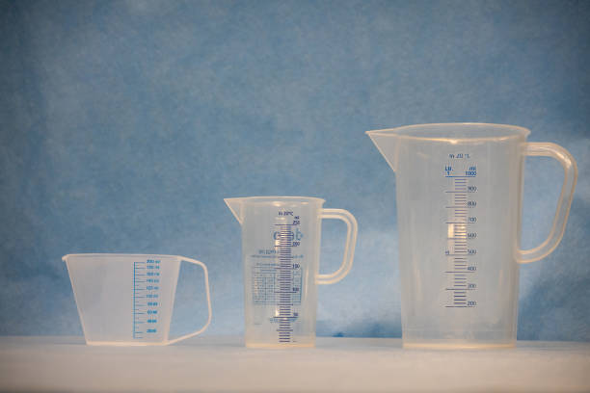
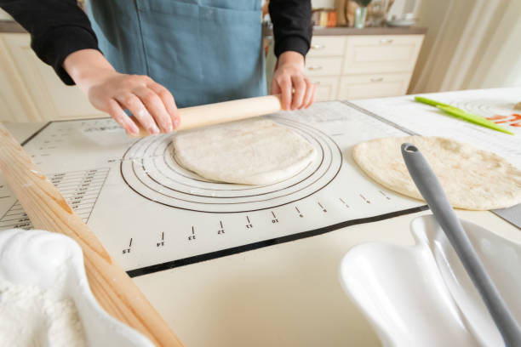
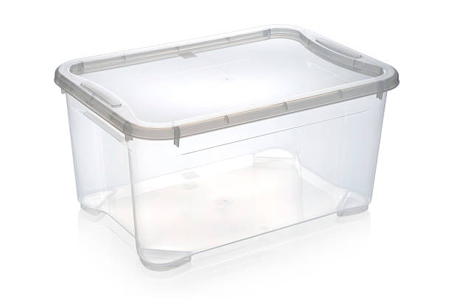
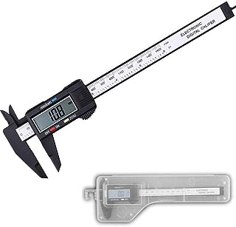
GET YOUR RESOURCES READY…. BUILD A CLASS BOX. REMEMBER ACCURACY IS VITAL FOR RECORDING RESULTS IN THIS TASK
Notes:
That class box. Collect a range of resources, build a class box. Remember that accuracy is vital in this task for recording results. As soon as you have decided on the task, you can start collecting equipment you need. Measuring cups or jugs, electronic weighing scales, viscosity charts. Use a plastic box and start your journey before your learners.

Slide 8
TEACH YOUR STUDENTS HOW TO RECORD RESULTS
What can you use?.....
Star diagrams
Munsell charts
Photographic evidence
Viscosity charts
Tasting and testing
Hedonic scale
Using sensory/organoleptic vocabulary
Charts and graphs
Descriptions of activities and outcomes
Notes:
You need to teach your students how to record results whilst delivering your content. Not all of these methods are needed for every task of course. But you will need to teach these things to your students so that they can choose the best method of showing their results depending on the experiment, the variable the adaptations and so on. They will have a repertoire of methods they can choose from.

Slide 9
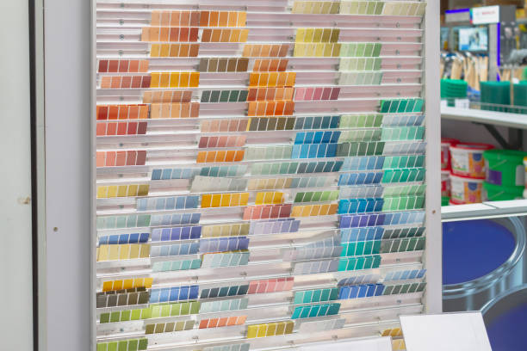
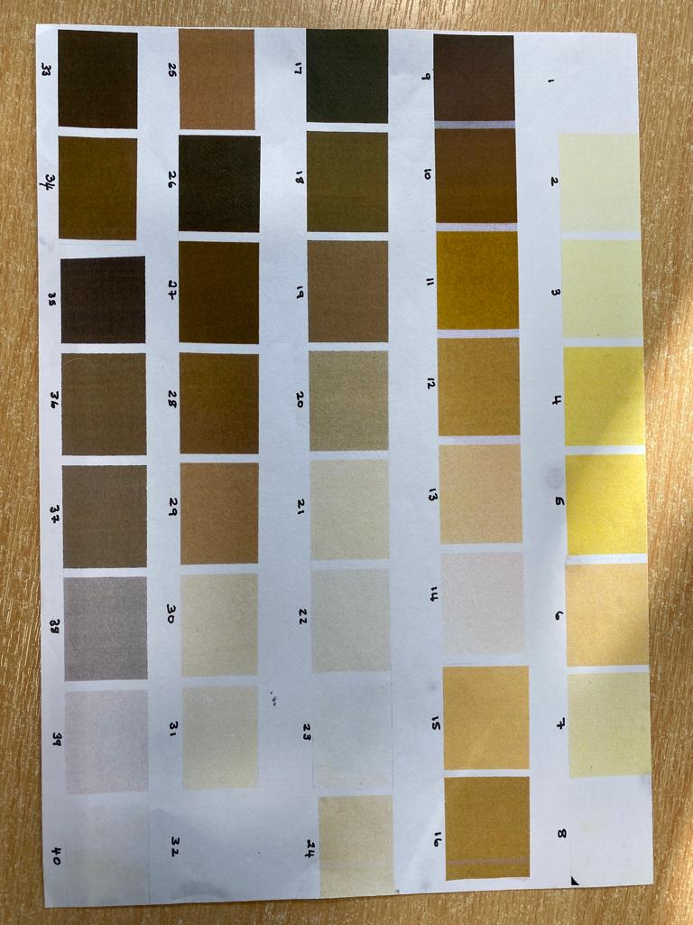
MUNSELL CHARTS… GO TO YOUR LOCAL DIY STORE
Notes:
Munsell charts are a really really good tool for showing results. But, they are also extremely expensive. What about going to your local DIY store and getting some paint cards and making your own charts. Choose the colour palette you think is best suited. Start with the control colour and work your scale out from these. These are really useful with investigations that involve colour ar a variable. For example bread, pastry, choux, biscuits. Use your own Munsell chart instead.

Slide 10
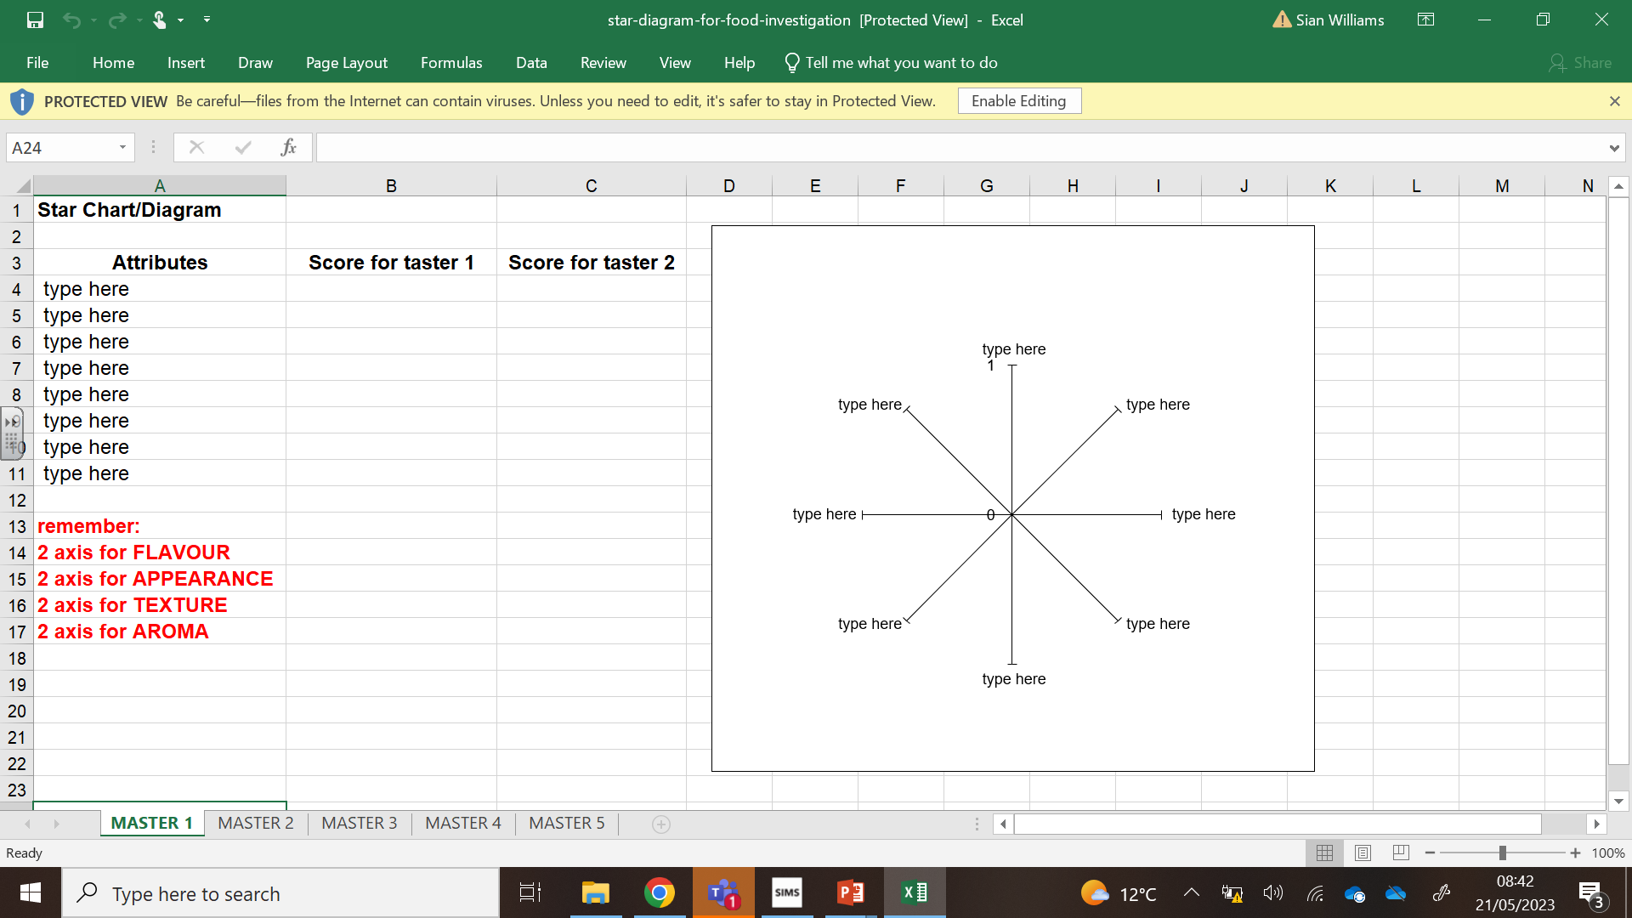
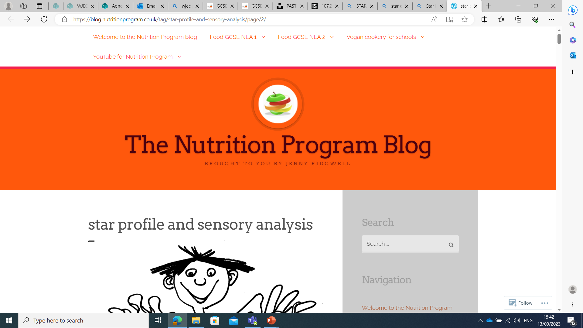
STAR DIAGRAMS – A FABULOUS WAY OF SHOWING RESULTS
Free online resources
Food a fact of life
WJEC website
https://blog.nutritionprogram.co.uk
star-chart-ws-1114c2.docx (live.com)
star-diagram-for-food-investigation.xls (live.com)
Paid for resources
Notes:
Star diagrams are an excellent way to illustrate results. Not all the experiments the students choose will need one, but when you do use one they show results clearly. The WJEC website has a simple excel example. There are paid for resources available, and free resources like Food a fact of life.

Slide 11
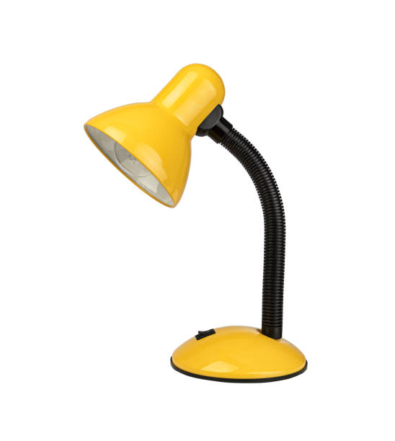
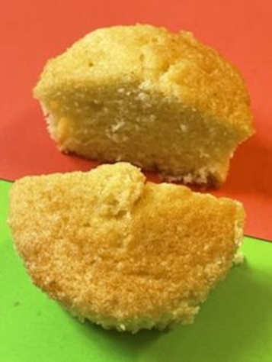
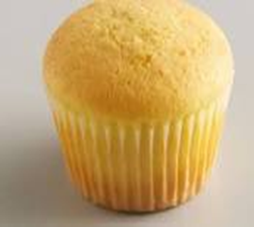
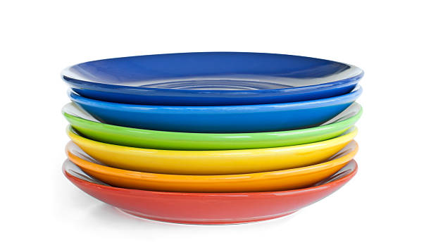
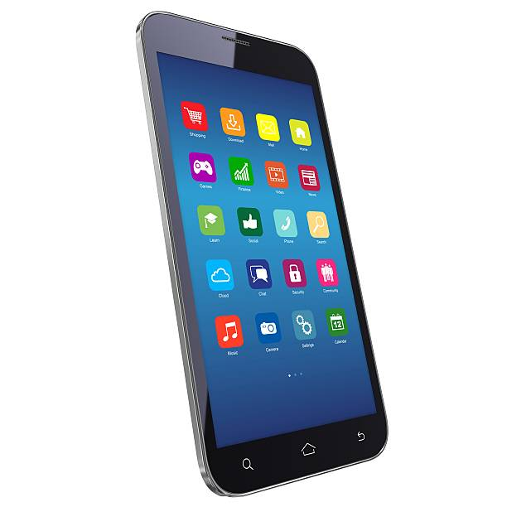
DO A LESSON IN FOOD PHOTOGRAPHY
GET A CHEAP DESK LAMP
CLASS SET OF CUP CAKES
DIFFERENT COLOURED PAPER/PLATES
TRY DIFFERENT ANGLES
FLASH/NO FLASH
SCHOOL POLICY ON MOBILE PHONES?
SETTING OUT YOUR PHOTOGRAPHIC EVIDENCE
Using a CHART is an effective way of putting photos on the work, especially if there is no wrap text function.
Notes:
Conduct a lesson in food photography, selfies all day every day. Food photography – not so much. Start with a batch of cup cakes, a desk lamp, different coloured plates and paper. Let them play, take loads of photos to see which ones look the best. School policy on mobile phones obviously comes into this. But if you can use phones – great, as they will need plenty of good photographic evidence in their results. Get them to set the photos out. A chart works well, or wrap text, depending on the softwear you have in school. How would you label the photos? Handy hint. Encourage your learners to download any photos at home onto their school one drive. This saves so much time, as they can then just move these across to their secure NEA during their timed lessons.

Slide 12
SPECIALIST ORGANOLEPTIC VOCABULARY
Make a display board
Stick a copy in their class books
Start evaluating their practical dishes from the beginning of the course - use the organoleptic vocabulary.
https://www.foodafactoflife.org.uk
Notes:
Ensure the students are familiar with using organoleptic or sensory vocabulary. They will need this when doing their tasting and testing. Remember “nice” is not a sensory descriptor. This is important for Unit 3 and there are plenty of free resources, this example if from Food a fact of life website. You can do a fabulous display for your classroom wall, or make a sheet to put in their classbooks to complete every time they cook.

Slide 13
VISCOSITY CHARTS
wjec.co.uk/umbraco/surface/blobstorage/download?nodeId=5384
viscosity-ws-1114fcc.docx (live.com)
There is an example on the WJEC and Food a fact of life website. Photocopy and laminate a class set.
Notes:
Viscosity charts are invaluable if the task is related to consistency/thickness of ice cream or a sauce. Good examples on the WJEC and Food a fact of life website. The links are on the slide. This can also be used if a task needs a student to roll out something to a particular size, for example pastry, and they did not intend on weighing it. This could be used a template for size.

Slide 14
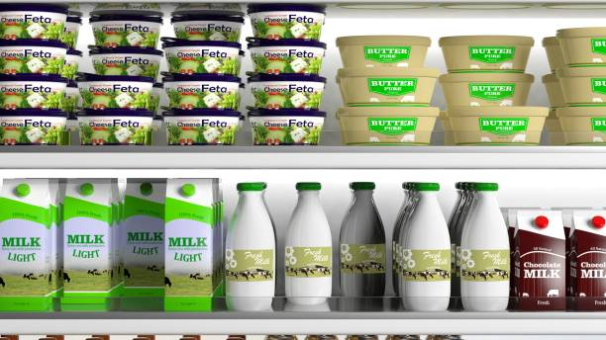
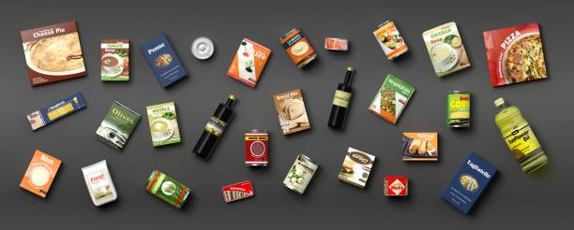
KEEP PACKAGING
A photograph works just as well. The ingredient list, nutritional analysis. Sometimes this is the information the students need and not the contents. This works well with unusual ingredients and the expensive ones!!
Notes:
Keep all the packaging. Sometimes the students need the information on the label more than the contents. Especially if they are doing a nutritional analysis. Some food products/ingredients are really expensive. A photo may be enough.

Slide 15
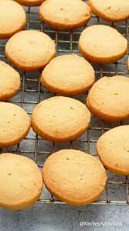
CUT DOWN THE RECIPE – CUT YOUR COSTS
This task can be expensive.
Cut down on the basic recipe if possible. For example – the bread task - Try halving the recipe. Find an amount that will still produce two/three good products for each experiment. Get the students to try this for their control and then adapt accordingly – depending on their experiments and hypothesis.
Notes:
Investigations can be expensive, so ensure learners have been introduced to scaling down recipes. Try halving a recipe, especially with bread , biscuits or pastry. You don’t need 6 rolls when 1 will do. Remember, teachers can also make the control to save time and cost. It will also be accurate. Students can then compare their variables to this accurate control.

Slide 16
ACCURACY MATTERS
Notes:
These are scientific experiments so accuracy matters. Weigh as much as you can with the digital scale, even when it comes to liquids. This way you know that you will achieve accurate results for the comparisons. Cocktail sticks are really good when it comes to measuring the depth

Slide 17
GOOD LUCK
If you have queries regarding this resource or require any information about the qualification. Please contact the team.
CONTACTS:
Contact our specialist Subject Officer and administrative support team with any queries.
Allison Candy - Subject Officer
food@wjec.co.uk
Gemma Edwards - Subject Support Officer
food@wjec.co.uk
Sian Williams – Subject Advisor
Food@eduqas.co.uk
E assessment
e-assessment@wjec.co.uk
Notes:
Work smarter not harder, I hope this helps. Contact details on slide.

