Slide 1
WJEC Level 3 Food Science and Nutrition WORK SMARTER NOT HARDER – UNIT 1 INTERNAL – THE PRACTICAL Pre-recorded Professional Learning: January 2024
Notes:
Welcome to this Pre-recorded Professional Learning resource for teachers of WJEC Level 3 Food Science and Nutrition. The aim of this resource is to help you prepare yourself and your students to complete Unit 1 internal – The practical – We will consider how to upskill the recipes chosen by the students for this assessment to achieve the best marks possible.
I am Sian Williams, subject adviser for this qualification. My role is to offer support for your Professional learning and assist you in delivering the best outcomes for your learners.

Slide 2
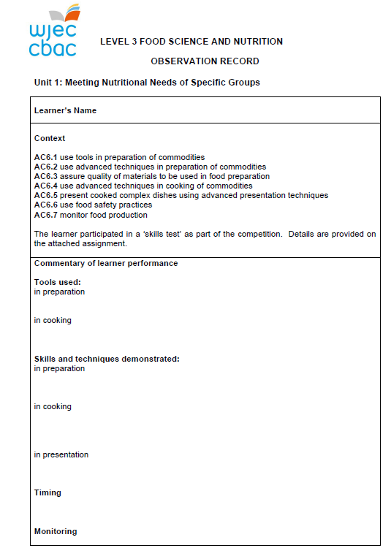
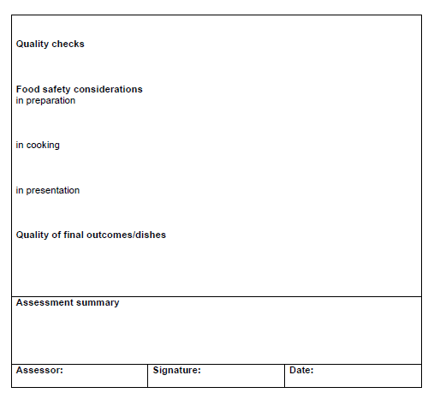
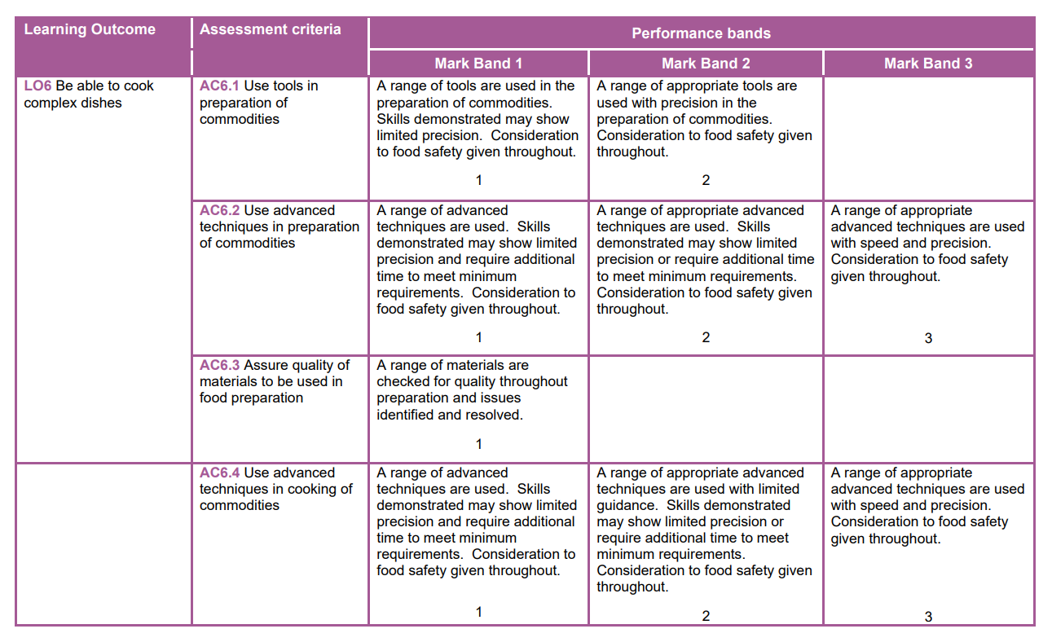
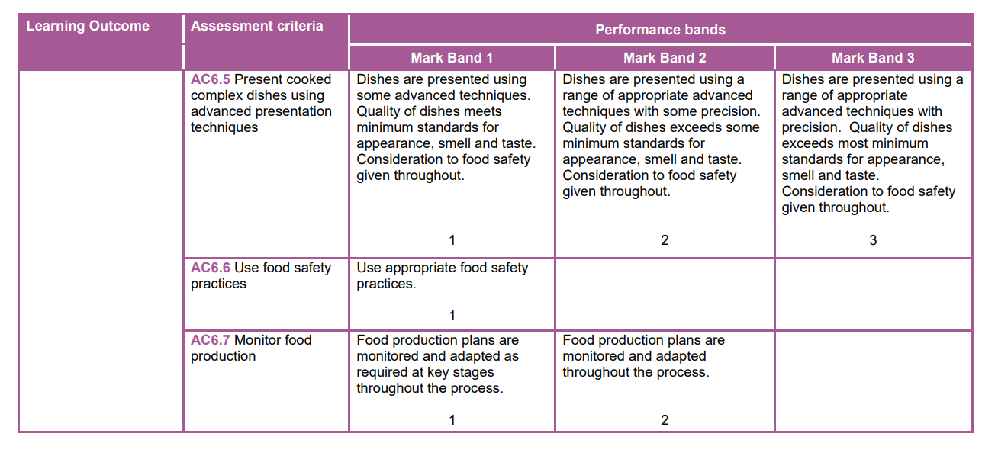
Unit 1 PRACTICAL ELEMENT
7 Assessment Criteria
Teacher completes observation record
Notes:
This section is worth 15 marks to the candidate across 7 Assessment Criteria. It must be remembered that just completing the skill or technique well is not sufficient to award top band marks. The candidates need high skilled dishes as well.
It has to be a three-course meal, with accompaniments. There is no recommendation on portion size but cooking for two covers enables recipes to be scaled down, reducing cost. Many centres and candidates like to present a three-course meal and a fully laid table. There are NO restrictions or rules in the Specification noting how the candidate presents the dishes.

Slide 3
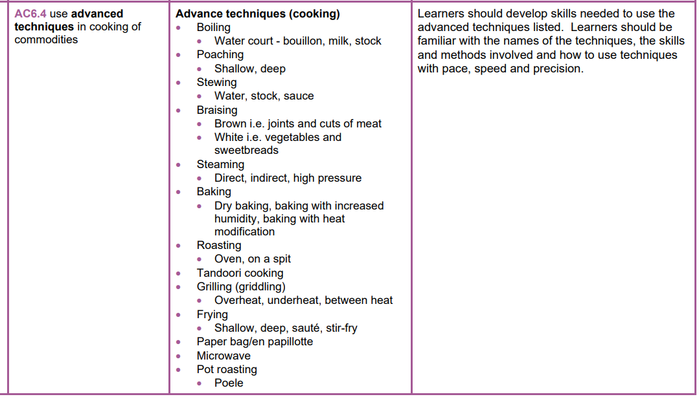
Skills & Techniques – page 20-22 Specification
Recipes in Textbook
Notes:
You and your learners need to be familiar with advanced level skills and techniques. These of course build on the skills that learners have developed during their GCSE or Level 1/2 course. Talk about all skills and Techniques with every practical lesson you do. It will be easy for your candidates to use this when they come to justifying their choices. You can even do a simple chart to go with every recipe that notes the skills and techniques, perhaps whilst evaluating the dish they have just made. There is also a section on skills, techniques and recipes in the textbook.

Slide 4
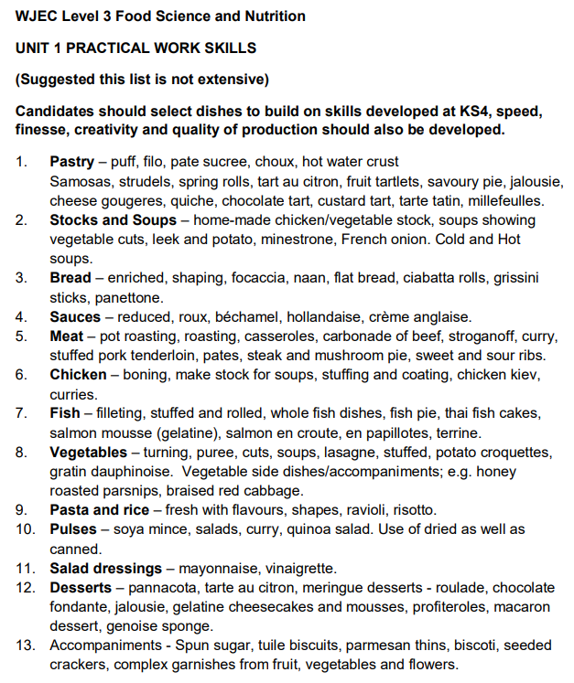
List of high skilled dishes – open website
Notes:
Whilst not a complete list, they outline examples of dishes which include the type advanced skills required for Level 3

Slide 5
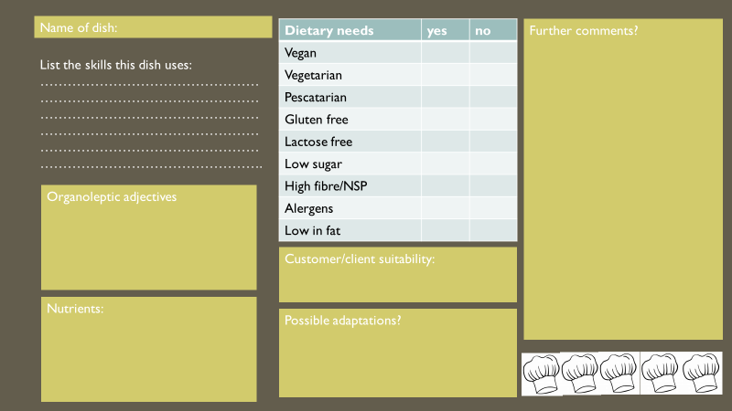
Build up a portfolio of recipes with evaluations
Create a simple checklist/evaluation sheet.
A photograph of each dish is also a good idea.
Notes:
A portfolio of recipes and dishes is such a simple but effective and invaluable tool. This could be started in GCSE or Level 1/2 . When it then comes to the practical, the students will have a bank of tried and tested recipes that they see at a glace how suitable they are.

Slide 6
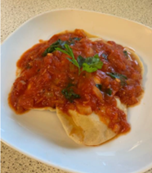
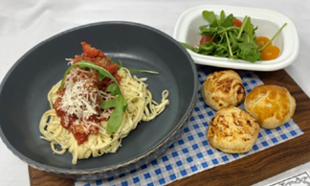
Upskilling recipes - pasta dishes
Make the pasta – use a food processor and pasta machine for rolling
Shaping and filling home made pasta
Sauce making/blending/knife skills
Bread making
Salad garnish
Make the dressing/mayonnaise
Notes:
In order for it to be considered advanced level, candidates should be encouraged to make their own pasta, this can be done using a food processor then rolled using a pasta maker. The sauce is another way of incorporating skills e.g. roux or tomato based, use of ready made sauces should be discouraged at this level. Think about adding a bread as an accompaniment to the menu, especially an enriched dough, shaped. Think accompaniments. “What would I get on my plate if I chose this in a restaurant?” It’s all about “beefing” up the number of skills in each complete dish. Look at this slide. The candidate could have chosen Spaghetti Bolognaise. But instead think Ravioli or tortellini with a meat or seafood filling, a tomato sauce – there could be portioning, filleting and deboning here , focaccia and a salad with dressing . These include more appropriate level skills.

Slide 7
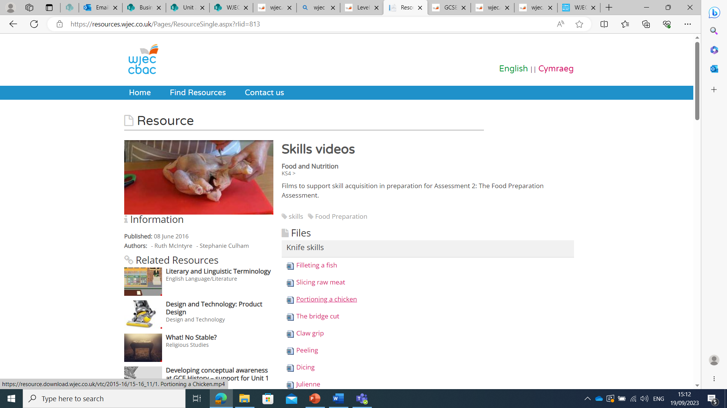
Upskilling recipes – using chicken
Resource WJEC Educational Resources Website
WJEC Website
Skills Videos
Katsu Chicken curry
Chicken Korma
Chicken kebab
Notes:
Chicken is the meat of choice for many candidates. During the delivery of the specification learners need to have been introduced to portioning a whole chicken and to have had the opportunity to develop skills. There is an excellent skills section on the WJEC website with videos to help.

Slide 8
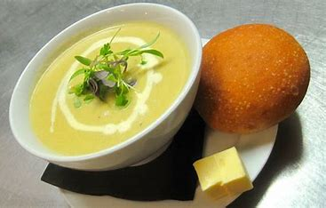
Accompaniments – what about Bread?
The candidates have 3½ hours to complete the task, more than enough time to make a bread dish as an accompaniment.
Homemade buns for burgers
Cheesy garlic bread for any Italian dish
Making flat breads
Soup will always need a bread roll
Notes:
Three and a half hours is more than enough time to make bread, get it proved and shaped and baked. Cut down recipes that use 400g of flour, make half batches. It will be dovetailed into their time plan, adds skills and techniques, and is an accompaniment for so many dishes. A simple burger is upskilled as soon as a brioche bun is made! Have you ever seen an Italian dish without cheesy garlic bread? Indian food – make flat bread, and when do you see soup without bread?

Slide 9
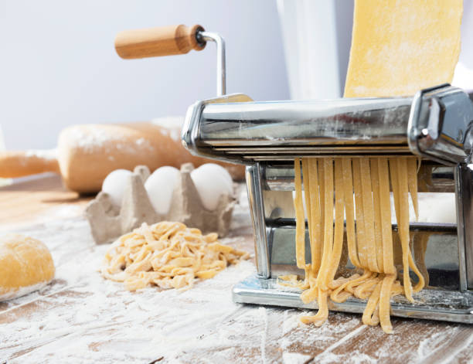
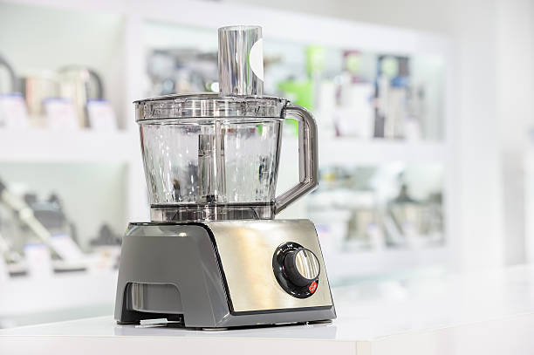
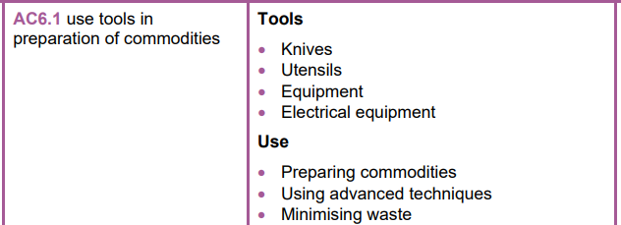
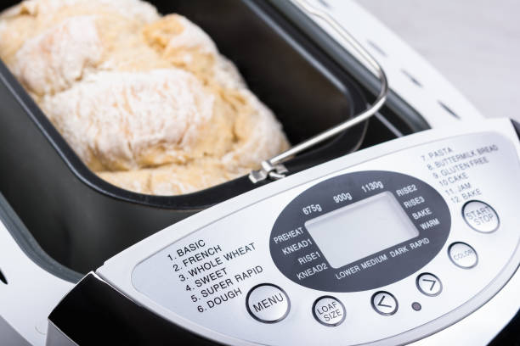
Use of equipment
Ask your staff in your school for “cast offs”.
You will be inundated with unwanted gifts of pasta machines and ice cream makers!
Using labour saving equipment should not be avoided:
Make short crust pastry/pasta/biscuit dough in a food processor
Whisk eggs into choux pastry with a hand mixer
Use a pasta machine for rolling & cutting pasta dough
Use a large stand mixer to knead dough
Blend soups with a hand blended or food processor
Pressure cookers for making stews
Bread makers
Notes:
Equipment is expensive, so beg and borrow. The first place to start is your staff room, send out an email, put a message on your bulletin board. Within days you will be overrun with pasta and ice cream machines. Think of all those lean green grilling machines hiding in people’s cupboards. Staff are desperate to off load unwanted gifts. Before long you wont need dishes, linen or serving dishes. It will all be coming the way of your department! Staff will be thanking you. Use a food processor to make pastry, pasta or biscuit dough. Whisk eggs into a choux dough with a hand mixer and not a wooden spoon. Use a pasta machine. Those huge stand mixers can knead dough and how many people don’t use their bread makers? Pressure cookers are great for making stews.

Slide 10
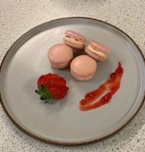
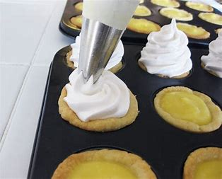
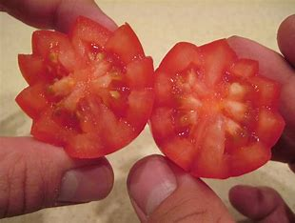
Add extra skills when presenting finished dishes
Simple sauces and coulis for garnish with a simple strawberry fan
Piping cream.
Chocolate work
Sugar work
Baking blind
Vegetable garnishes
Notes:
A candidate may choose to make a cheesecake – with gelatine of course! But why not add a fruit coulis and some chocolate work – it’s immediately upskilled. Pipe cream on desserts. Pipe a meringue. Bake blind

Slide 11
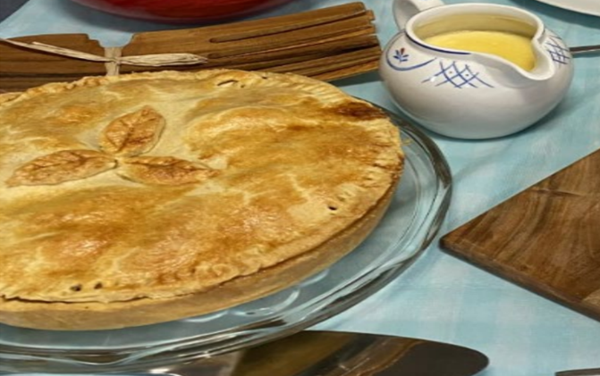
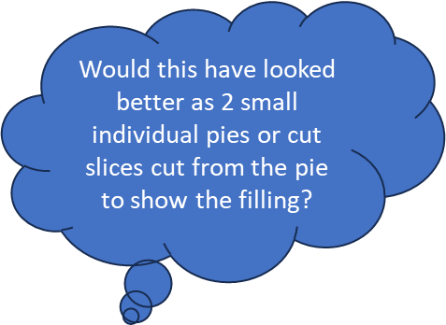
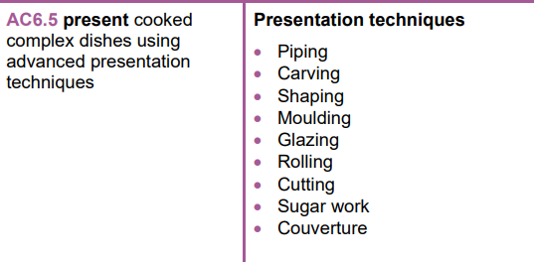
Think garnishes and accompaniments…
Curry and rice not sufficient. Samosas and flat bread added, with 3 homemade chutneys
Coulis
Fruit or vegetables
Herbs
Chocolate work
Sugar work
Notes:
Presentation is important. The only thing your moderator will see is the photos you send along with the mark record sheets. So make sure that the dishes or plates look their best. Build up a stock of table cloths, serving dishes and place settings to support candidates in the presentation of their finished dishes. Not all candidates will have serving dishes or even a table cloth in some cases. So what can school do to help? Just look at these pictures. Your candidate wants to do curry and rice, so what about adding samosas and a flat bread with some home made chutneys. Look at that pie, would two small pies or two cut slices not have looked better? With custard of course.

Slide 12
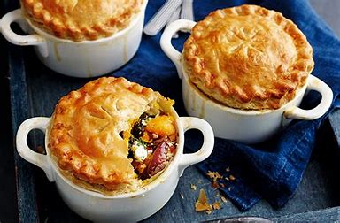
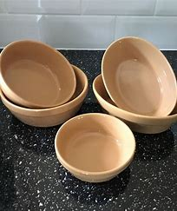
Smaller portions and individual dishes
Notes:
This Unit can be expensive, but you need your candidates to show as many skills, dishes and accompaniments as they can. So what about cutting down on recipe sizes. Avoid full “family” sized dishes. Smaller individual dishes not only look better, but cost less, take less time to prepare and can sometimes add to the skill level. So by cooking for two covers this avoids full family sized dishes saving on time and cost.

Slide 13
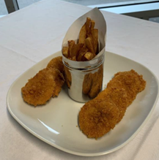
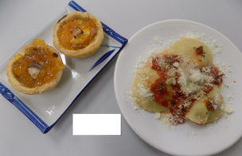
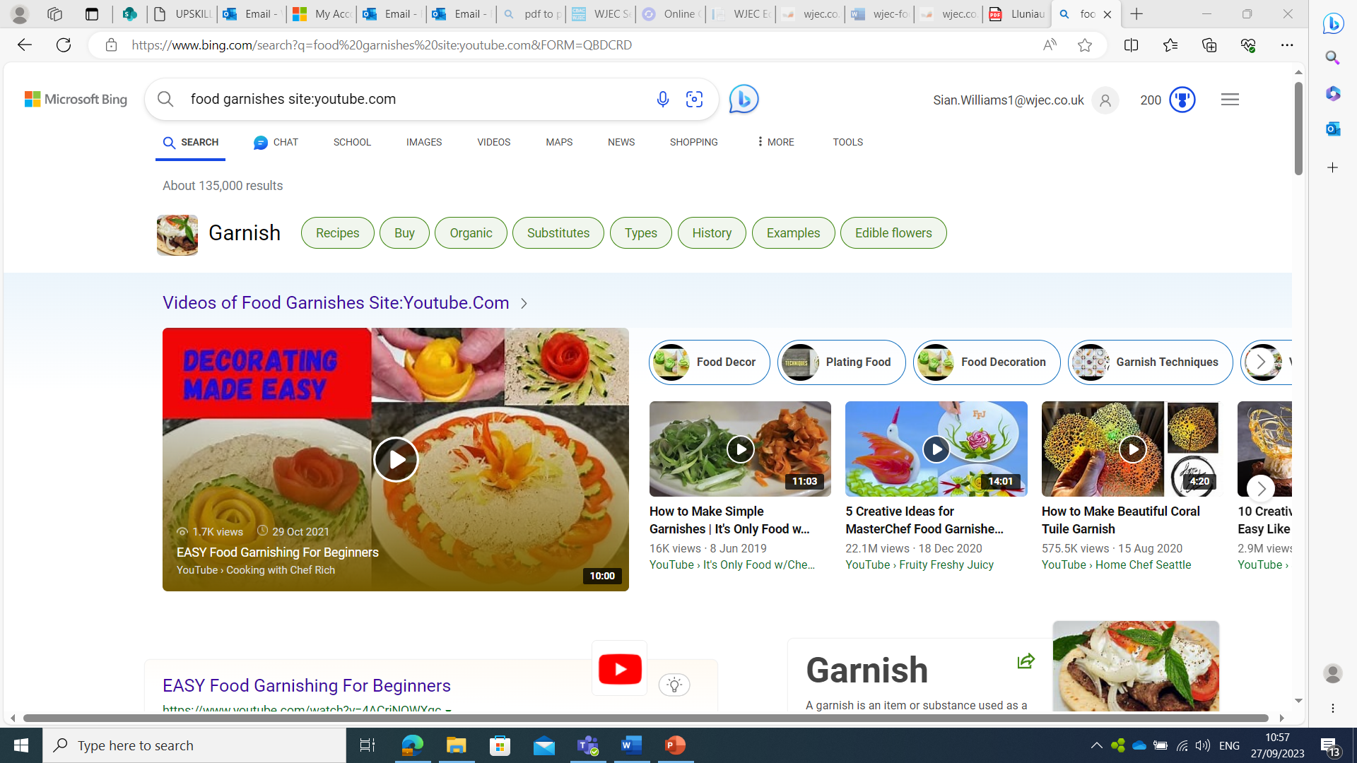
Presenting – appetizing, colour, portioning, decoration, garnishing, table laying, choice of dishes
There are many resources on the internet – start with you tube
https://youtu.be/r2tuI8uyzA8
There is a section on presenting dishes in the WJEC text book.
Notes:
Look at the internet for help. You tube is a great place to start. There is also a section in the WJEC textbook.

Slide 14
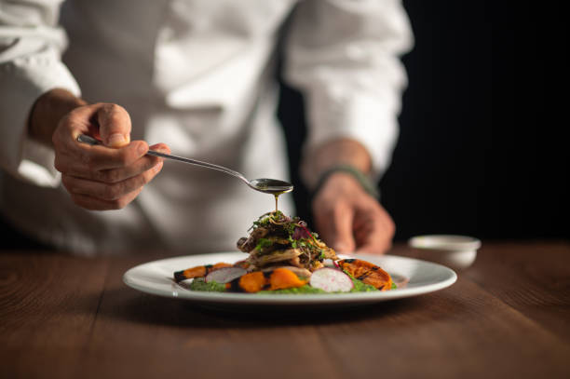
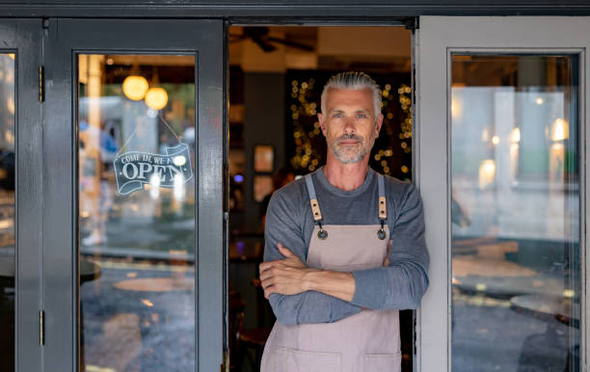
Make use of Professionals
Local college
Careers Wales
Parents
Local businesess
https://careerswales.gov.wales/
Notes:
Careers Wales for instance has a department that can find professionals to come into schools or you can take your learners out to their workplaces. Is there a local college with a catering department that you can either visit or arrange for someone to come out and do a lesson on plating and garnishing? What about parents? One might be a chef who can spare an hour to do a dem with your Year 12’s? Many learners may have a part time job in a local hospitality business, can that business help? This is also building links within your wider school community. Your SMT will love you for that!

Slide 15
Including a few photographs of each stage of their practical work.
This can be a tricky issue in schools – depending on mobile phone policy. Class teachers would not have time to go around a class taking lots of photos.
Tablets or ipads?
Technician?
Is there a photography course in school that can help out?
Notes:
This is an excellent method of showing the skills and techniques, however, not always a feasible idea as some schools don’t allow mobile phones. You could go and see your SMT to explain why they need phones to photograph food. This could be the case for Unit 1 and 3. Some schools have ipads or tablets that can be booked for lessons. A technician – if you have one is a good idea. Is there a photography course running in your centre? There are too many photographs here, but one or two of the main skills could be invaluable. A few photographs of key skills could be included to support assessor comments/ Candidate’s production plan.

Slide 16
Sometimes “less is more”
Notes:
This is a good example of careful selection. A few photos of the main skills for each dish.

Slide 17
GOOD LUCK
If you have queries regarding this resource or require any information about the qualification. Please contact the team.
CONTACTS:
Contact our specialist Subject Officer and administrative support team with any queries.
Allison Candy - Subject Officer
food@eduqas.co.uk
Gemma Edwards - Subject Support Officer
food@eduqas.co.uk
Sian Williams – Subject Advisor
Food@eduqas.co.uk
E assessment
e-assessment@eduqas.co.uk
Notes:
Work smarter not harder, I hope this helps. Contact details on slide.

