Slide 1
Celebrity tweets and how they have evolved

Slide 2
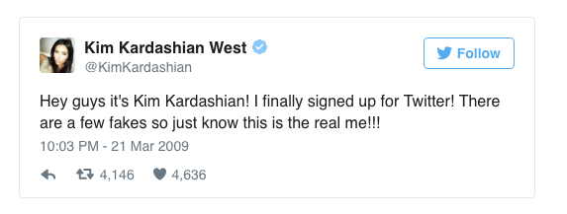
Kim kardashian
Why are they a celeb? | Reality TV
How many current followers | 49.3 million
How many tweets sent | 22.5K
Nature of first tweet | As below, saying hello to the world, stroking her ego about how many fake accounts there are for her. Though Kim did seem to grasp the basics and used informal language and a lot of punctuation!

Slide 3
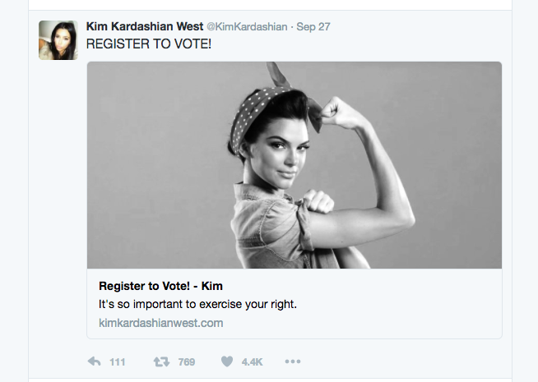
Kim KardashiAn
Now, Kardashian's tweets make headlines and we often hear that she may have
‘broken the internet’. She uses Twitter to promote products but does
also promote some positive messages to followers

Slide 4
Linguistic analysis of first tweet
Hey guys it’s Kim Kardashian!
opening vocative is informal (Hey guys)—plural to address a wide audience; creating relationship with fanbase
gender neutral noun phrase (unlike gendered collocations e.g. ‘good guys’/’bad guys’)—typical of younger language users
starts with emphatic simple sentence: present tense (immediacy of communication)—emphasis on establishing identity
standard punctuation—though no comma after vocative.

Slide 5
Linguistic analysis of first tweet
I finally signed up for Twitter!
another simple sentence (communicating straight forward message)
verb is simple past (signed up for)—perhaps would have expected present perfective (i.e. ‘have signed up for’) to indicate a past action with ongoing effect
multi-word verb (phrasal-prepositional verb)—associated with informality
word position: adverb (finally) used before verb for emphasis.

Slide 6
Linguistic analysis of first tweet
There are a few fakes so just know this is the real me!!!
reinforcing statement of identity: compound-complex sentence (are … [and] so … know [that] … is …)—conjunctions elided (restricted space—saving characters)
shared knowledge: noun phrase a few fakes i.e. fake accounts
informal imperative (just know) – adverb reduces force of imperative (informal)
emphatic self-identification: demonstrative pronoun (this) + complement noun phrase (the real me)
multiple use of exclamatories—informal tenor to engage.

Slide 7
TOM HANKS
Why are they a celeb? | Film star
How many current followers | 12.5 million
How many tweets sent | 744
Nature of first tweet | Very light hearted, also hints at being from an older generation and not used to using such social media previously.

Slide 8
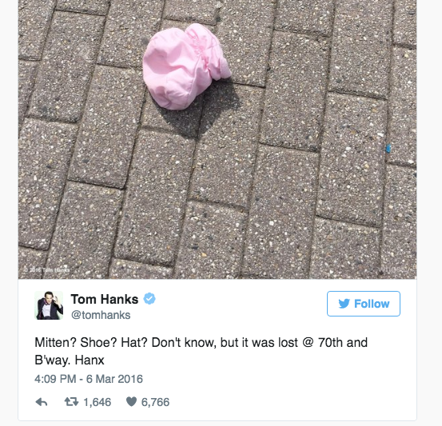
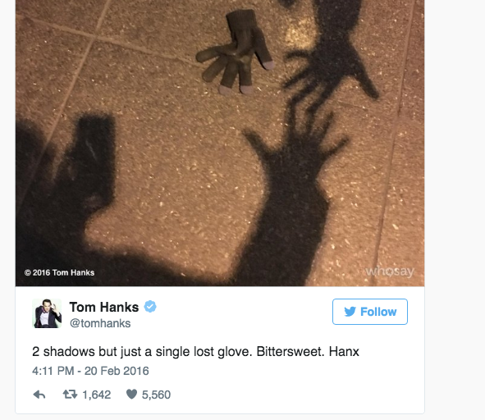
TOM HANKS
Tom has kept up this light-hearted approach to Twitter and is famous for using Twitter to report missing items he has found. There are lots of examples of this. A few are attached.

Slide 9
Linguistic analysis of first tweet
Testing … testing …. Is this thing on?
repetition of elliptical clauses—present participle implies ongoing action
shared knowledge: collocation—analogy with physical technology such as microphones (intentional humour: implied lack of understanding of online platform)
implied audience in interrogative—aims to engage
use of deixis in demonstrative determiner (this)—exophoric reference implies immediate audience (physical proximity) rather than distant Twitter audience (humour)
extended metaphor of microphone is developed in vague concrete noun (thing)—referent is purposefully unnamed (humour).

Slide 10
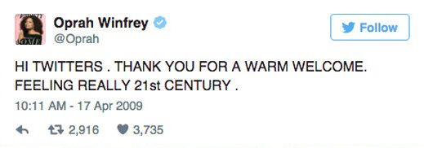
Oprah winfrey
Why are they a celeb? | Chat show host, movie star
How many current followers | 35.1 million
How many tweets sent | 11.9K
Nature of first tweet | Not sure people on Twitter are called Twitters, but Oprah is happy at how friendly everyone has been. She did get a lot of abuse for recent Donald Trump comments when he met with Obama.

Slide 11
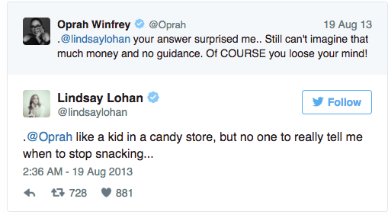
Oprah winfrey
Has used Twitter to supplement her talk show. Oprah spoke with Lindsay Lohan about her stint in rehab and subsequent recovery during the show, but a live conversation also took place on Twitter, where Winfrey and Lohan continued their chat and discussed the interview as it aired.

Slide 12
Linguistic analysis of first tweet
HI TWITTERS. THANK YOU FOR A WARM WELCOME.
informal vocative to engage audience (plural)
term of address (plural noun Twitters) suggests lack of familiarity with genre (neologism)—Twitter users are ‘tweeters’
politeness marker thank you (interjection)—creates positive relationship
reinforced by prepositional phrase for a warm welcome (collocation)
grammatical fragment (minor sentence)—typical of elliptical style associated with genre.

Slide 13
Linguistic analysis of first tweet
FEELING REALLY 21st CENTURY.
style is elliptical—omission of subject and auxiliary verb in simple sentence (saving characters; conversational)
use of present progressive to mark ongoing state of mind ([am] feeling)
subject complement (noun phrase) referencing time—ordinal modifier using symbol rather than word to save characters (excitement at engaging with contemporary form of communication)
adverb (really) for emphasis.

Slide 14
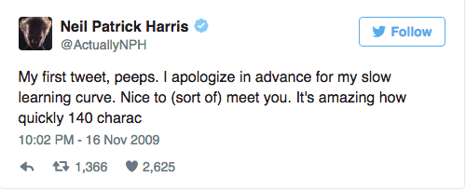
Neil patrick harris
Why are they a celeb? | Played Dougie Howser in the late 80s. Now coming back into films again and hosted the Oscars in 2015.
How many current followers | 25.8 Million
How many tweets sent | 2,598
Nature of first tweet | Even if you’re too young to remember him, it had to be included as it was the most humorous I could find.

Slide 15
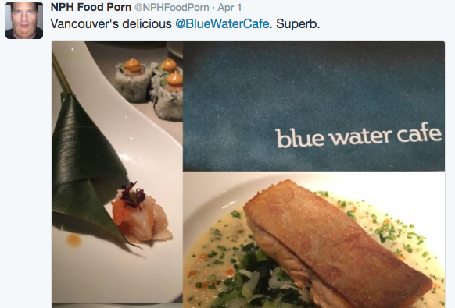
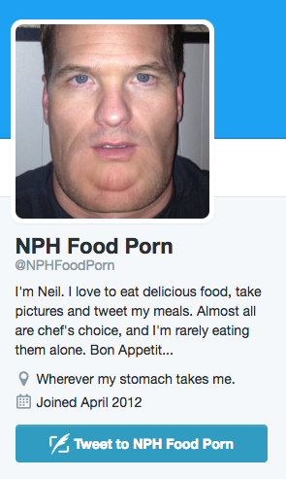
Neil patrick harris
Obsessed with sending pictures of food over Twitter, he set up a separate Twitter account dedicated just to food pictures called - @NPHFoodPorn, asking people to – “Follow if you like deliciousness”

Slide 16
Linguistic analysis of first tweet
My first tweet, peeps. I apologize in advance for my slow learning curve.
grammatical fragment: noun phrase + vocative
informal term of address: peeps (plural)—casual relationship
straightforward message (simple sentence)—engaging audience through apology (negative politeness—face-saving)
prepositional phrase (adverbial) immediately follows verb—places emphasis on timing of apology (in advance)
self-critical: my slow learning curve (noun phrase)—new to genre
standard punctuation.

Slide 17
Linguistic analysis of first tweet
Nice to (sort of) meet you. It’s amazing how quickly 140 charac
structure is elliptical (saving characters)—omission of dummy subject (‘It’) + predicator (‘is’)
cleft sentence throws emphasis onto adjective phrase (nice)
parenthesis of idiomatic adverb (sort of) dividing infinitive is humorous—making a joke about the lack of real, personal engagement on Twitter (i.e. conversation that is not face-to-face)
cleft sentence throws emphasis onto adjective phrase (amazing) and delays subject (incomplete noun clause)—intentional humour (incomplete noun demonstrates restrictions of the genre).

Slide 18
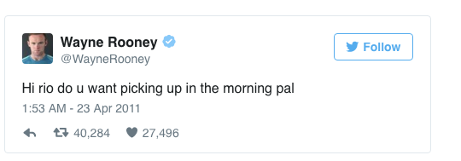
WAYNE ROONEY
Why are they a celeb? | Footballer, all round superstar
How many current followers | 14.1 million
How many tweets sent | 2,060
Nature of first tweet | This is really Wayne’s first tweet. May have been easier just to have texted Rio? Not sure Wayne totally understands the platform at this point.

Slide 19
WAYNE ROONEY
Real mixed bag of Twitter usage. He once tried, and failed, to kick-off his own film review page with one brief tweet, threatened to beat himself up and hasn’t quite got the hang of hashtags

Slide 20
Linguistic analysis of first tweet
Hi rio do u want picking up in the morning pal
personal vocative (proper noun—specific individual)
directed interrogative: closed question so little opportunity for developed interaction (missing point of platform)
agency removed: verbal noun (picking up) instead of indirect object (‘me’) + direct object nonfinite clause (‘to pick you up’)—impersonal style
informal (singular) vocative pal (reflects personal relationship)
use of abbreviation u (second person pronoun ‘you’)--logogram
no punctuation or capitalisation (except for opening greeting Hi).

Slide 21
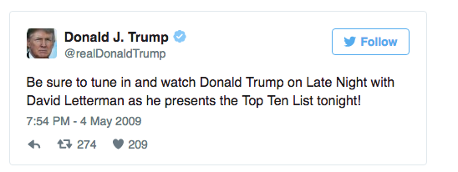
Donald trump
Why are they a celeb? | Reality TV, Business and next US President
How many current followers | 17 million
How many tweets sent | 34.1K
Nature of first tweet | Refers to himself in the third person—the ego has definitely landed!

Slide 22
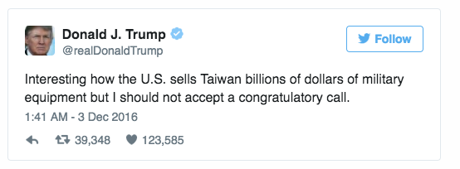
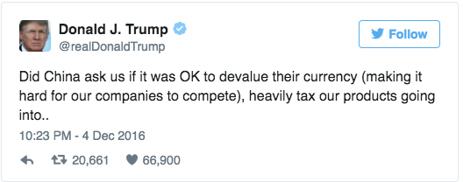
Donald trump
Nearly starting WWIII via Twitter at the moment. China lodged a complaint with the United States about what the President-elect had done when speaking to Taiwan and they found out via Twitter. Chinese authorities stated. "We urge the relevant side in the US to adhere to the 'one China' policy, abide by the pledges in the three joint China-US communiqués, and handle issues related to Taiwan carefully and properly to avoid causing unnecessary interference to the overall China-U.S. relationship."

Slide 23
Linguistic analysis of first tweet
Be sure to tune in and watch DT on LN with DL as he presents the Top Ten List tonight!
more like traditional written language: compound-complex sentence (Be sure to tune in and watch … as … presents …)—marketing function (publicity)—little sense of multi-modal
assertive imperative (Be sure to …)—little attempt to engage
shared knowledge: proper nouns—celebrity names (Donald Trump/David Letterman); popular television show (Late Night); regular feature in show (Top Ten List)
adverbial of time (tonight): promotional—communicating time-sensitive information.

Slide 24
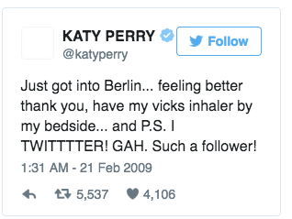
Katy perry
Why are they a celeb? | Popstar
How many current followers | 94.6 Million
How many tweets sent | 7,562
Nature of first tweet | Shares her love for Twitter and an update to fans on her health.

Slide 25
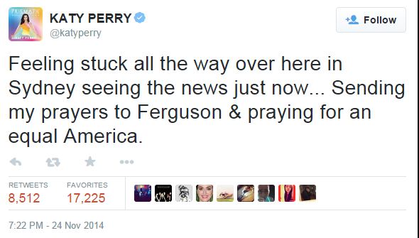
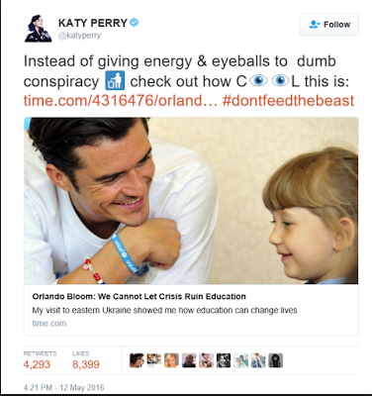
Katy perry
The singer has become the most followed Twitter user in history, reaching 94.6 million followers. The singer also regularly donates a portion of her ticket sales to The Red Cross, The Humane Society, and The Children’s Health Fund and uses her following to promote good causes to followers.

Slide 26
Linguistic analysis of first tweet
Just got into Britain … feeling better thank you,
elliptical simple sentence—brings adverb into initial position (creates sense of immediacy)
informal high frequency verb (got)—here, got into = ‘arrived’
elided subject and auxiliary verb (present progressive, [I] [am] feeling …)
verb functions as copular with comparative adjective (better)
politeness marker thank you (interjection) to engage with readers
capitalisation of proper noun, but comma splice.

Slide 27
Linguistic analysis of first tweet
have my vicks inhaler by my bedside …
elided subject
no use of capitalisation for branded product (shared knowledge)—inconsistent (place name capitalised)
intimate detail: prepositional phrase by my bedside (creating relationship)
use of ellipses—reflects multi-modal genre (loose sentence structure is conversational)
inconsistent use of conventional sentence punctuation.

Slide 28
Linguistic analysis of first tweet
and P.S. I TWITTTTER! GAH. Such a follower!
ellipsis followed by coordinating conjunction (as conversational afterthought)—topic shift: excitement about joining Twitter
use of capitalisation for effect + exclamatory (emphasise mood)
playing with orthography (creative)
language change: interjection GAH traditionally expressed annoyance, but now also denotes excitement; noun follower (subject specific meaning re. Twitter)
determiner Such used to express strong feelings (used as an intensifier).

Slide 29
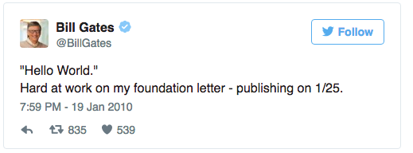
Bill gates
Why are they a celeb? | Technology, one of the richest men in the world
How many current followers | 32.3 Million
How many tweets sent | 2,213
Nature of first tweet | Plans to give away the majority of his fortune to charitable causes and his first tweet promoted his foundation.

Slide 30
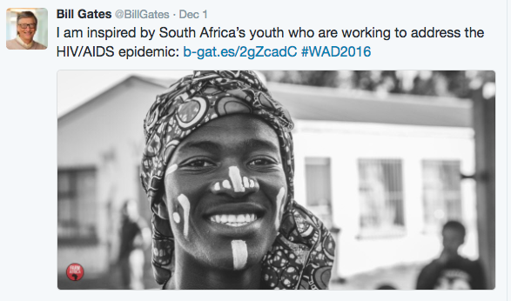
Bill gates
Bill Gates used Twitter to launch his charitable website. Bill Gates’ Twitter account is updated almost daily. Not only does he pop on Twitter for a browse and a tweet, he puts a lot of thought into his responses, and uses hashtags like a social media strategist. Uses photos and videos to help portray key messages.

Slide 31
Linguistic analysis of first tweet
“Hello World.” Hard at work on my foundation letter
broad opening greeting—vocative consciously addresses international audience (indicative of BG’s intentions—publicising his charity)
quotation marks perhaps suggest artificiality of social media interactions
more formal interjection Hello (rather than ‘Hi’ or ‘Hey’)
elliptical—brings adverb hard to initial position
detail provided by prepositional phrases (postmodifying hard)
shared knowledge (presupposition): my foundation letter (noun phrase with possessive determiner)—no other first person references

Slide 32
Linguistic analysis of first tweet
– publishing on 1/25.
loosely structured sentences (grammatical fragments)—shows some understanding of multimodal genre (dash is conversational)
elliptical: subject and auxiliary verb elided (could be future reference with modal e.g. ‘will be publishing’)—intention
American formatting of date (cardinal numbers with month first, followed by day).

Slide 33
THE queen
Why are they a celeb? | She is the Queen!
How many current followers | 2.65 million
How many tweets sent | 24.3K Not sure she has personally sent all of these.
Nature of first tweet | Caused some controversy. Her Majesty Elizabeth II took to Twitter to post on the @BritishMonarchy account saying: "It is a pleasure to open the Information Age exhibition today at the @ScienceMuseum and I hope people will enjoy visiting. Elizabeth R.“ The tweet was shown on BBC News when reporting the Queen's introduction to social media, unfortunately so were some of the comments as you can see on the next slide.

Slide 34
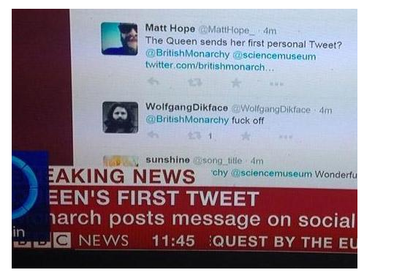
THE queen
The tweet, which was retweeted 36,000 times and favourited 37,000 times, was responded to by a curt "f*** off" from a user named @WolfgangDikface, which the broadcaster showed live on BBC News.

Slide 35
Linguistic analysis of first tweet
It is a pleasure to open the IA exhibition today at the @Science Museum
formal, written style with no spoken features—compound-complex sentence (is … to open … and … hope [that] … will enjoy …)
cleft sentence: noun phrase complement brought to the front of the clause (It is a pleasure to …, collocation)
capitalised proper nouns to promote venue (Science Museum) and event (Information Age)
adverbial today: promotes event and Queen’s attendance (time-sensitive)
use of @ symbol for Twitter ID

Slide 36
Linguistic analysis of first tweet
and I hope people will enjoy visiting. Elizabeth R.
use of first person pronoun (but tweet is not personal—no attempt to engage audience)
impersonal reference to potential visitors: people (plural noun)—subject of noun clause [that] people …
modal will implies a wish for the future
the only example with a formal closing token (subscription)—more like written language (letter); suggests lack of familiarity with genre.

Slide 37
PIERS MORGAN
Why are they a celeb? | Journalist, presenter, all round annoying commentator on life
How many current followers | 5.3 million and very proud of this
How many tweets sent | 93.9K (Easily the most in our list)
Nature of first tweet | Told us what we all knew already.

Slide 38
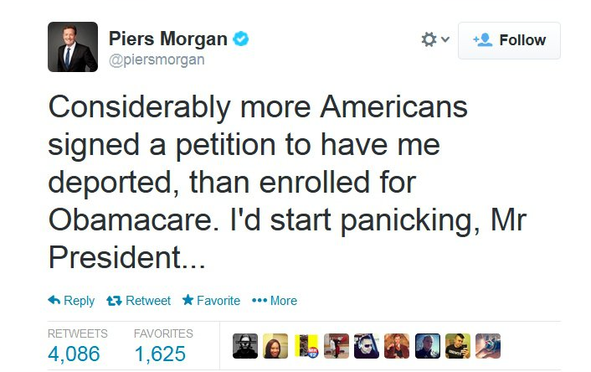
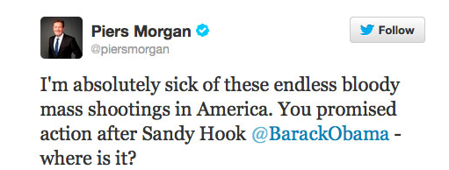
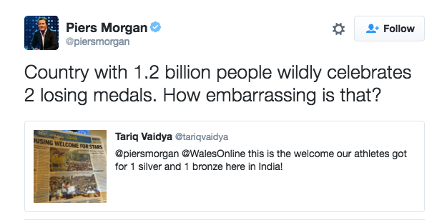
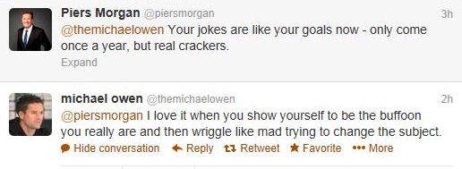
PIERS MORGAN
Such an extensive user of Twitter that it’s difficult to put into words on 1 slide….

Slide 39
Linguistic analysis of first tweet
BREAKING NEWS: I’m now a Twit. Official.
journalistic collocation (noun phrase): functions as headline (no recognition of audience)—suggests PM joining Twitter is big news!
simple sentence—straightforward statement of fact (humour)
connotations of noun Twit: foolish or annoying person (can be used affectionately, humorously)—addition of capital to link to Twitter
position of adverbial places emphasis on time (currency of message)
grammatical fragment: adjective (emphatic position)—humour i.e. has put on record that he now tweets AND accepts public perception
intended in-joke backfires: unintentional humour (noun is ‘tweeter’)—suggests lack of familiarity with genre.

Slide 40
Some key points/observations about tweets
Many tweets show a naivety or a lack of experience as regards social media. It is important to understand the difference between a reply and a direct message - Rooney's mistake!
Some tweets allude to the brevity and restrictions of the medium.
Some tweets can also be unclear or even incoherent as they are replies to previous tweets. There is often a need to understand what content has preceded the tweet.
Tweets are elliptical in structure, often employ high frequency and monosyllabic/disyllabic lexis.

Slide 41
CONTINUED…
Political and powerful figures may have somebody to manage their Twitter feed. Apparently not Trump.
Use of hashtag indicates subject/theme. The @ symbol indicates a person who you can follow.
Recent innovation is Tweet Edit so you can amend without deleting. This acknowledges the need for some accuracy and perhaps self-censorship especially if you have a global audience.
Fake/spoof accounts have become more prevalent as the medium has matured. @Pippatips
#PippaTip: Encourage children to enjoy the outdoors by taking them outside.
#PippaTip: Recover from tiredness by resting.

Slide 42
CONTINUED
Individuals leaving Twitter or following/unfollowing somebody can now be news in itself. See Stephen Fry after BAFTAS. Calvin Harris after Hiddleswift went public.
Can provide a running commentary on an event like the Oscars or may show public opinion/reaction to Brexit, for example.
Many are humorous/light-hearted in nature but others are ranting about various issues.
Increasingly celebrity tweets are tools for self-promotion/marketing. Rio Ferdinand and Rosso.
Number of followers is visible and shows relative popularity of the individual. Alternatively, they might be followed as they are a controversial figure.
People you could follow: Trump, Piers Morgan, James Blunt, Frankie Boyle, Kanye West, Justin Bieber.

Slide 43
COMPONENT 2 – SECTION b EXAM QUESTION
Using your knowledge of twenty-first century English, analyse and evaluate the
ways in which contextual factors affect how writers use language in tweets.
[40] 45 minutes
In your response, you must refer to the set of data (Texts 1 - 8), but, in addition, you
may wish to draw on your own examples. You must also:
. consider relevant contextual factors and language features associated with
the construction of meaning
. apply appropriate methods of language analysis, using associated
terminology and coherent expression
. demonstrate understanding of relevant language concepts and issues.

Slide 44
Sentence starters:
The data shows…
Text 1 includes…
In terms of context, in Text 1 we can see that…
The lexis OR grammar is interesting because…
In my own examples/research of this genre, I have found/identified x 2
Text 1 and 2 seem to share similar contextual influences because…
Text 3 is the most different and distinctive because…

